Slide 1
IAWN Update

Slide 2
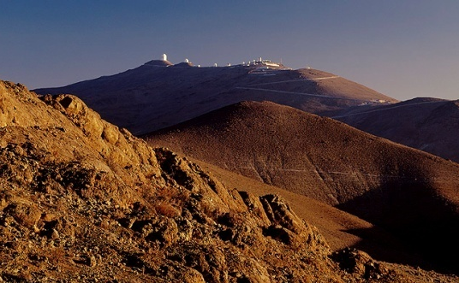
European Southern Observatory
Intergovernmental organization for astronomy
Founded in 1962 by five countries with the goal to build a large telescope in the southern hemisphere
15 (+1) Member States (Ireland to join in 2018)
Mission
Develop and operate world-class observatories for astronomical research
Foster cooperation in astronomy
All ESO Observatories are in Chile
Headquarters in Garching near Munich

Slide 3
Telescope Time
Framework: ESO / ESA Cooperation agreement
Follow-up for faint (23 < mag < 27) objects under ESA’s Space Situational Awareness NEO programme
Director-General’s Discretionary Time (DDT)
4 years programme for VLT approved (24hrs/year)
Target of Opportunity (TOO) in principle, but most via regular Service Mode
Flexible use of quality seeing conditions, based on object
Astrometric follow-up for newly discovered objects
TOO with follow-up in days
Orbit follow-up of faint, threatening NEOs
Window of observability known (roughly) in advance
Service mode scheduling
Notes:
FORS2 = 6.8’ fov, astrometric precision of 0.1”
This program has been operating since P93. As of July 2017, 80 observations have been performed over 61 objects. Of these, 21 have been denitely removed from the "risk list", 20 more have had their risk downgraded. Interestingly, in 6 cases, the improved orbit resulted in an increase of their risk. Finally, 8 observation failed: the object could not be seen in the data. The median magnitude of the targets was 25. We secured consecutive "records" detection of the faintest NEO ever observed.

Slide 4
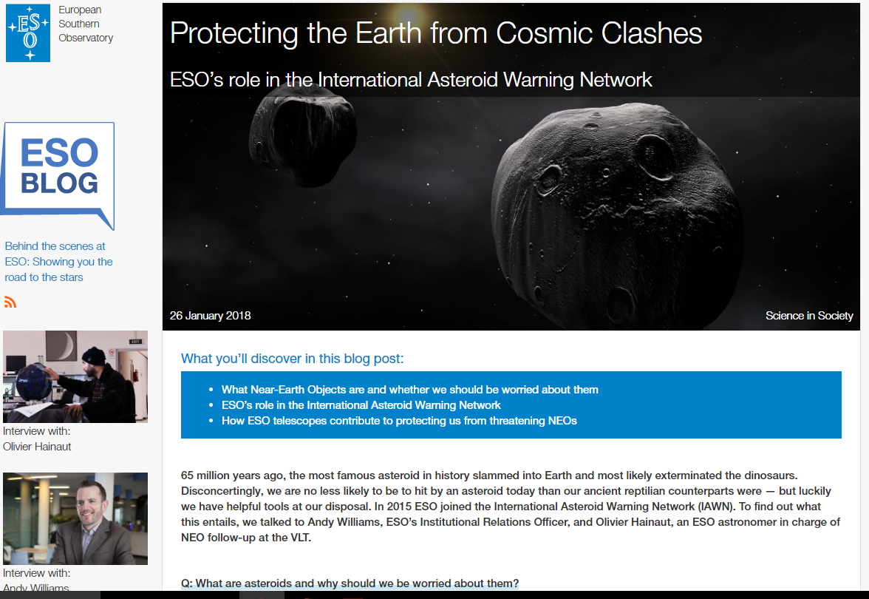
http://eso.org/public/blog/

Slide 5
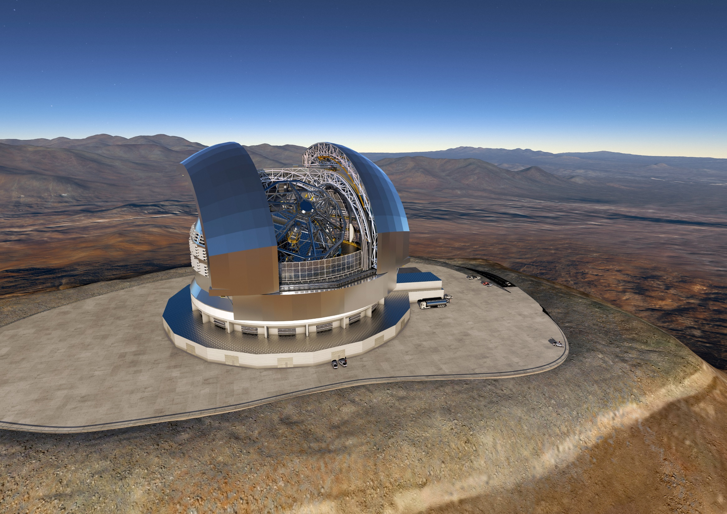
The future – The Extremely Large Telescope
Andy Williams; awilliam@eso.org
Executive Office of the Director General
@Andy4Science
reachandywilliams

