Slide 1
ATLAS Status
Asteroid Terrestrial-impact Last Alert System
Larry Denneau, University of Hawai‘i
6th IAWN Steering Group Meeting
19 Oct 2018

Slide 2
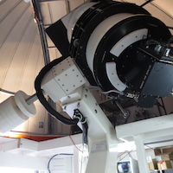
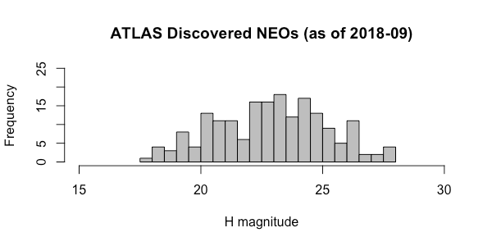
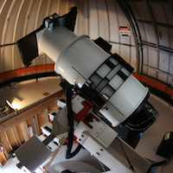
ATLAS #1 (Mauna Loa) and ATLAS #2 (Haleakalā)
Operating ~3 years now (Haleakala since 2015, Mauna Loa 2017), ops funded through 2020
200+ NEO discoveries to date
Robotic — no observer, automatic pipeline, human review of NEO candidates after MOPS processing
Observed 2018 LA prior to impact (See Davide’s talk shortly)
Haleakalā
Denneau IAWN 6, 19 Oct 2018
Mauna Loa

Slide 3
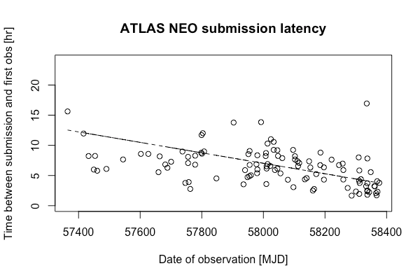
ATLAS Performance
Continuously improving, focusing on latency
Large-scale simulation to understand performance and biases; shows good performance for close approachers
Keep everything: ~1PB dataset and growing
Publications: ATLAS System and Design (Tonry 2018), ATLAS Reference Catalog (Tonry 2019)
Denneau IAWN 6, 19 Oct 2018

Slide 4
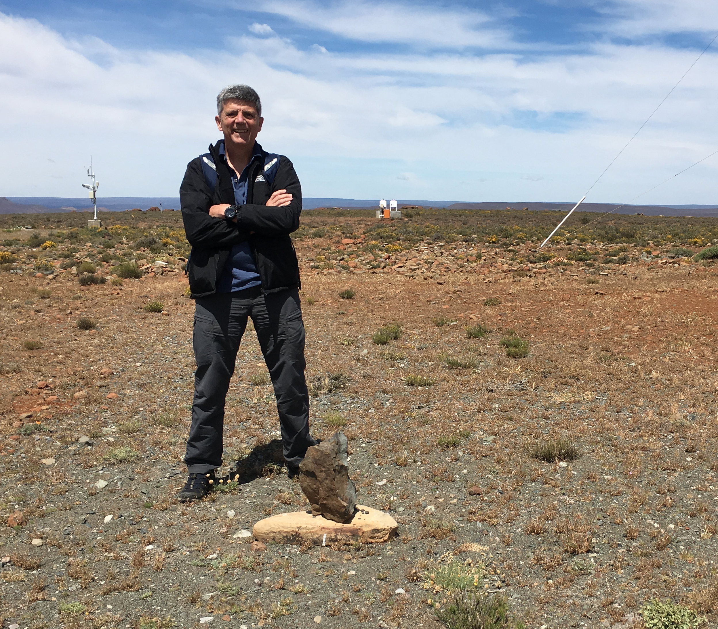
ATLAS System Expansion
South African Astronomical Observatory (Sutherland)
Just visited SAAO, very promising
ATLAS #3 online in late 2020
ATLAS-Chile (Site TBD: several options including commercial)
ATLAS #4 online mid 2021
Entire sky 4X every 24 hours!
Future site of ATLAS #3 in Sutherland
Denneau IAWN 6, 19 Oct 2018

Slide 5
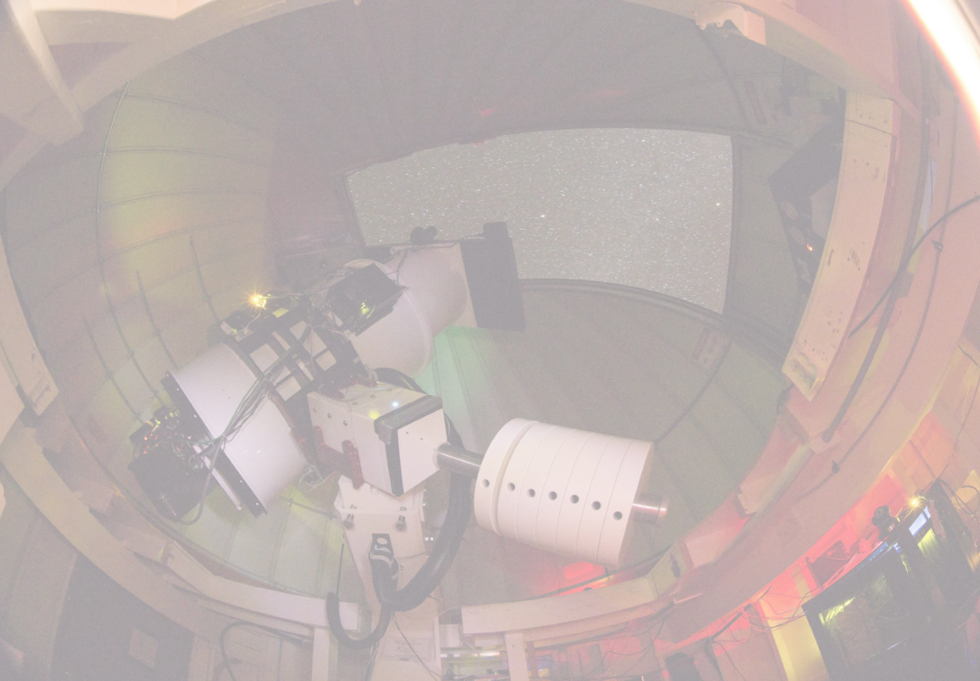
ATLAS
Is brought to you by
NASA NEOO/PDCO
NASA Grant #80NSSC18K0284
IFA MANOA
John Tonry
Larry Denneau
Andrei Sherstyuk
Ari Heinze
Heather Flewelling
Henry Weiland
Jessica Young
Karl Uyehara
Amy Miyashiro
Richard Wainscoat
IFA MAUI
Mike Maberry
Joey Perreira
Tom McCall
Garry Nitta
EXTERNAL
Alan Fitzsimmons
Armin Rest
Stephen Smartt
Ken Smith
Brian Stalder
Chris Stubbs
David Young
FRIENDS
Phil Whitney
Gareth Wynn-Williams
Chris Oliver
The STAC
IFA HILO
Klaus Hodapp
fallingstar.com

