Slide 1

6th International Asteroid Warning Network (IAWN) Meeting
NASA Update
19 October 2018
Knoxville, Tennessee USA

Slide 2
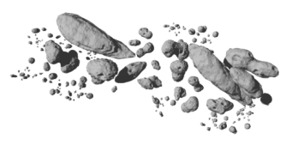
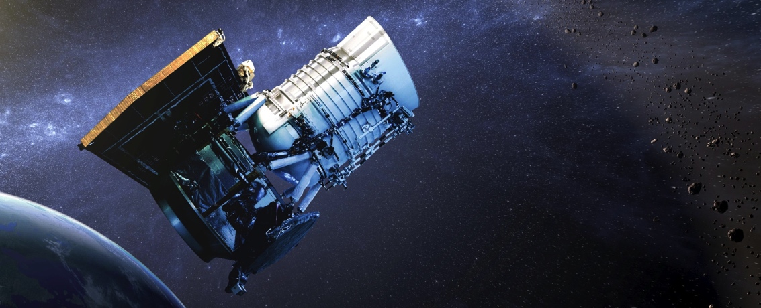
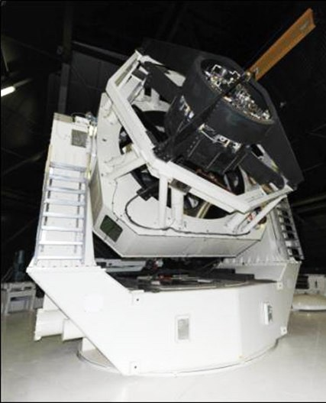
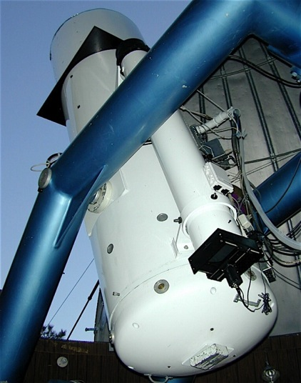
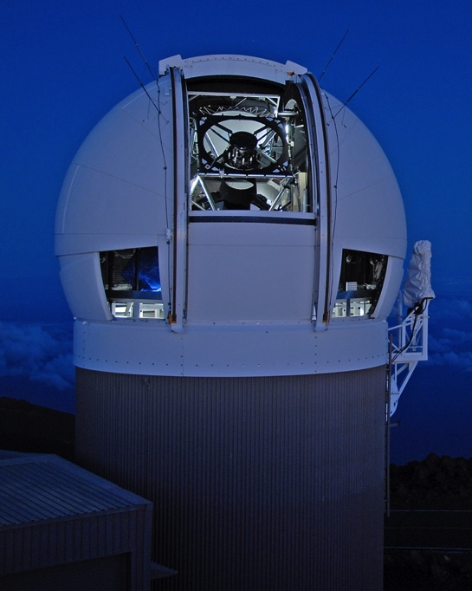
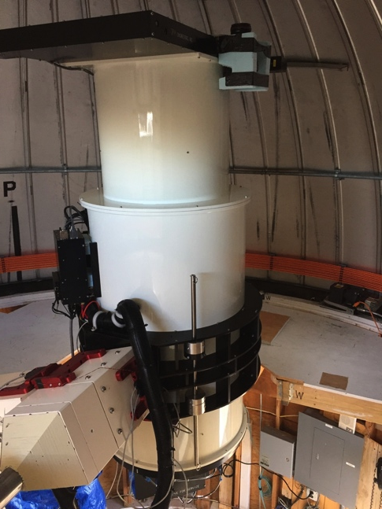
NASA’s NEO Search Program: Surveys
Current Surveys:
NEOWISE
NEOWISE
CSS
Pan-STARRS
ATLAS
LINEAR/SST (being re-assembled in Western Australia)
JPL
Sun-synch LEO
0.4 m
LINEAR/SST
Catalina Sky
Survey
Pan-STARRS
ATLAS
Two 1.8-m telescopes
Haleakalā, Maui
1.5-m
0.7-m
0.5-m Haleakalā Mauna Loa
3.5-m (to Australia)

Slide 3
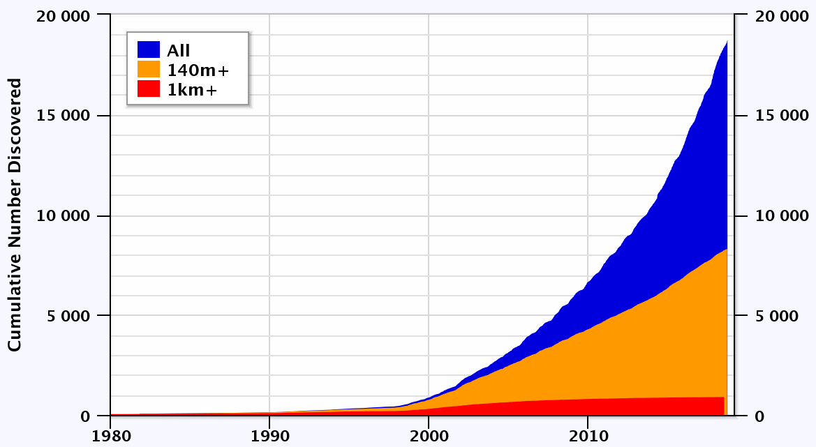
NEAs Discovered (to date)
NEA total:
18,731
PHAs:
1,929
(155 > 1 km)
NECs: 107
NEO Obs Prg
begins
(as of 22 Sep 2018)
https://cneos.jpl.nasa.gov/stats Alan Chamberlin JPL/Caltech

Slide 4
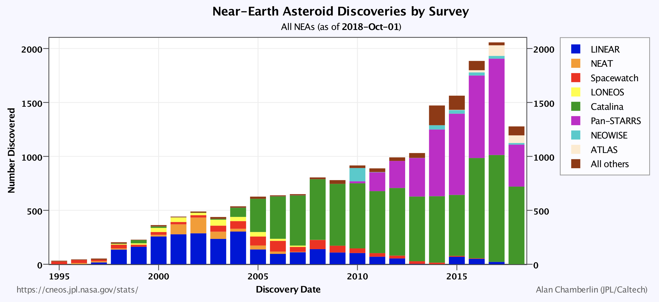
NEAs Discovered by Survey (to date)
2053 discoveries
in 2017
1278 discoveries
in 2018 (so far)

Slide 5
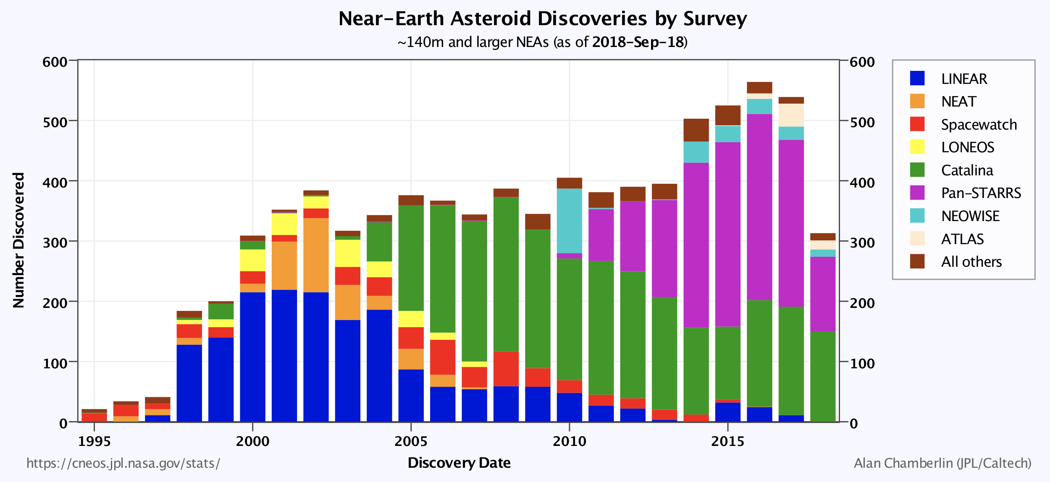
NEAs Discovered by Survey (140 m+)
539
in 2017
313

Slide 6
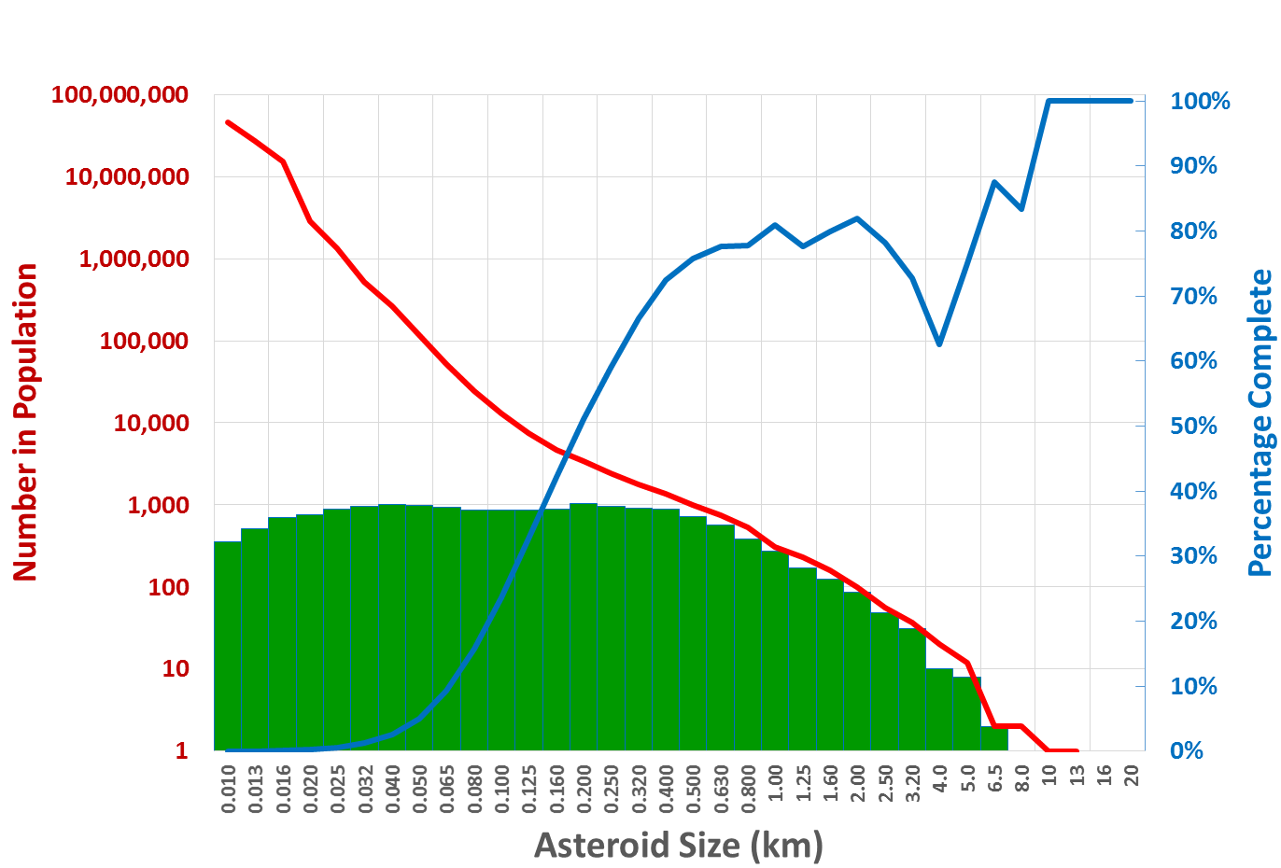
Impact
Devastation None City Region Continent Global
1908
Tunguska
2013
Chelyabinsk
George E. Brown
Survey Limit
Required to meet
current objectives
Spaceguard
Survey Limit
Number Found
KT Impact
Killed Dinosaurs
NEA Population & Survey Progress (2018)

Slide 7
NEO Population – 140 meters and larger*
*based on an estimated population of ~25,000
Note: at current discovery rate (relying on ground-based assets alone) it will > 30+ years to complete survey.

Slide 8
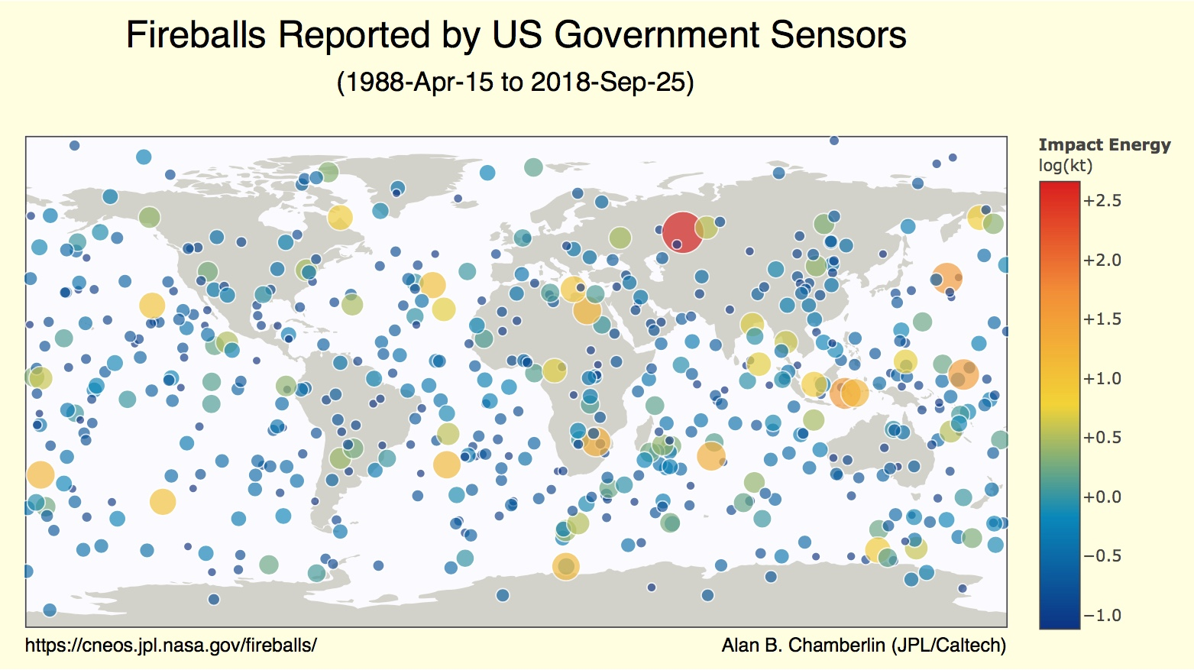
2.8 kT
38.1°E, 52.8°N
21 June 2018
01:16:20 UTC
2.1 kT
69°E, 76.9°N
25 July 2018
21:55:26 UTC
440 kT
61.1°E, 54.8°N
15 Feb 2013
03:20:33 UTC
2008 TC₃; 0.98 kT
3143°E, 20.9°N
7 Oct 2018
02:45:45 UTC
2018 LA; 0.98 kT
23.3° E, 21.2° S
2 June 2018
16:44:42 UTC

Slide 9
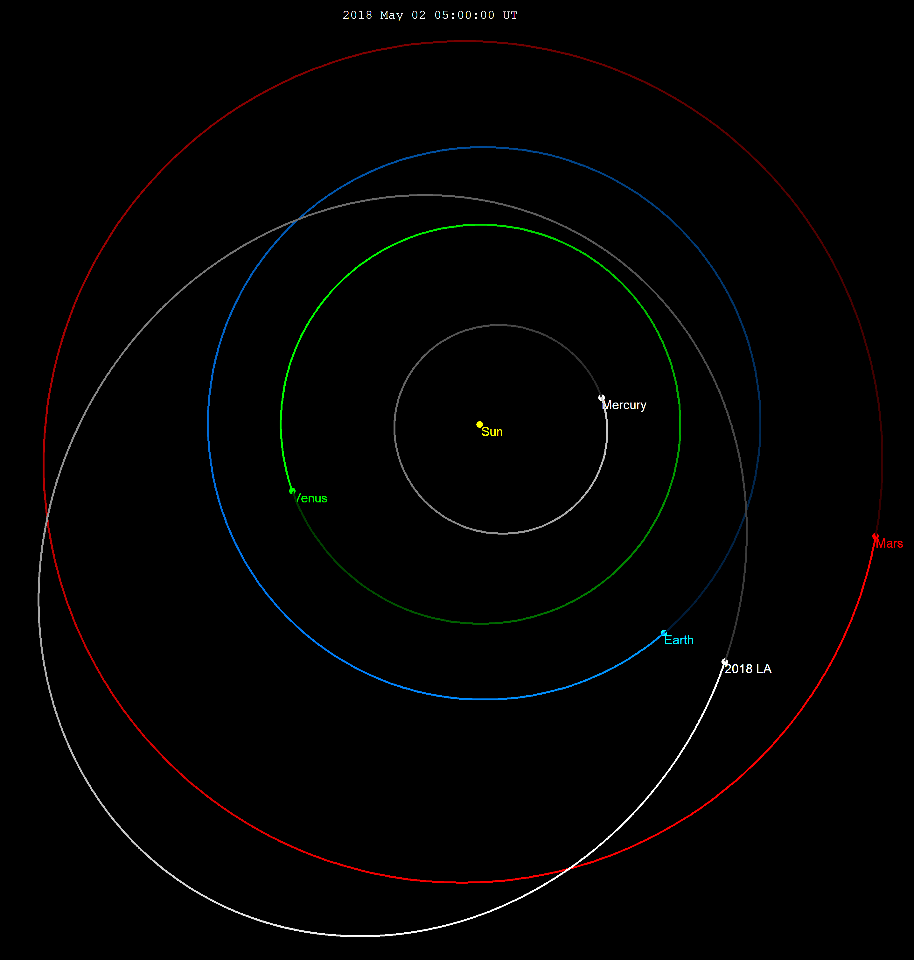
Discovery of 2018 LA & Impact
Discovered ~8 hours prior to impact over Botswana
Impact on 2 June 2018 at 16:44 UTC; bolide lasted for ~3.5 sec; magnitude –27.
3rd time NASA’s NEOO Program discovered an object & impact sol’n calculated (2008 TC3 over Sudan; 2014 AA over the mid-Atlantic).
CTBTO infrasound sensors also detected bolide.
Last orbit the Sun of 2018 LA

Slide 10
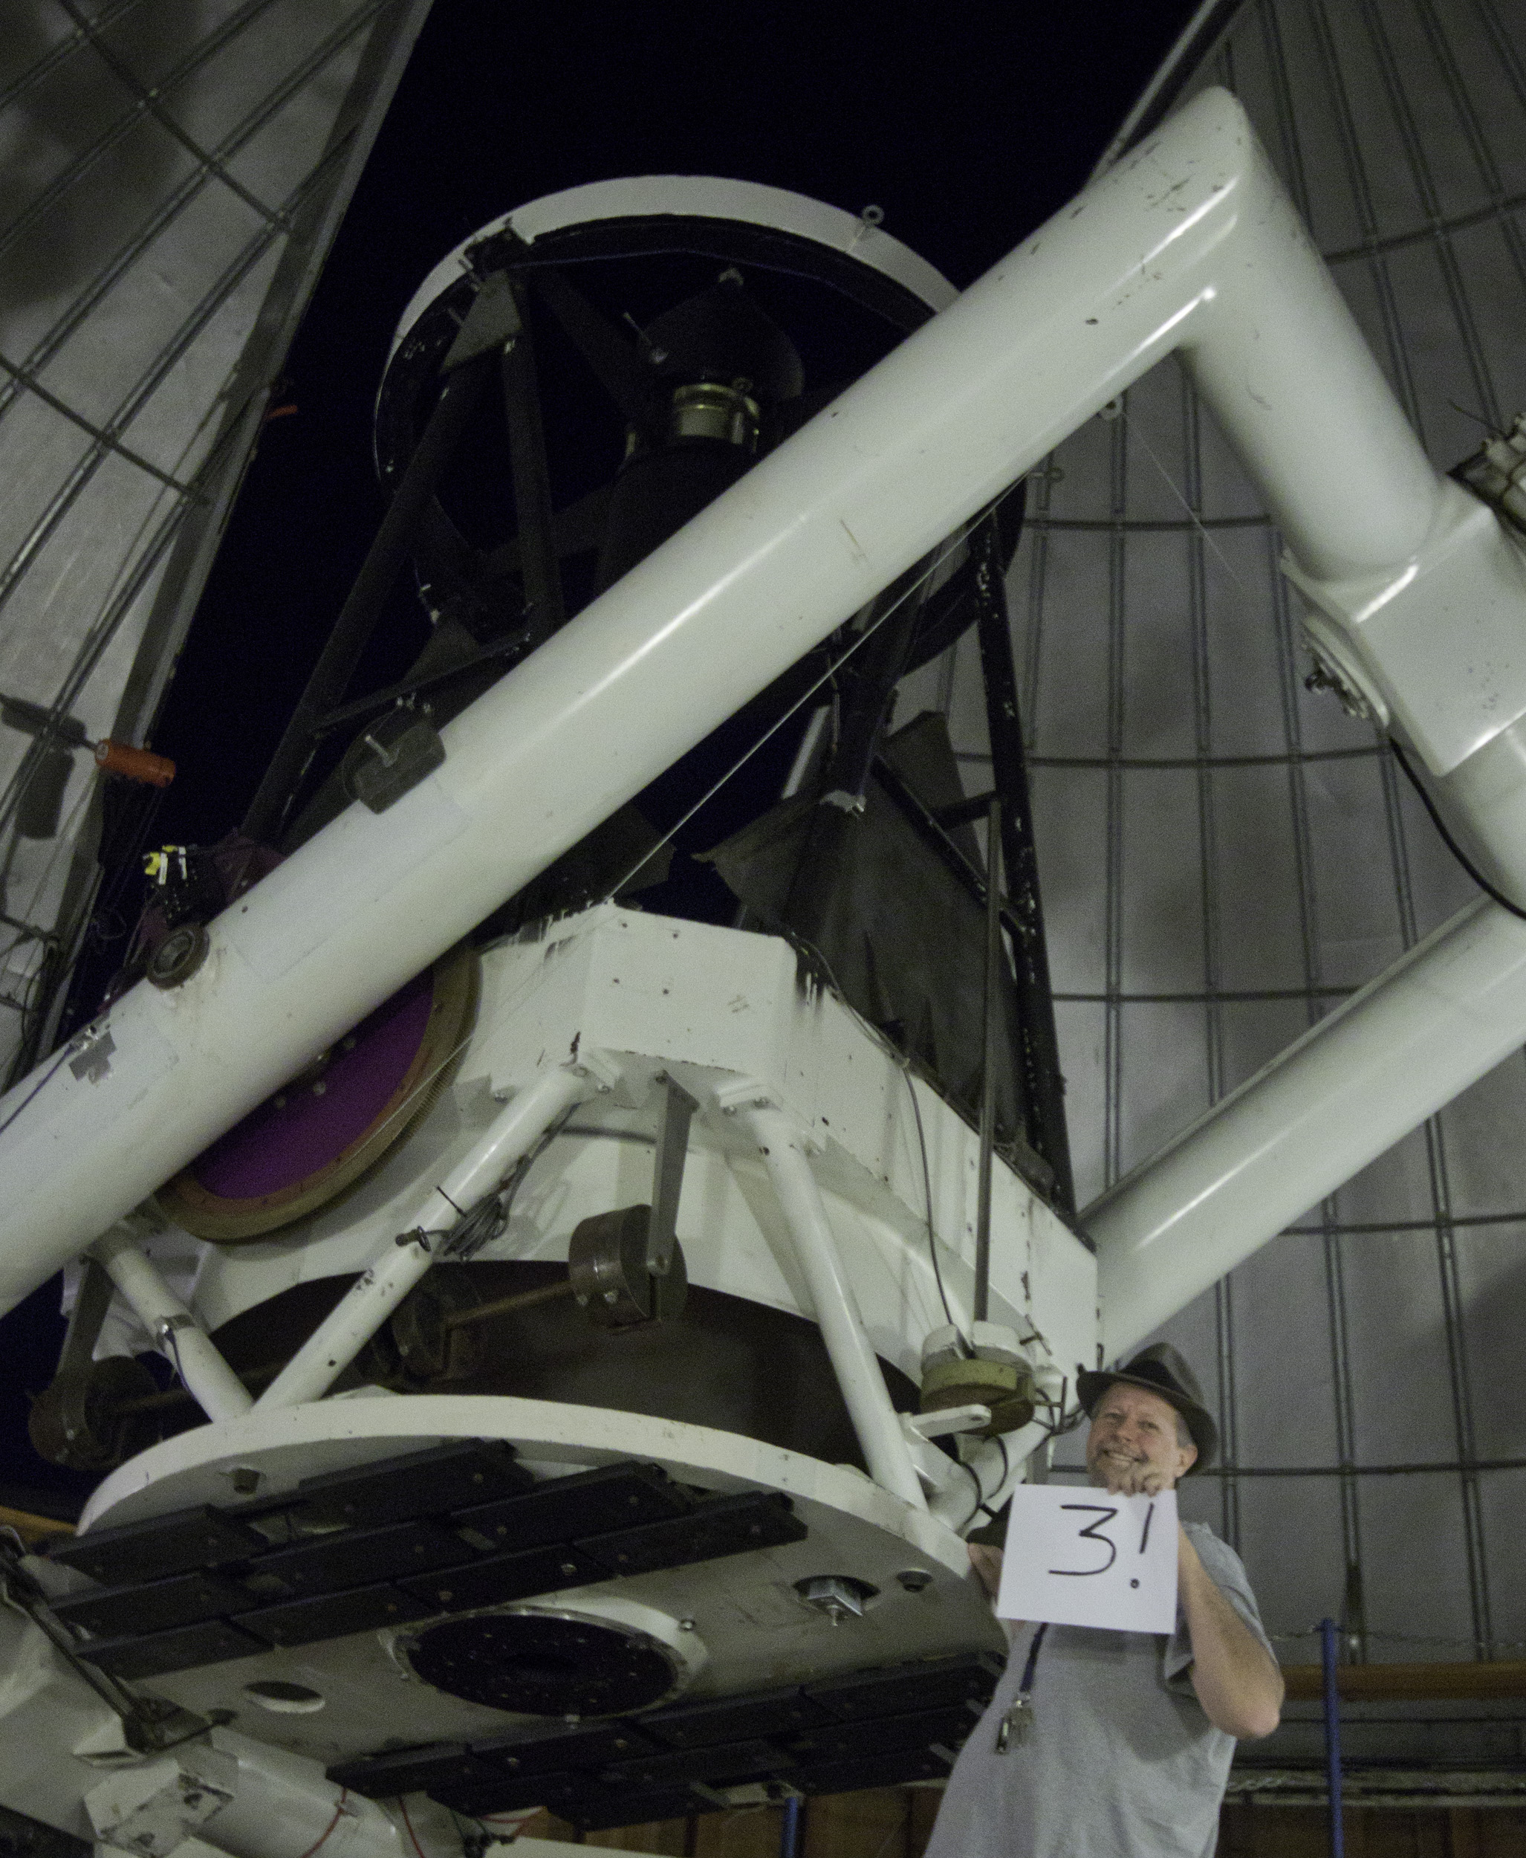
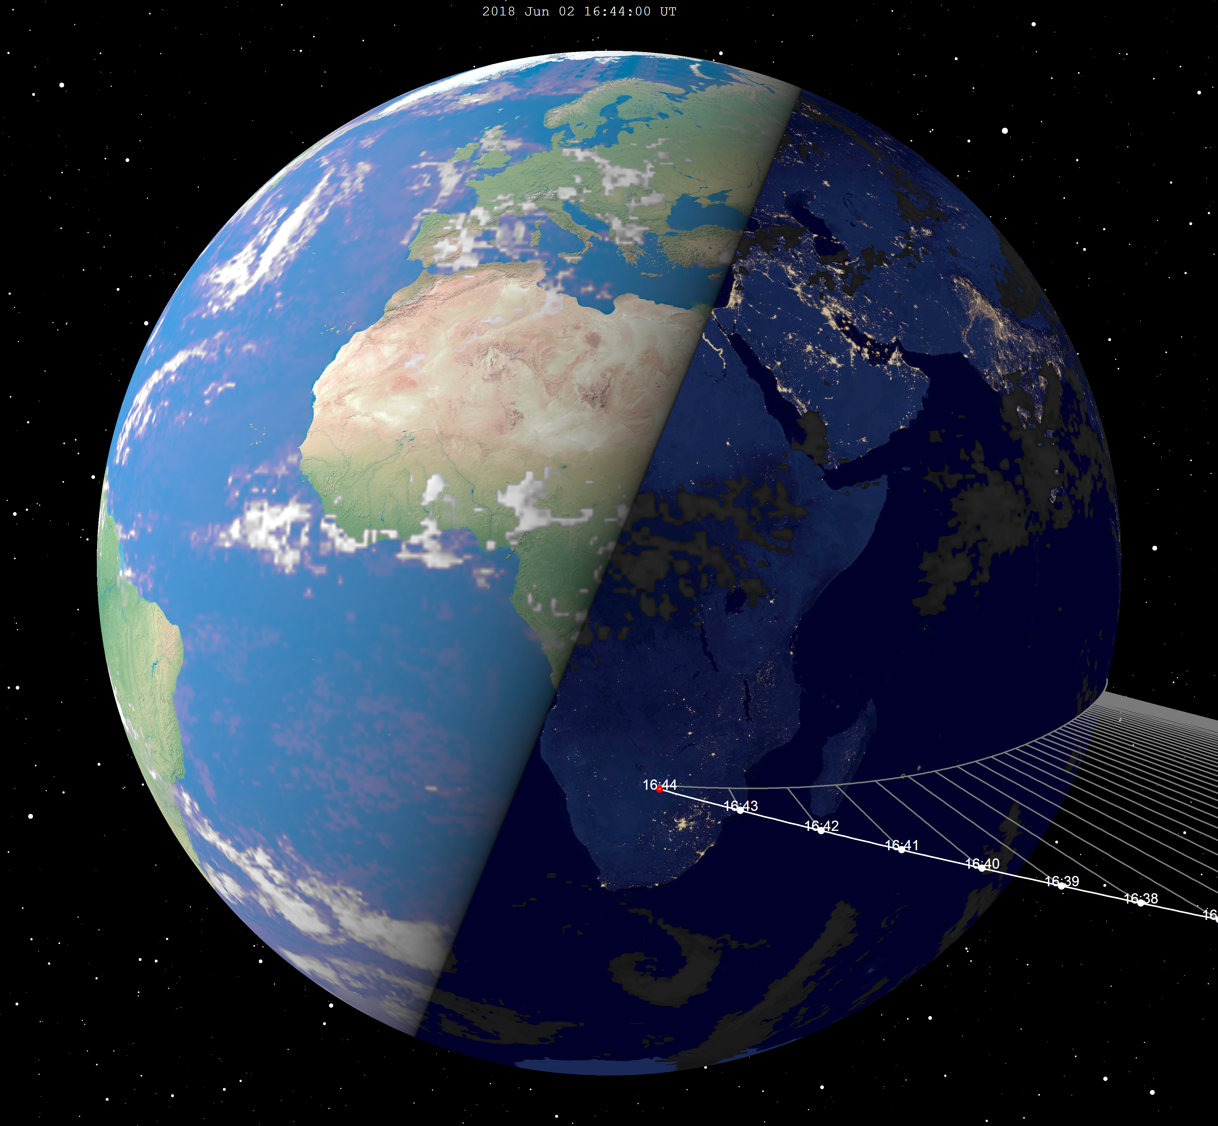
2018 LA

Slide 11
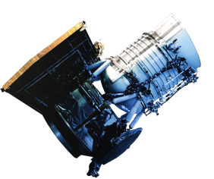
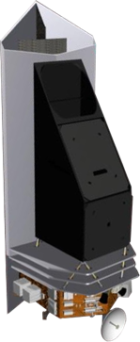
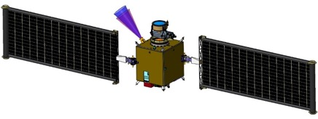
PDCO Flight Mission Projects
NEOWISE
Continues in extended NEO survey operations
NEOCam: Near-Earth Object Camera
Infrared survey telescope optimized for meeting congressional mandate to find and characterize NEOs down to 140 meters in size
Extended Phase A – completed; continuing as an instrument
DART: Double Asteroid Redirection Test
Demonstration of kinetic impactor technique
Target - Moon of 65803 Didymos
Launch 2020, impact 2022
Continues in Phase C

Slide 12
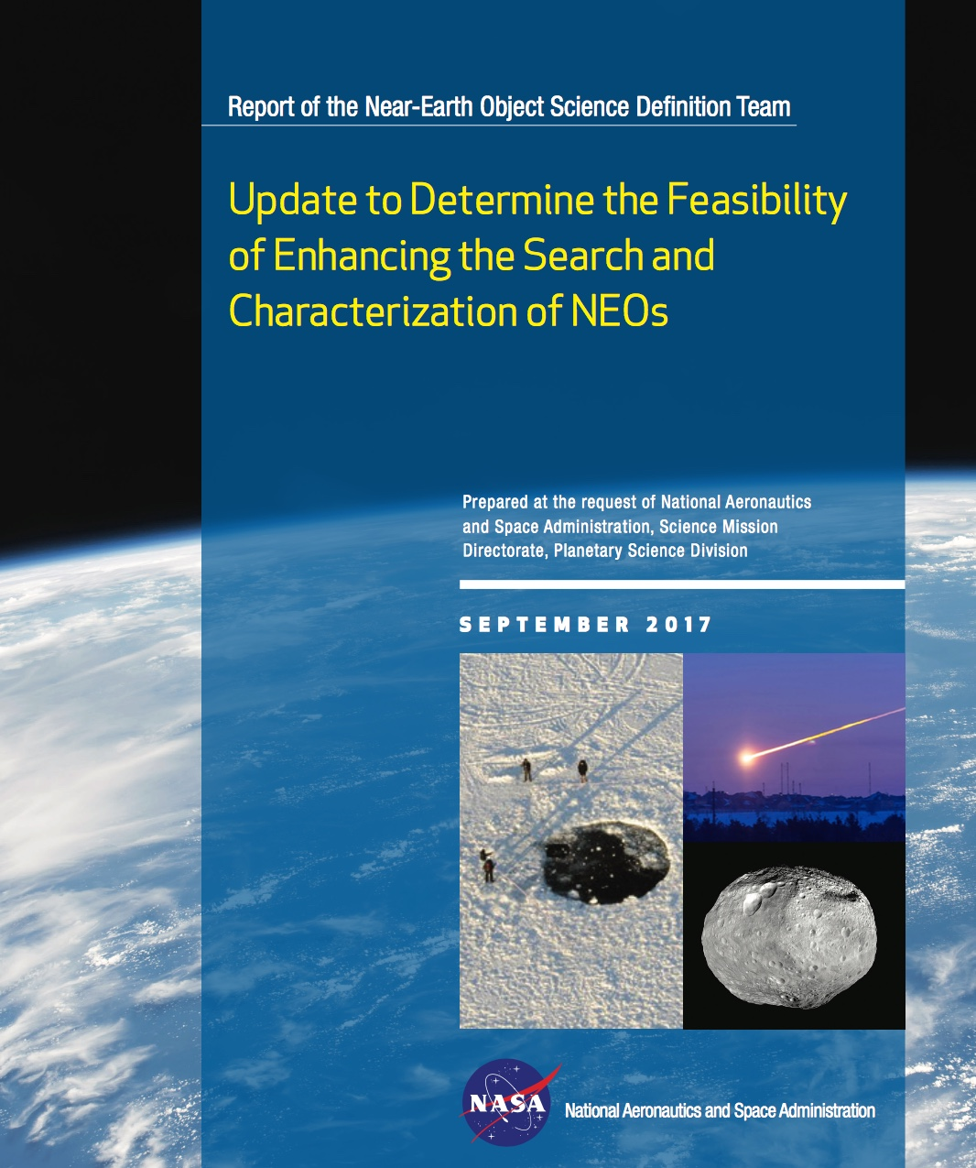
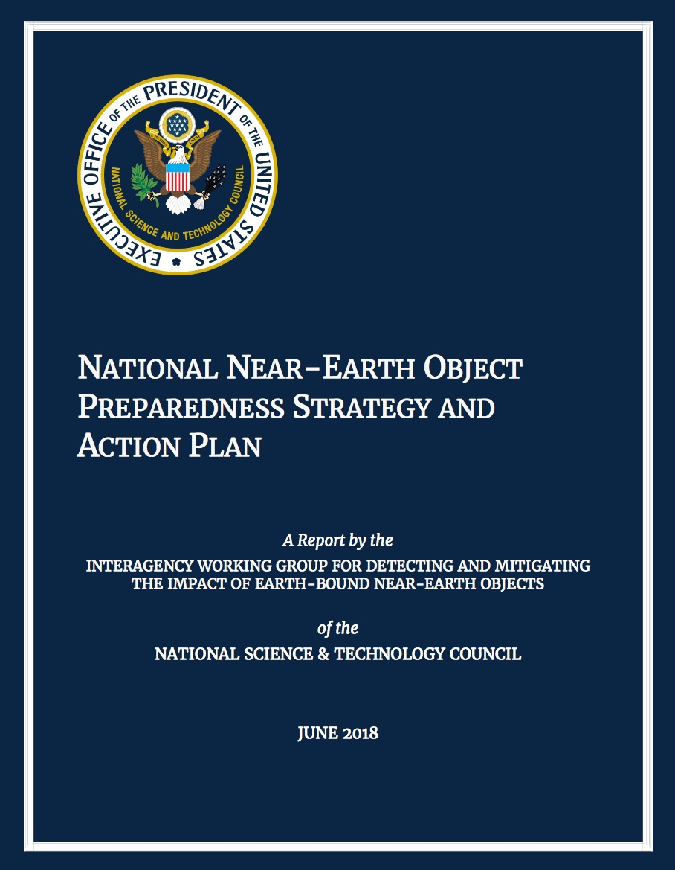

Slide 13
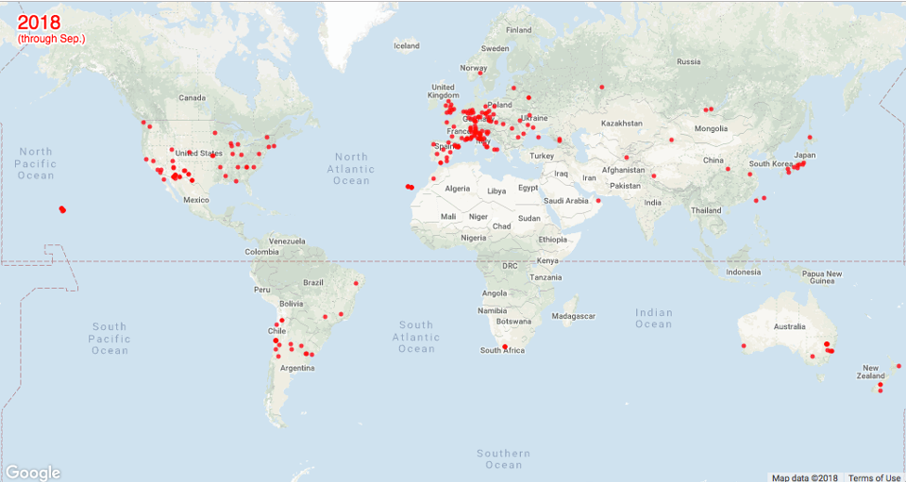
Observations Worldwide
(as tallied by the MPC)
13.5 million observations world wide
(of which 135,000 of NEOs)
41 countries + 1 observatory in space

Slide 14
Signatories to IAWN
KASI — Korean Astronomy Space Science Institute, Daejeon, South Korea
INAOE - the National Institute of Astrophysics, Optics, and Electronics in Cholua, Mexico
INASAN - the Institute of Astronomy, Russian Academy of Sciences, Moscow, Russia
ESO - European Southern Observatory
ESA – European Space Agency
NASA
University of Nariño, Pasto, Colombia
Peter Birtwhistle, amateur astronomer, West Berkshire, England
CNSA – China National Space Administration
Zwicky Transient Facility, Palomar Observatory, California

