Slide 1
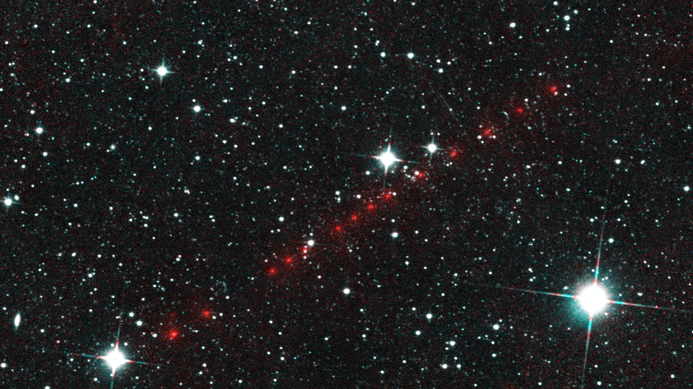
5th International Asteroid Warning Network (IAWN) Meeting
P/2014 L2
Comet NEOWISE
Current Status & Agenda
30 January 2018
Vienna, Austria

Slide 2
5th International Asteroid Warning Network Gathering (1/2)
IAWN Status – around the room (~5-10 min each)
  Recovery of 2012 TC4
  New Members
IAWN Report to STSC
New IAWN Webpage
  SBN
  Univ of Maryland
IAWN-specific SMPAG Action Items (5.1 and 5.6)

Slide 3
5th International Asteroid Warning Network Gathering (2/2)
UN-SPIDER – Technical Advisory Missions, Global Network
Coordination/distribution of IAWN-relevant Information between EU & NATO
UNISPACE+50
  Pamphlet
  Poster
Next IAWN Gathering
  COSPAR (Pasadena, CA – July 2018)
  DPS (Knoxville, TN – Oct 2018)
  IAC (Bremen, Germany – Oct 2018)

Slide 4
IAWN Status - NASA

Slide 5
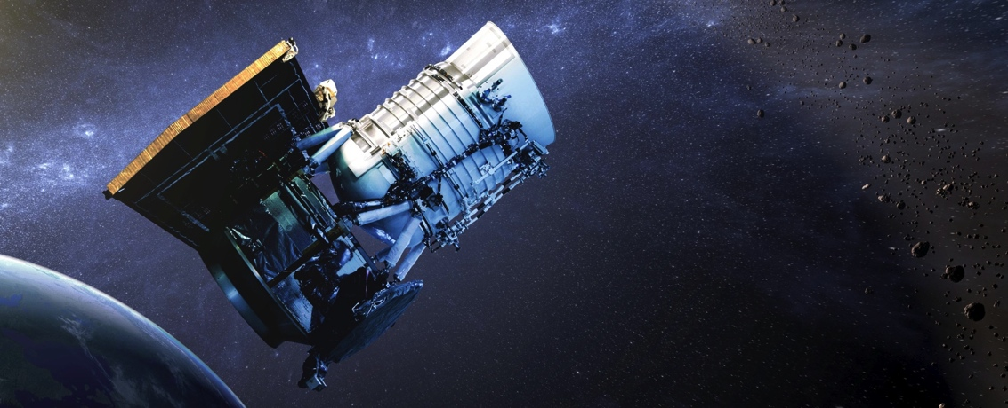
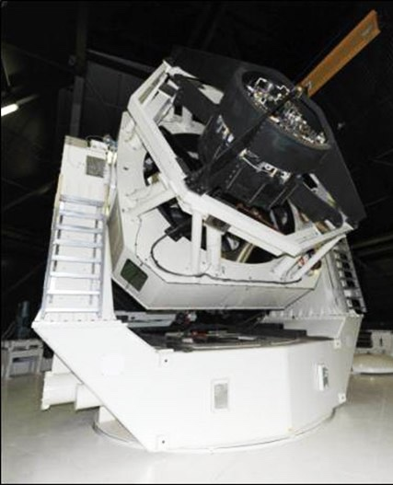
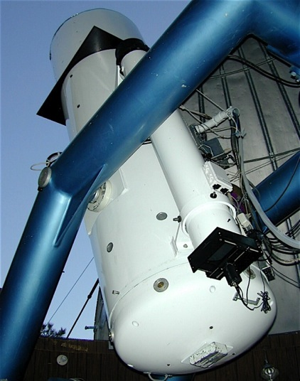
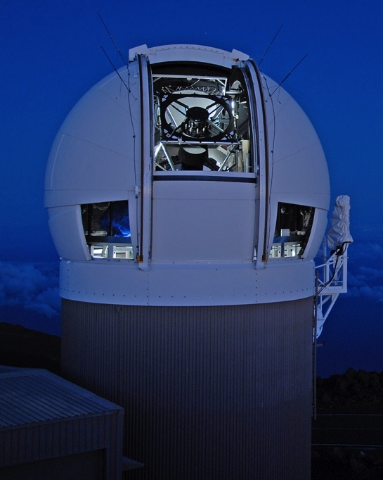
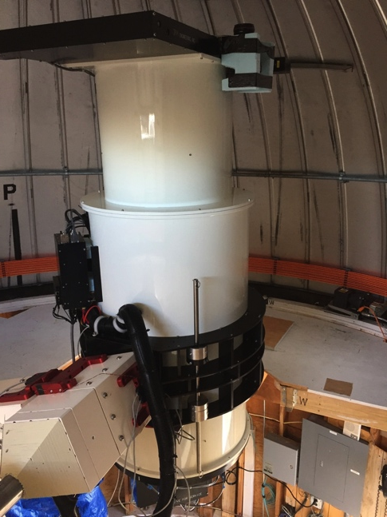
NASA’s NEO Search Program: Surveys
Current Surveys:
NEOWISE
NEOWISE
CSS
Pan-STARRS
ATLAS
LINEAR/SST (being re-assembled in Western Australia)
JPL
Sun-synch LEO
0.4 m
LINEAR/SST
Catalina Sky
Survey
Pan-STARRS
ATLAS
Two 1.8-m telescopes
Haleakalā, Maui
1.5-m
0.7-m
0.5-m Haleakalā Mauna Loa
3.5-m (to Australia)

Slide 6
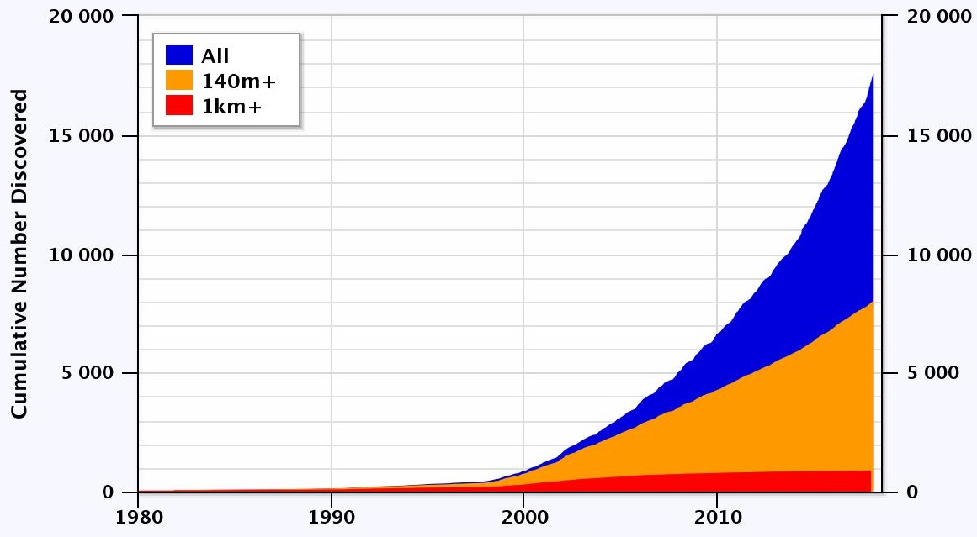
NEAs Discovered (to date)
NEA total:
17,587
PHA:
1,887
(187 > 1 km)
NEC: 106
https://cneos.jpl.nasa.gov/stats Alan Chamberlin JPL/Caltech

Slide 7
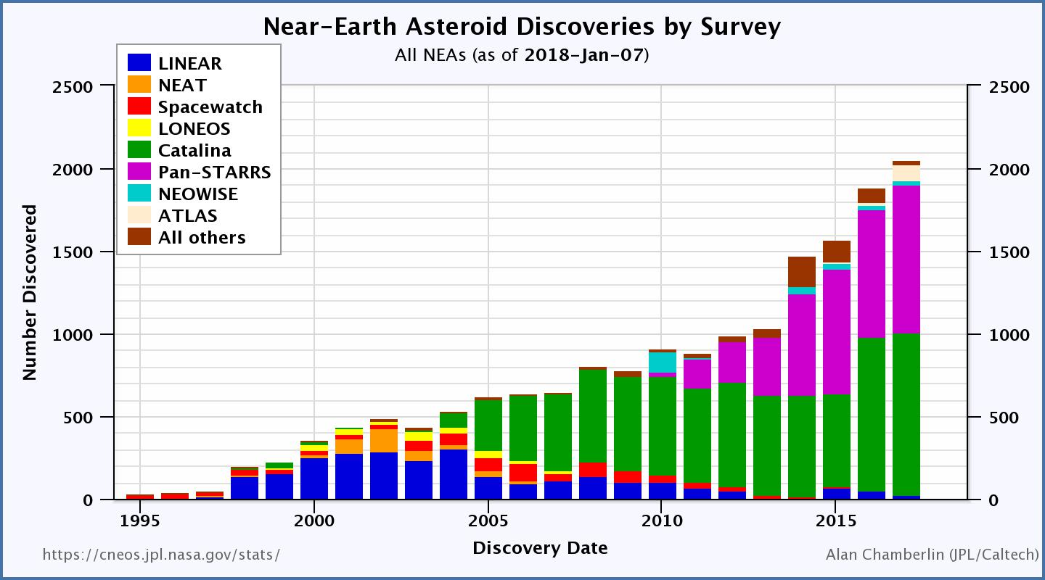
NEAs Discovered by Survey (to date)
2053 discoveries
in 2017

Slide 8
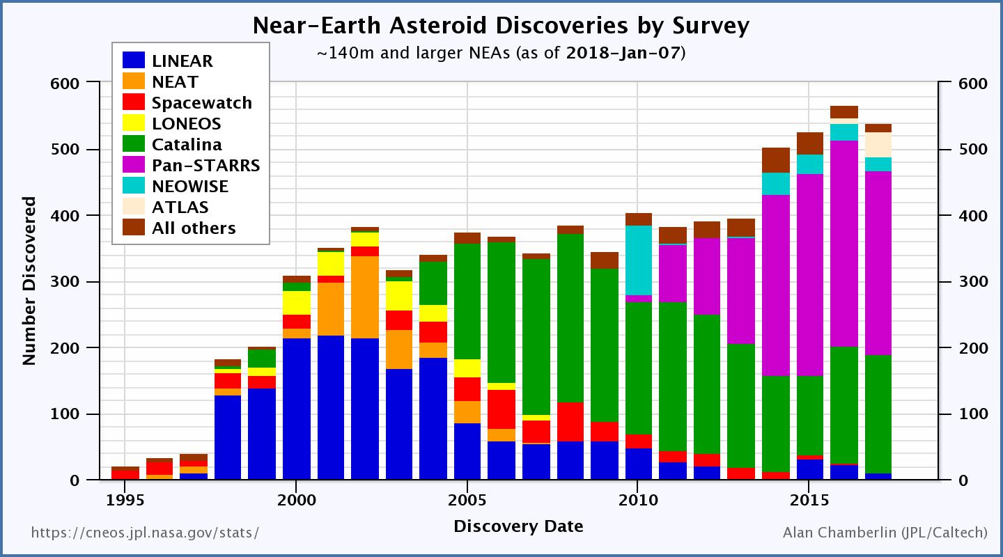
NEAs Discovered by Survey (140 m+)
538 discoveries
in 2017

Slide 9
NEO Population – 140 meters and larger*
*based on an estimated population of ~25,000

Slide 10
Recovery of 2012 TC₄
Goal - Exercise the Planetary Defense system
Recovery and Follow-up: Recovery confirmed early August 2017
Characterization: Light curves, photometry, spectroscopy, radar
Modeling: orbit determination, threat assessment and impact modeling exercises
Communications:
  NASA management, White House, other agencies
  Within the NEO community and with the public
International Asteroid Warning Network (IAWN) participation

Slide 11
Recovery of 2012 TC₄
(Initial Results)
Astronomers from the U.S., Canada, Colombia, Germany, Israel, Italy, Japan, the Netherlands, Russia and South Africa tracked TC4
Close approach occurred at about 43,700 km
Radar observations of 2012 TC₄ seem to indicate an oblong shape of about 6 x 12 meters in size
Light curve and then radar showed it tumbling with about a 12 minute period
Precision orbit determination was able to rule out any impact by TC4 for the foreseeable future
More information: http://2012tc4.astro.umd.edu/

Slide 12
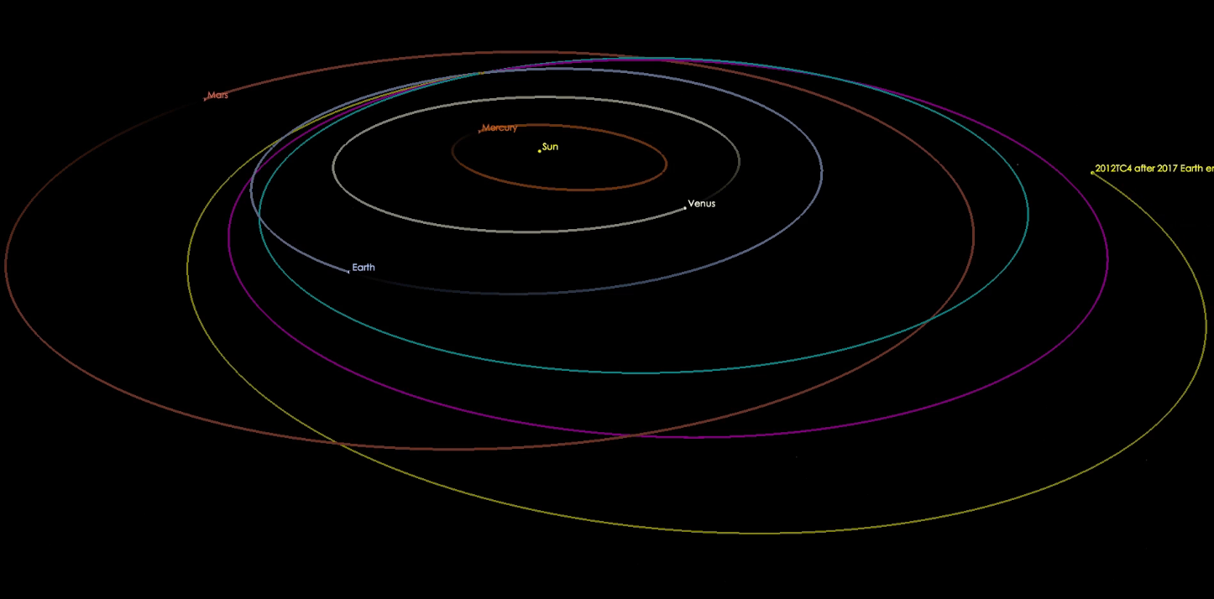
prior to 2012
Earth encounter
post-2012
flyby
post-2017
flyby

Slide 13
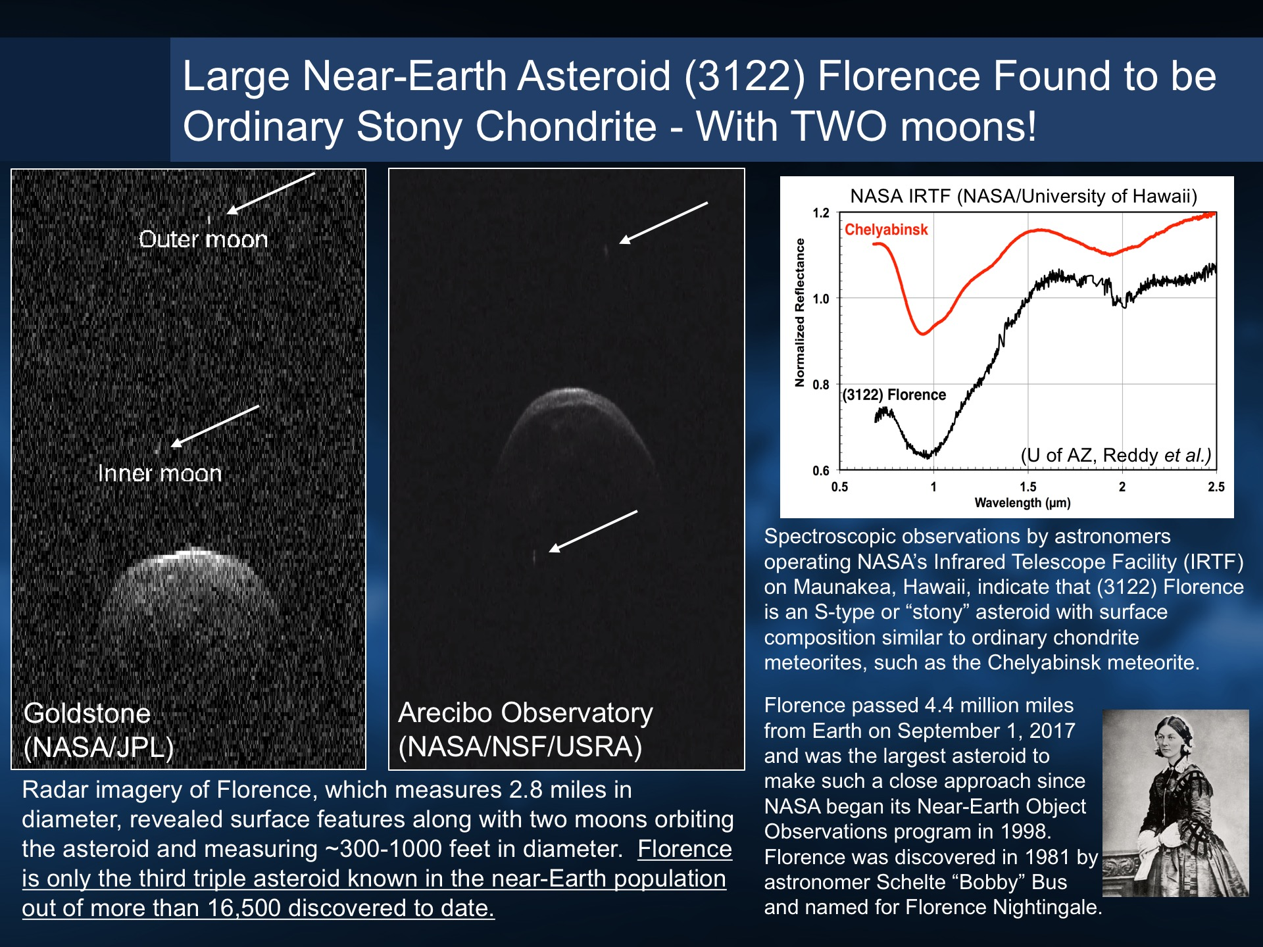
Science
Nuggets
Discovered by Bobby Bus in 1981 (1981 ET₃)
ranks 4th in size of large PHOs
Came within 0.047 AU of Earth on 1 Sept 2017
3rd NEO found to be a ternary system

Slide 14
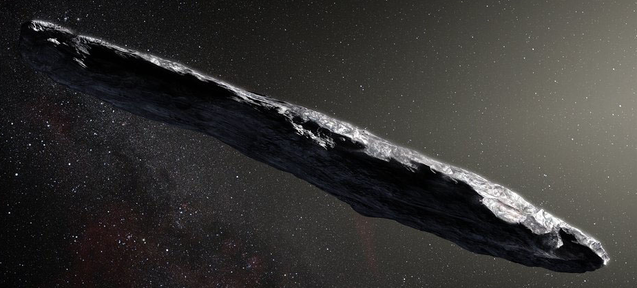
Discovery of First Interstellar Object
1I/2017 U1 (‘Oumuamua)
Discovered on 19 October 2017, by the Pan-STARRS1 telescope during near-Earth object survey operations
Speed and trajectory indicate it originated outside of and is not bound to our solar system
Object is asteroidal in nature (no coma observed)
Object is highly elongated, with an axis ratio >3:1 perhaps 10:1
(real image)
Observations suggest a surface reddened due to irradiation by cosmic rays over its history
(artist’s concept)

Slide 15
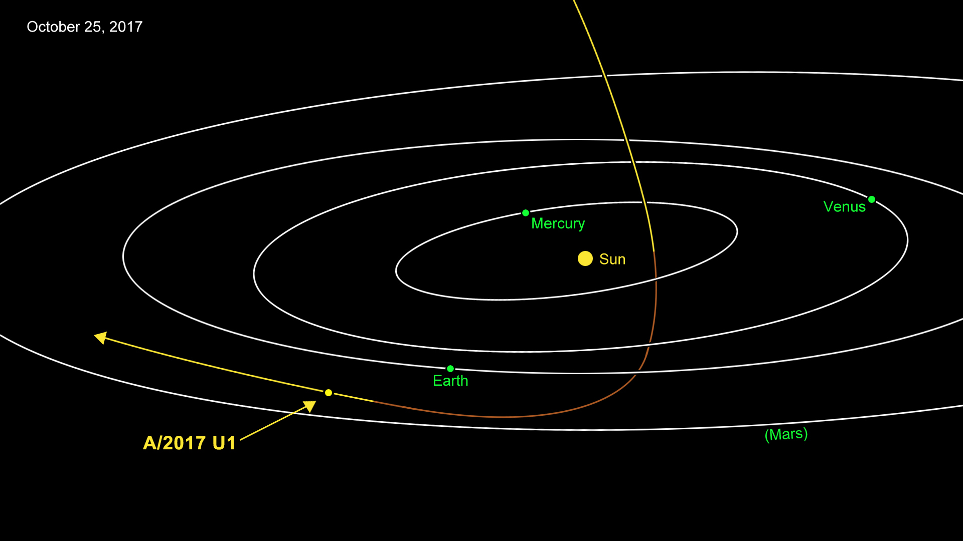

Slide 16
Sentry object of interest - 2017 YZ₁
Discovered by the Catalina Sky Survey (G96, Mt. Lemmon) on 20 December 2017
43 observations over two weeks
Diameter 250 meters
Impact probability < 1/20,000 on 20 June 2047
1 (Green) on the Torino scale due to size, and was re-assigned to 0 with further observations on 18 January 2018.

Slide 17
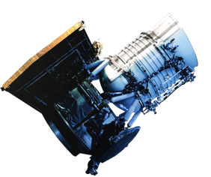
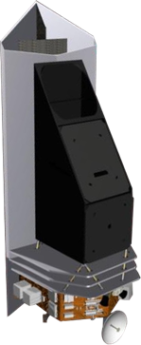
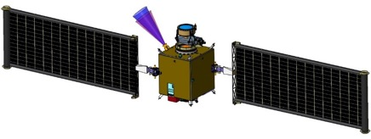
PDCO Flight Mission Projects
NEOWISE
Continues in extended NEO survey operations
NEOCam: Near-Earth Object Camera
Infrared survey telescope optimized for meeting congressional mandate to find and characterize NEOs down to 140 meters in size
Continues in extended Phase A
DART: Double Asteroid Redirection Test
Demonstration of kinetic impactor technique
Target - Moon of 65803 Didymos
Launch 2020, impact 2022
Continues in Phase B

Slide 18
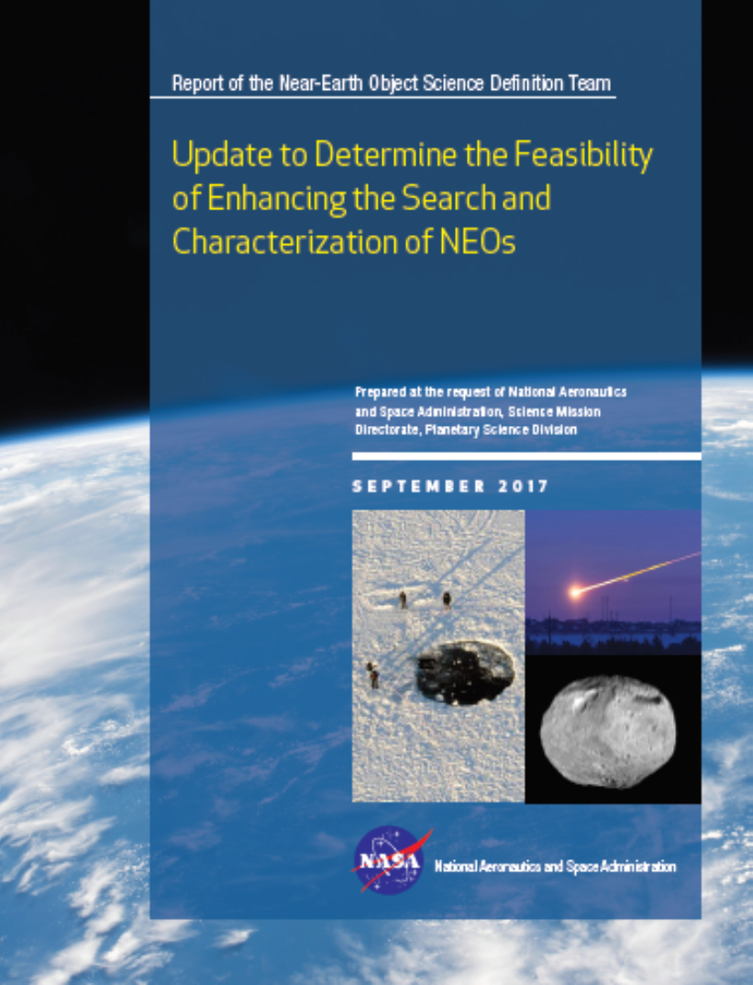
NEO Survey Science Definition Team Report*
Findings
Finding 1. Future goals related to searching for potential Earth‐impacting objects are best stated explicitly in terms of the statistical risk characterized and should be firmly based on cost/benefit analyses. Such a search would best be executed in a way that eliminates the maximum amount of statistical risk uncertainty per dollar of investment.
Finding 2. It would be most productive to develop and operate a NEO search program with the goal of discovering and cataloging the potentially hazardous population sufficiently well to eliminate 90% of the uncharacterized risk from sub‐kilometer objects (i.e., sub‐global impact effects). Over a period of 9 to 25 years, a number of system approaches are capable of meeting this search metric with quite good cost/benefit ratios.
Finding 3. The satisfaction of the 140‐meter cataloging objective will require space‐based search system(s). Infrared (IR) and visible sensors in the 0.5‐ to 1.0‐meter aperture range are credible and cost/benefit‐favorable options that use available technology.
*https://www.nasa.gov/sites/default/files/atoms/files/2017_neo_sdt_final_e-version.pdf

Slide 19
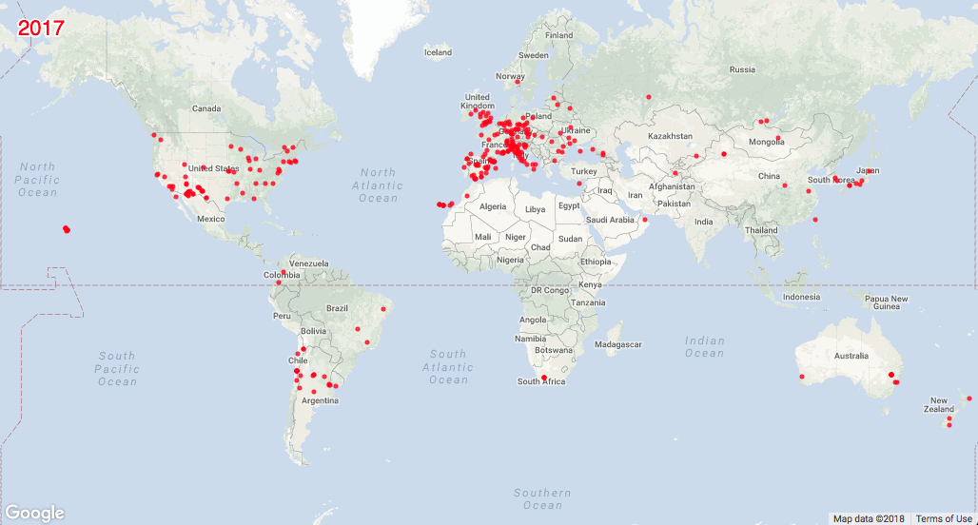
Observations Worldwide
(as tallied by the MPC)
22 million observations world wide
(of which 201,000 of NEOs)
47 countries + 1 observatory in space

Slide 20
IAWN Report to STSC

Slide 21
Framing the IAWN Statement
5 year mark since Chelyabinsk event
Signatories up to 13 now
Framing NEO discovery statistics – rate of discovery over the past few years
2012 TC4 recovery effort

Slide 22
IAWN-specific SMPAG Action Items

Slide 23
(1/3)
IAWN/SMPAG:
5.1
Criteria/Thresholds for
Impact Response Actions
Discussion and concurrence at previous SMPAG Meeting in February 2017
IAWN shall warn of predicted impacts exceeding a probability of 1% for all objects characterized to be greater than 10 meters in size, or roughly equivalent to absolute magnitude of 28 if only brightness data can be collected.
Rationale: Impact probabilities greater than 1 per cent are rare yet warrant awareness of possible effects. Most objects greater than 10 meters in size could have some effects (air blast and pieces) that could reach the Earth’s surface. IAWN is compelled to warn populations if bodies will have effects that reach the ground. Setting threshold at 1 per cent is a compromise between not being overly alarmist and not warning too late for necessary action to be initiated. It is a probability figure that individuals and governments can comprehend. An alert such as this demonstrates that the IAWN is functioning. Further, it ensures the flow of communications from IAWN to the public and the United Nations.

Slide 24
(2/3)
IAWN/SMPAG:
5.1
Criteria/Thresholds for
Impact Response Actions
Terrestrial preparedness planning should begin when warned of a possible impact:
  Predicted to be within 20 years,
  Probability of impact is assessed to be greater than 10%, and
  Object is characterized to be greater than 20 meters in size, or roughly equivalent to absolute magnitude of 27 if only brightness data can be collected
Rationale: Effective terrestrial preparedness involves determination of the “risk corridor” for impact of an object. This is made possible with the increased 10% impact probabilities within 20 years, which is not too long to begin planning, especially in cases for larger objects. This provides population centres on the Earth information to begin plans for emergency preparedness if needed. The surprising effects of the Chelyabinsk event in 2013 from an object ~18 meters in size led to the establishment of a relatively low limit (20 meters) in this threshold criteria.

Slide 25
(3/3)
IAWN/SMPAG:
5.1
Criteria/Thresholds for
Impact Response Actions
SMPAG should start mitigation mission option(s) planning when warned of a possible impact:
  Predicted to be within 50 years,
  Probability is assessed to be greater than 1%, and
  Object is characterized to be greater than 50 meters in size, or roughly equivalent to absolute magnitude of 26 (assuming)if only brightness data can be collected.
Rationale: Several decades warning, if available, provides sufficient lead time to mount in-space characterization missions to enable more effective mitigation techniques. If more than 1 per cent probability of impact by a 50-meter sized object is assessed, IAWN will inform SMPAG immediately following verification of the orbit. Part of a characterization mission plan would likely be to deploy a radio transponder with the object to enable more precise tracking of the orbit.

Slide 26
IAWN/SMPAG:
5.6
Communication Guidelines (in the event of a credible threat per IAWN)
If an object (10-meters or greater in size has a 1% or greater probability of impact, IAWN shall warn of the pending impact on the IAWN webpage (http://www.iawn.net ) and JPL sentry page (http://neo.jpl.nasa.gov/risks ). One page description suffices.
if such an object is on impact trajectory, NASA’s Center For NEO Studies (CNEOS) and ESA’s Near-Earth Object Dynamic Site (NEODyS) shall independently prepare appropriately relevant maps of the Earth impact sites with time of impact
Content of the page
  Designation
  Facts (discovery, size estimate, composition)
  Impact location
  (example – next pages)
IAWN spokesperson informs UNOOSA [local … regional]
UNOOSA informs appropriate entities and member states of the credible threat

Slide 27
Example Notification Sheet
A small asteroid, provisionally designated 2017 XYZ) was discovered on 31 Nov 2017 by Pan-STARRS located atop Halekakala (Maui), Hawaii and reported to the Minor Planet Center. Additional follow-up observations by the Catalina Sky Survey, the University of Hawaii 2.2-meter, and the Large Altazimuth Telescope (BTA-6) 6-meter telescopes have confirmed the orbit of 2017 XYZ.
2017 XYZ is observed to be approximately 120 meters in size. Based on current calculations, the asteroid has a 4% probability of impact will be on 31 Sep 2028 in the Eastern Pacific Ocean near the northern coast of Mexico at 13:13 UTC.
Future observations are planned with the planetary radar systems located in Goldstone and Arecibo on 1 April 2018. Further radar observations will precisely determine the orbit of 2017 XYZ.
The International Asteroid Warning Network (IAWN) has informed the Space Mission Planning Advisory Group (SMPAG), currently chaired by the European Space Agency.
Basic facts RE: discovery, follow-up, etc.
Current predicted details
Next Observations
IAWN & SMPAG (trusted sources of information, etc.)

Slide 28
Notification Particulars
(to be agreed upon by IAWN members)
Asteroid name/designation
Asteroid characteristics – size (metric and standard), composition (if known), brightness/albedo, etc.
Observational history (discovery information, follow-up)
Prediction of asteroid trajectory including closest distance to Earth (surface, not center) and date and time of close approach.
A colloquial (non-statistical) qualifier of impact risk
Hazard to space assets (if any)
Future observations
Visibility, visual magnitude (i.e., amateur astronomers be able to see the object)
Consistent terms of measurement: “size” rather than “diameter” of object, brightness/albedo of object, etc.
Authoritative source(s) for more information (i.e., IAWN, SMPAG)

Slide 29
Overview for NEO Threat Response
(very simplified)
United Nations
COPUOS/OOSA
UN Office of Outer Space Affairs
Committee on Peaceful Uses of Outer Space
Inform in case of
credible threat
Parent Government
Delegates
Determine Impact time, location and severity
Potential deflection mission plans
International Asteroid Warning Network (IAWN)
Space Missions Planning Advisory Group
(SMPAG)
Observers, analysts, modelers…
Space Agencies and
Offices

Slide 30
IAWN & SMPAG Actions (again, Notional)
Object detected, impact potential confirmed
SMPAG members convene to formulate recommendations
SMPAG member agencies vet, and agree to, recommendations
IAWN, supported by NASA, ESA and others validates existence of impact threat
No
SMPAG recommendations briefed to member states
Member states agree to support SMPAG recommendations
IAWN informs SMPAG
of all known information on impact threat
IAWN formally communicates the threat to UNOOSA who in turn inform member states
Yes
Member states inform UN of recommended actions to be taken
IAWN, serves as a central international information point of contact
Action Taken

Slide 31
Discussion
Format
Official header
Accompanying orbit diagrams
Maps

Slide 32
UNISPACE+50
Brochure
Poster

Slide 33
UNISPACE+50 Brochure (IAWN/SMPAG)
Booth
  Staffed
  Video
Pamphlet
  Simple, colorful
  Signatories
  Images (observatories, data, etc.)
Poster

Slide 34
Planetary Defense Timeline
Modeling
Decision-Making
International Cooperation
Communications and Coordination
Detection
Characterization
Tracking
Disruption
Deflection
Terrestrial Mitigation
Response/Recovery
Emergency Response Domain
Decades
Years
Days
Weeks/Days
Impact
* From National NEO Preparedness Strategy, 30 December 2016

Slide 35
Flow Chart for Communications Flow
Object detected, impact potential confirmed
SMPAG members convene to formulate recommendations
SMPAG member agencies vet, and agree to, recommendations
IAWN, supported by NASA, ESA and others validates existence of impact threat
No
SMPAG recommendations briefed to member states
Member states agree to support SMPAG recommendations
IAWN informs SMPAG
of all known information on impact threat
IAWN formally communicates the threat to UNOOSA who in turn inform member states
Yes
Member states inform UN of recommended actions to be taken
IAWN, serves as a central international information point of contact
Action Taken

Slide 36
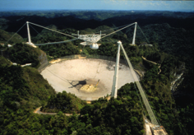
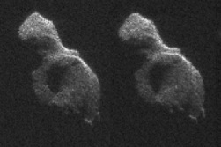
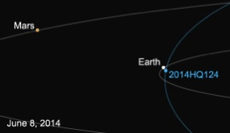
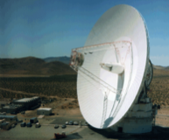

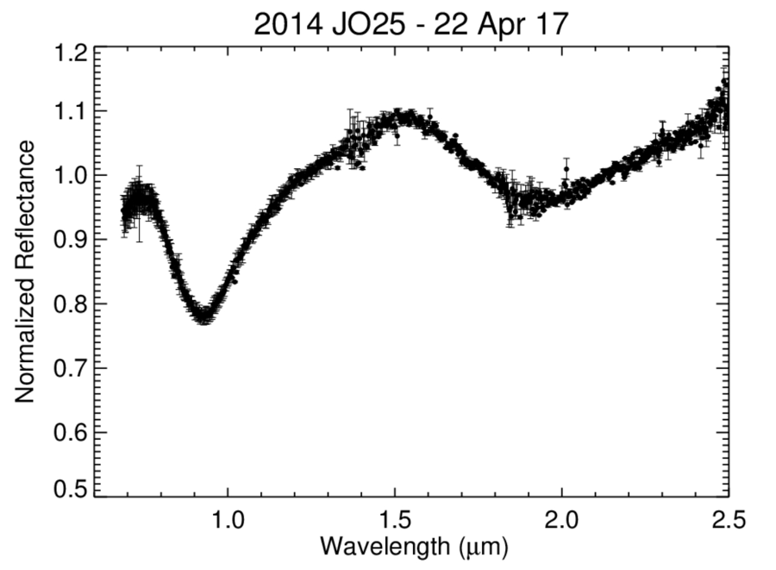
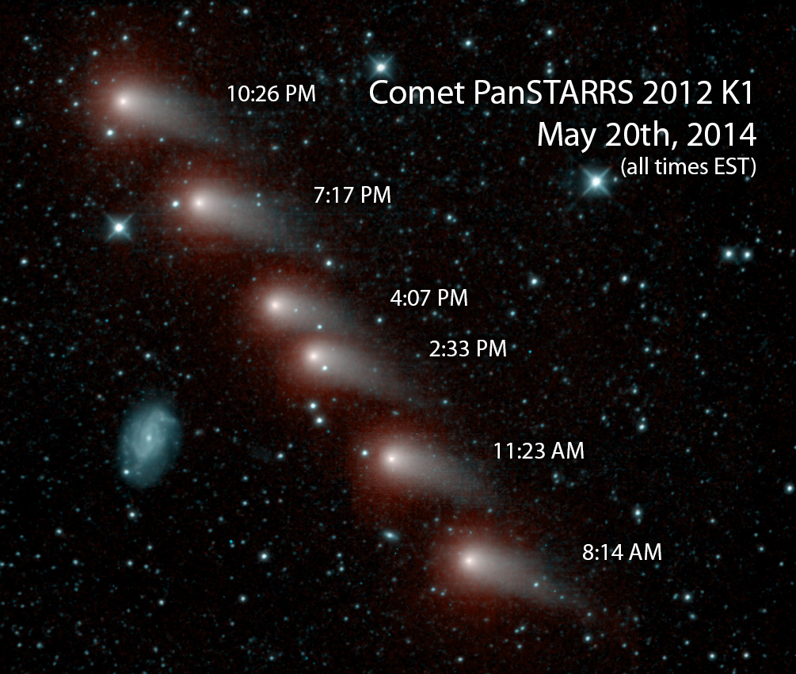


Imagery: Observatories, Radar Images, Visible-IR Images, Spectra

