Slide 1
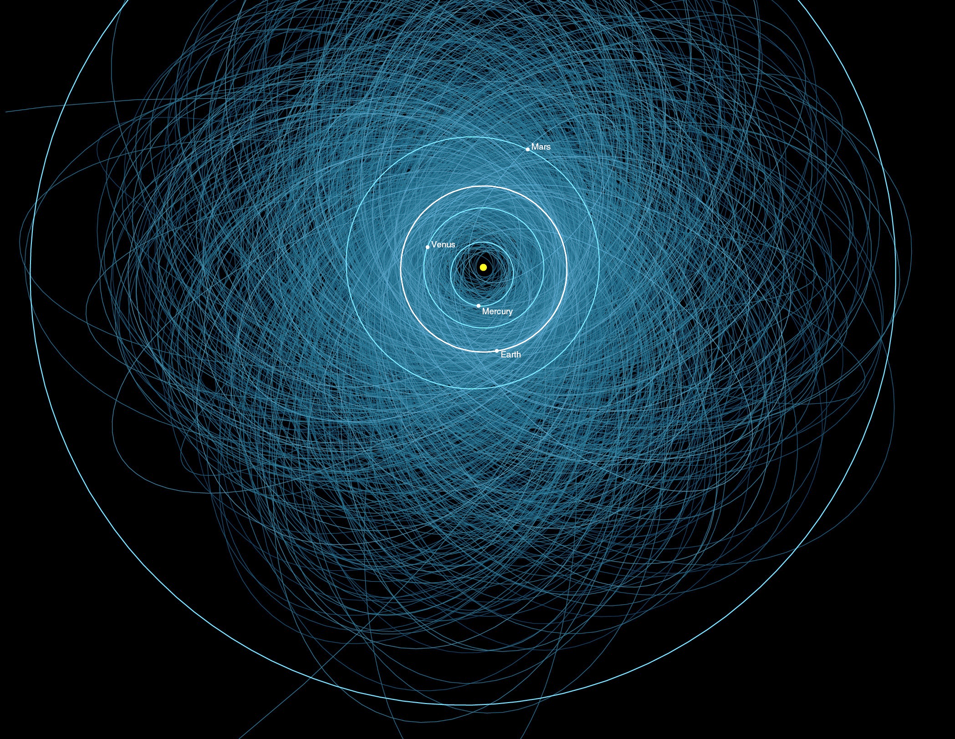

CNEOS Status Update
Paul Chodas
Director, Center for NEO Studies (CNEOS)
Jet Propulsion Laboratory, California Institute of Technology
6th IAWN Steering Group Meeting, Knoxville TN, Oct. 19, 2018

Slide 2
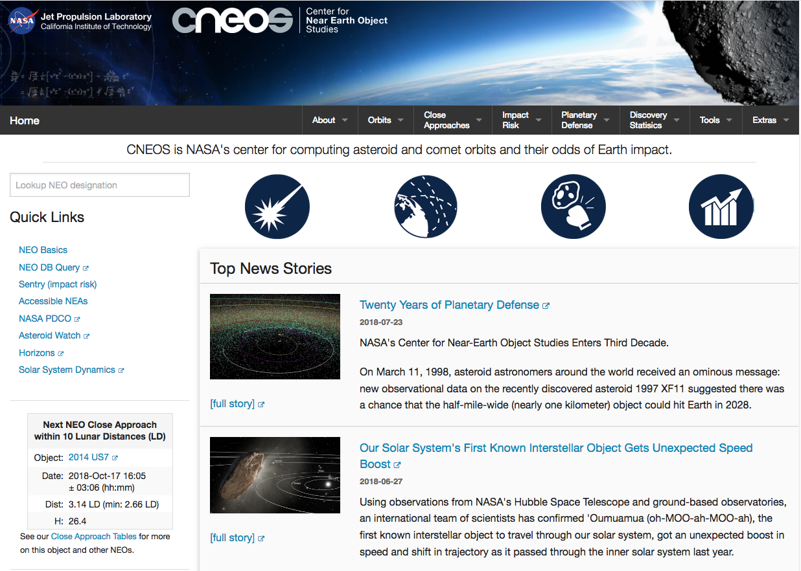
CNEOS Website: cneos.jpl.nasa.gov

Slide 3
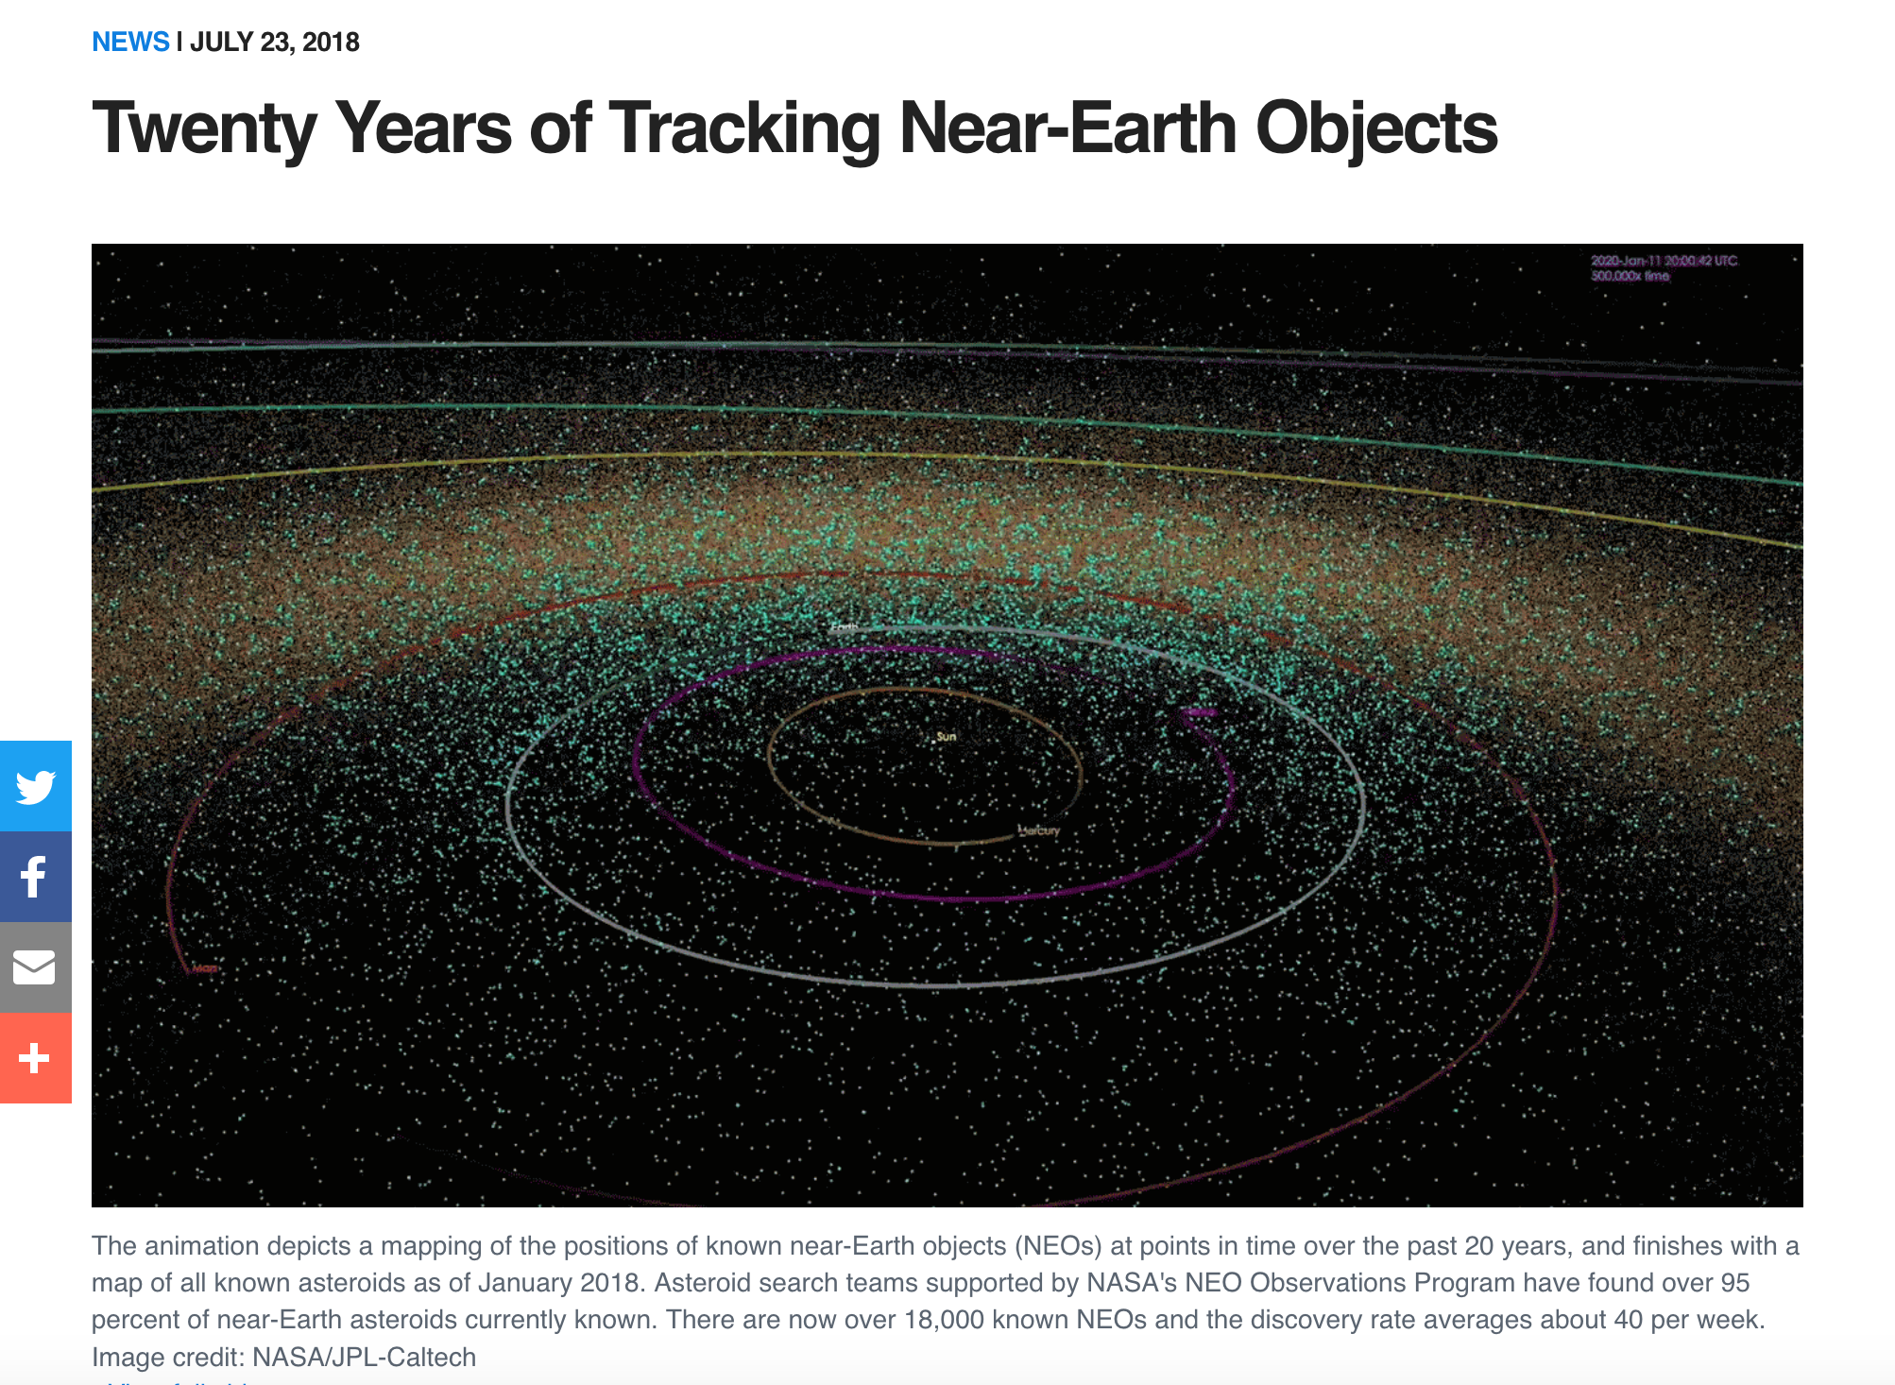
CNEOS: 20th Anniversary

Slide 4
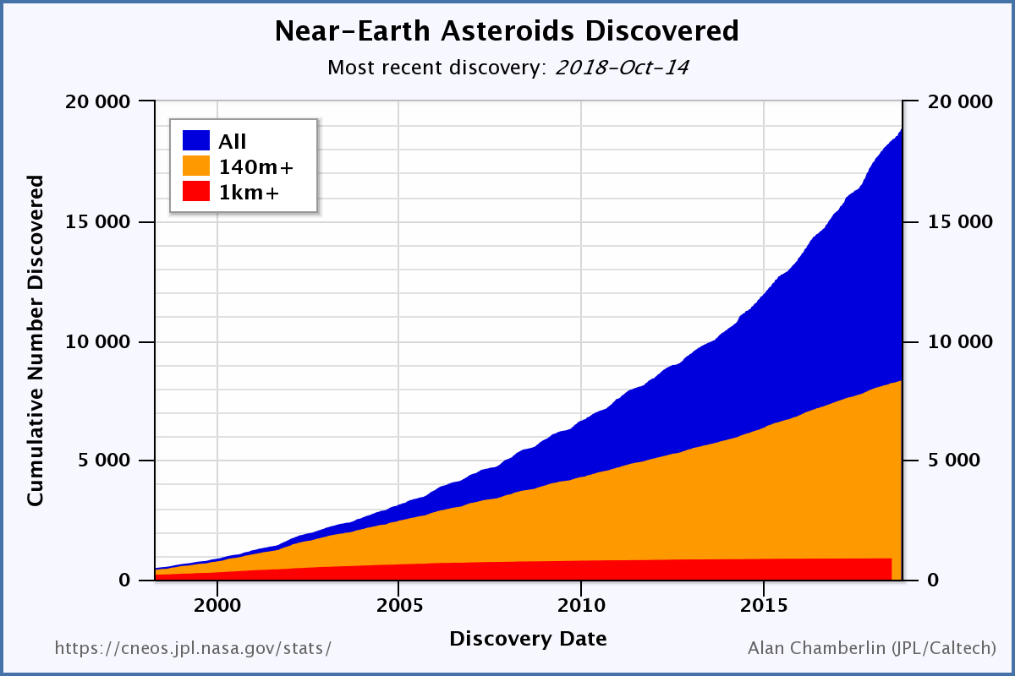
Number of Near-Earth Asteroids (NEAs)
18 976
all sizes
(~2000/yr)
8330
larger than
140 m
(~500/yr)
1936 PHAs
893
larger than 1 km
(~6/yr)
Start of
NASA NEO
Program

Slide 5
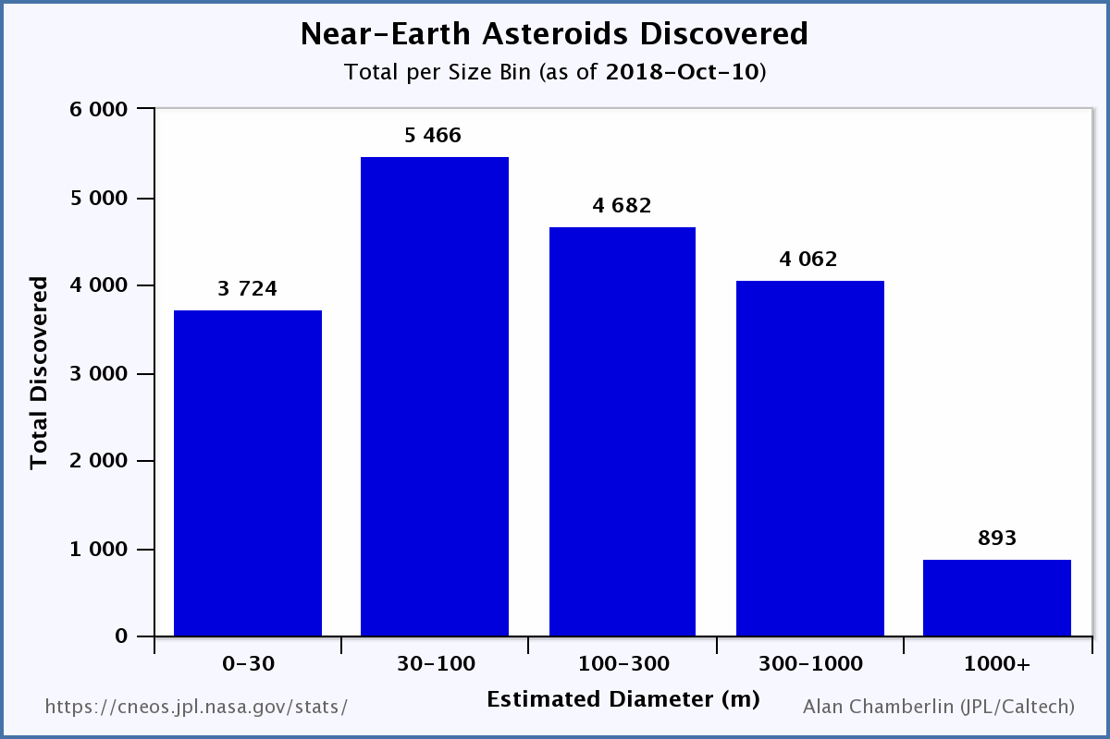
Fraction of NEA Population Known
< 1%
~15%
~70%
<< 1%
96%

Slide 6
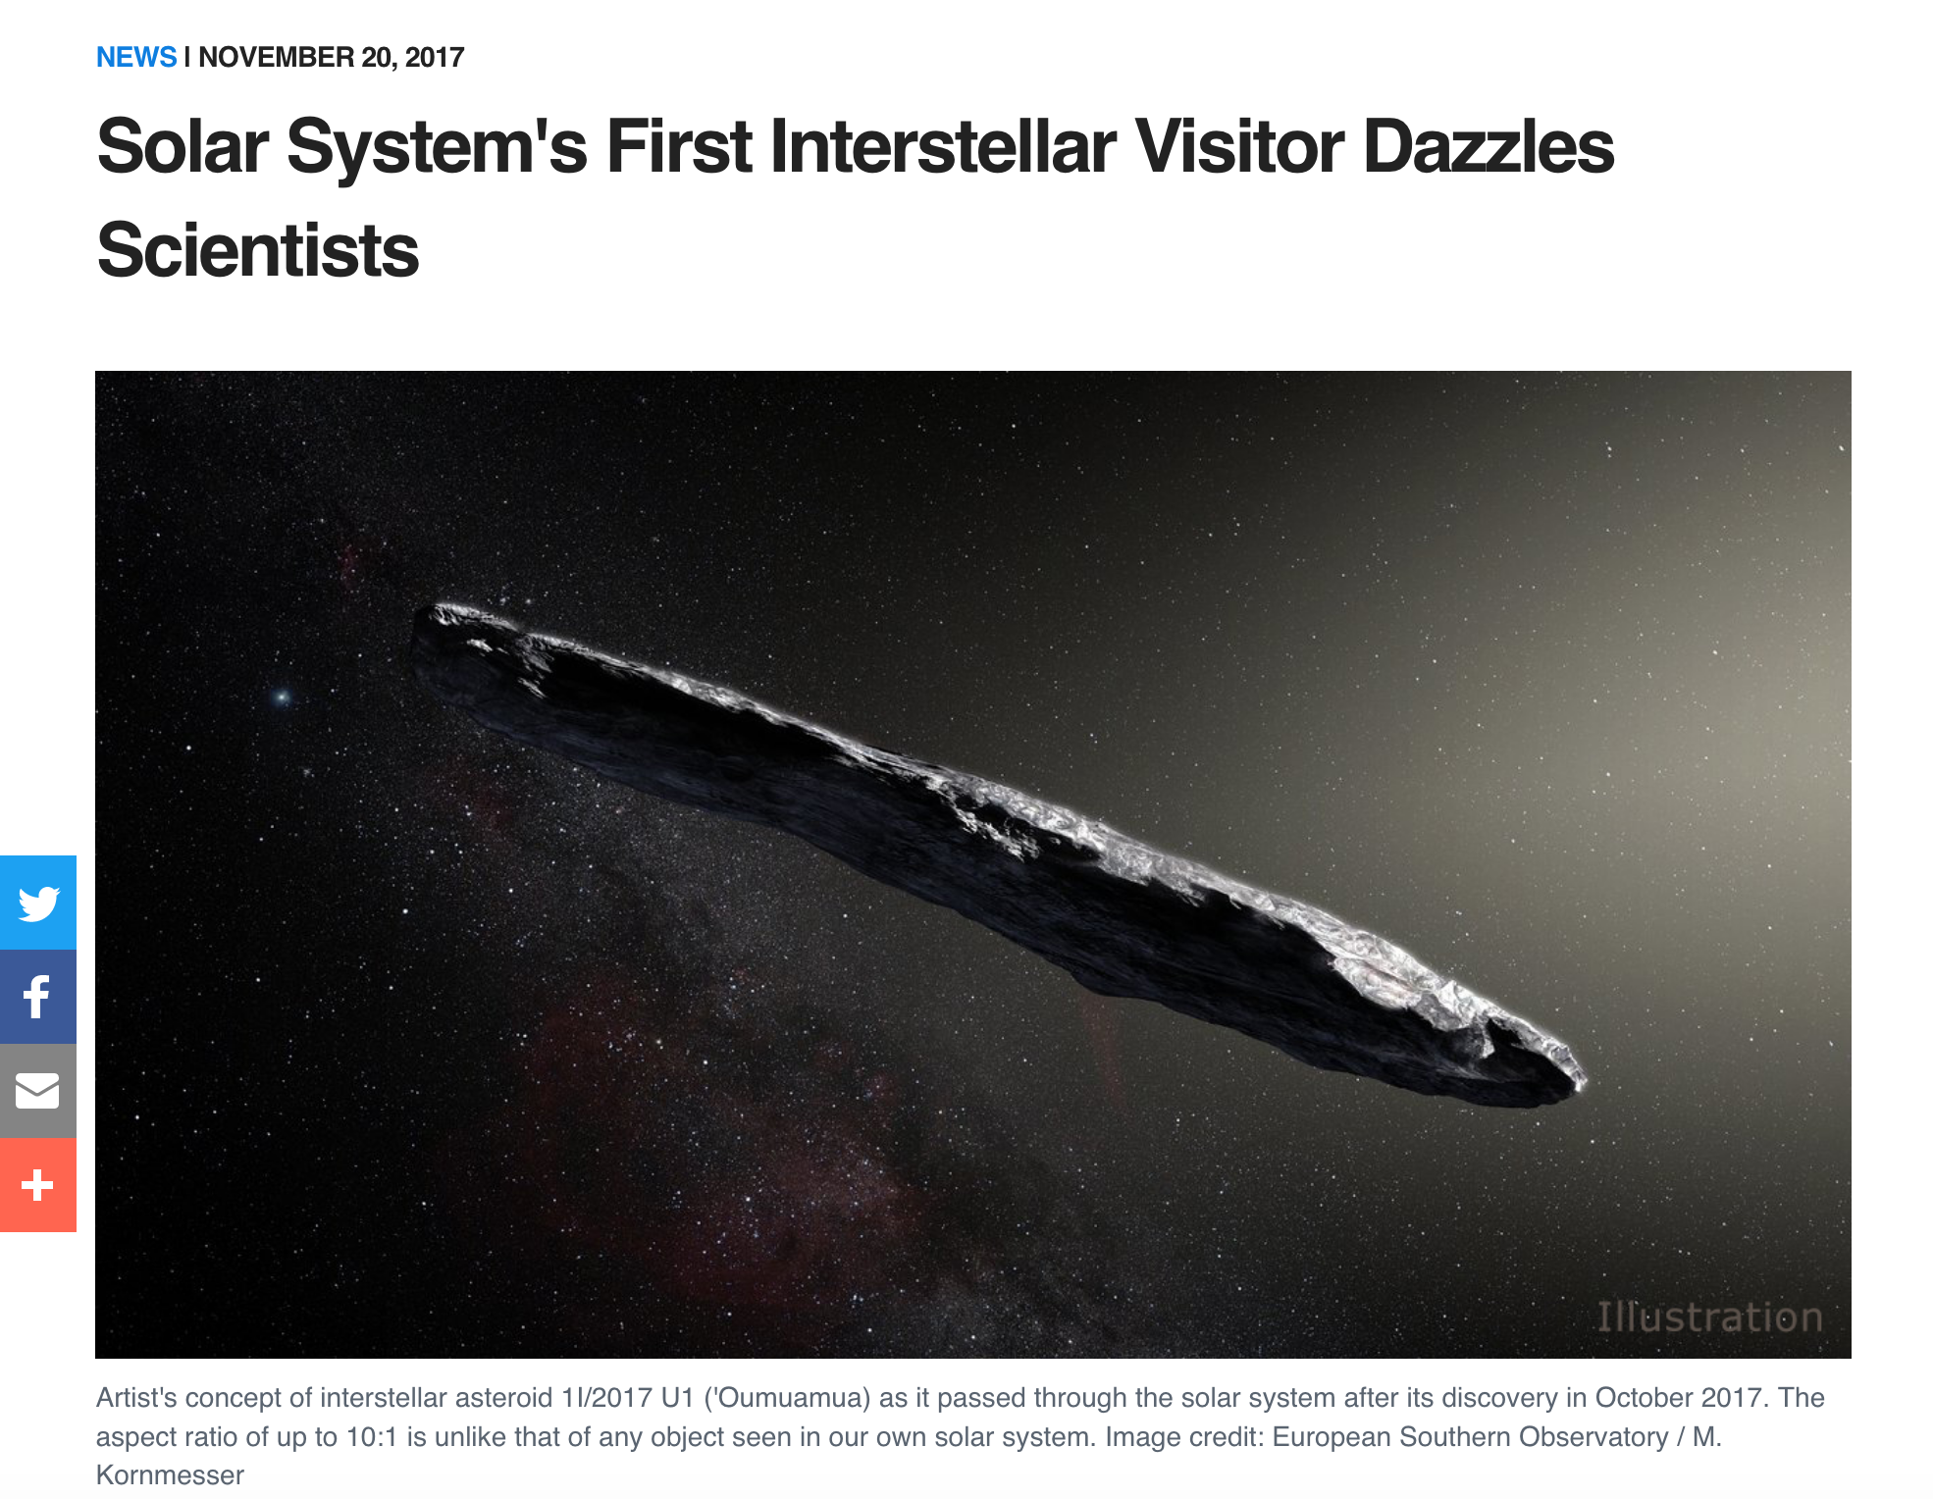
`Oumuamua: First Interstellar Object

Slide 7
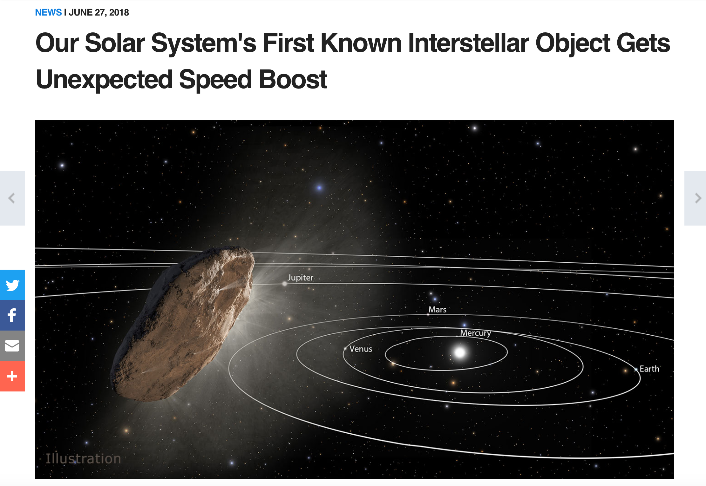
Mysterious Non-Gravs of `Oumuamua

Slide 8
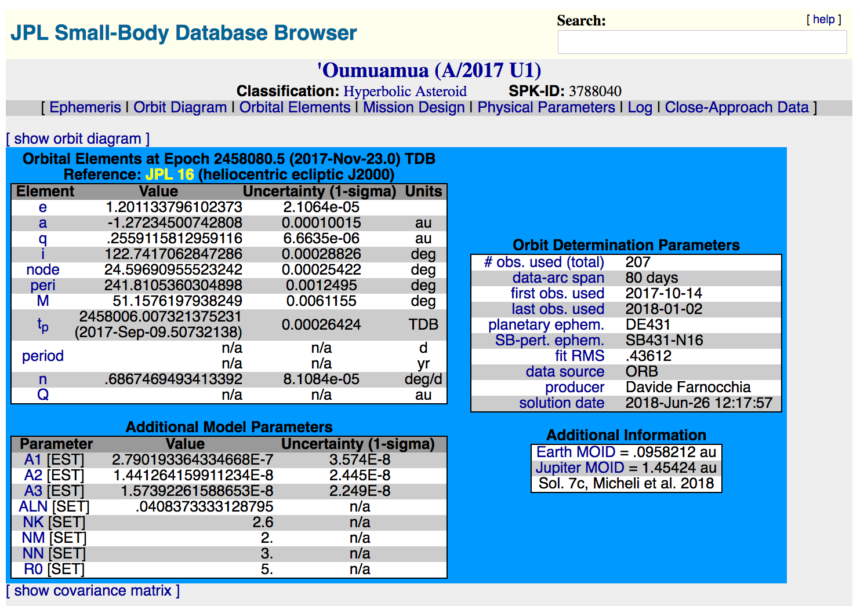
`Oumuamua: First Interstellar Orbit

Slide 9
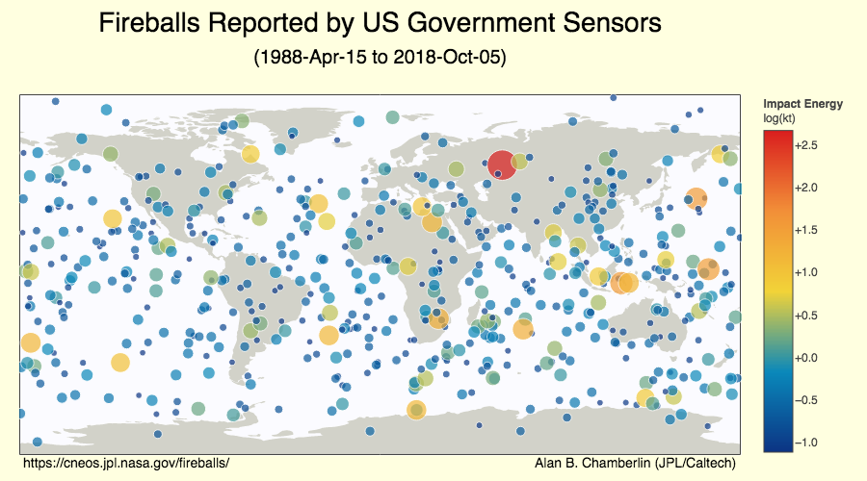
CNEOS Fireballs Page
Chelyabinsk
761 events shown on this map and tabulated on the webpage

Slide 10
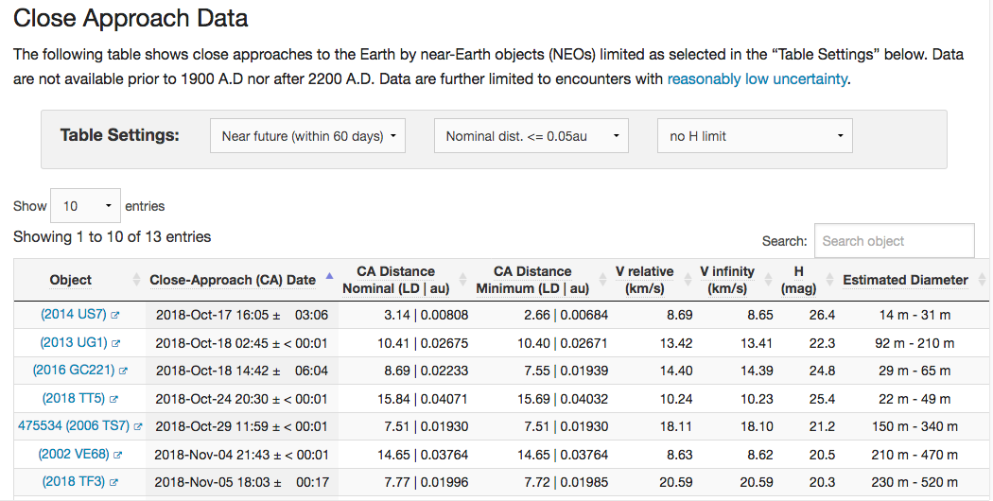
CNEOS: Close Approach Table

Slide 11
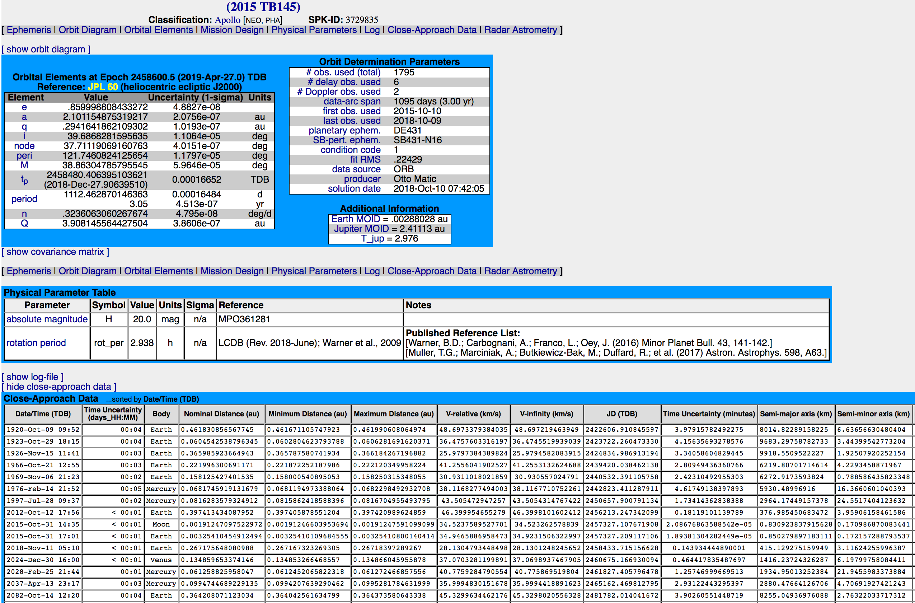
Individual Object Close Approach Table

Slide 12
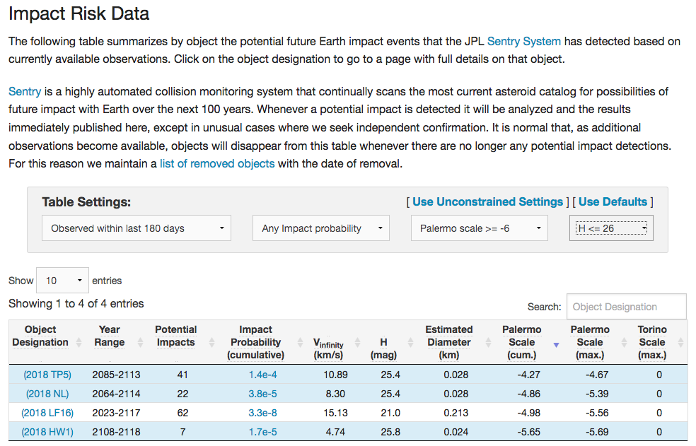
Sentry Risk Table

Slide 13
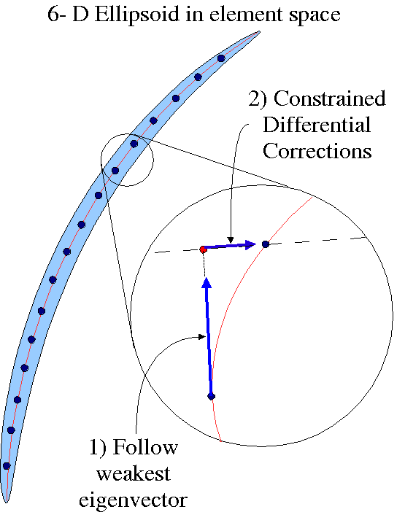
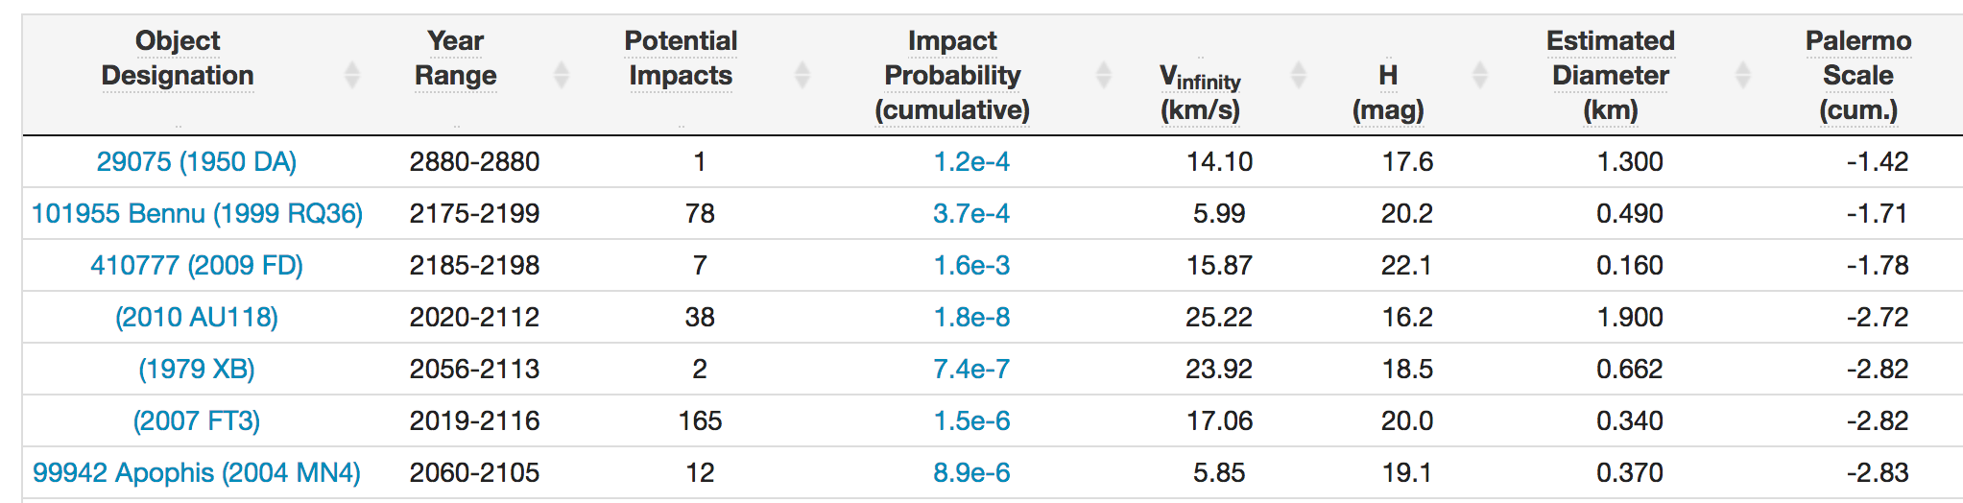
How Sentry Performs Impact Hazard Analysis
Orbit dynamics are inherently non-linear, so sample the
uncertainty at epoch and integrate each case separately
  10,001 samples over +/- 5 sigma with Gaussian distribution
Propagate forward 100 years, recording all close
approaches, with uncertainties; group sequences of close
approaches into “streams”
Interpolate for closest approach of each stream
Compute linearized impact probabilities with P_{ip} > ~10⁻⁷
New this year: Monte Carlo hazard analysis for selected objects

Slide 14
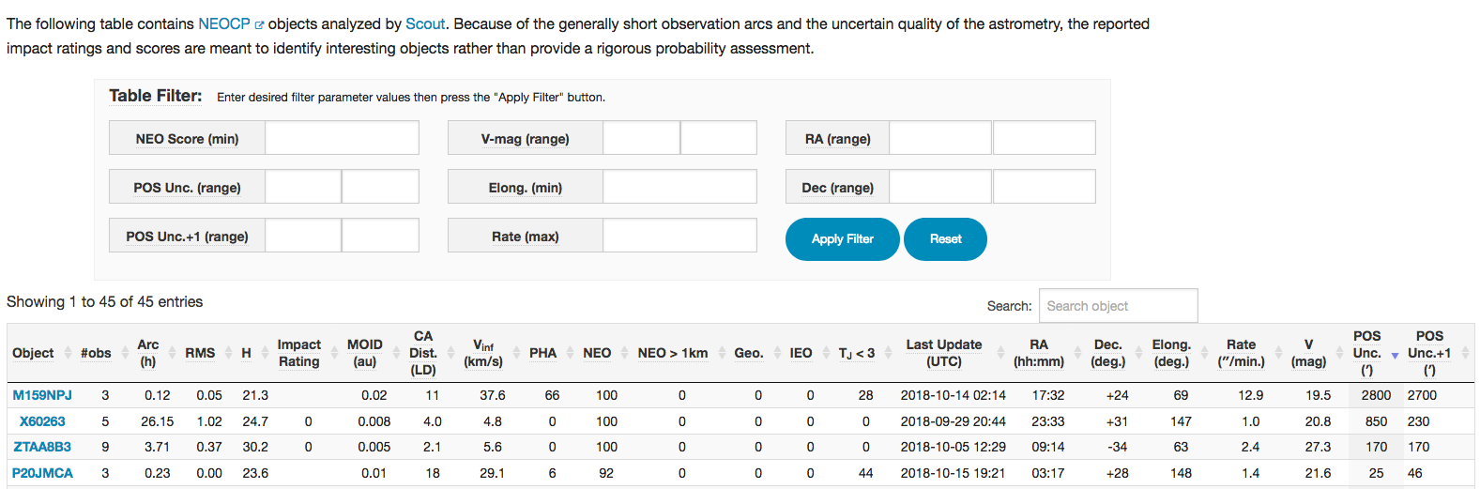
Short-Term Impact Hazard Assessment (Scout)
Automated system to perform initial orbit analyses, including uncertainties and impact hazard analyses, for NEOCP objects
Automated alert messages for extreme close approaches
Objects may not be real, or at least not NEOs
Scout can help identify likely geocentric objects

Slide 15
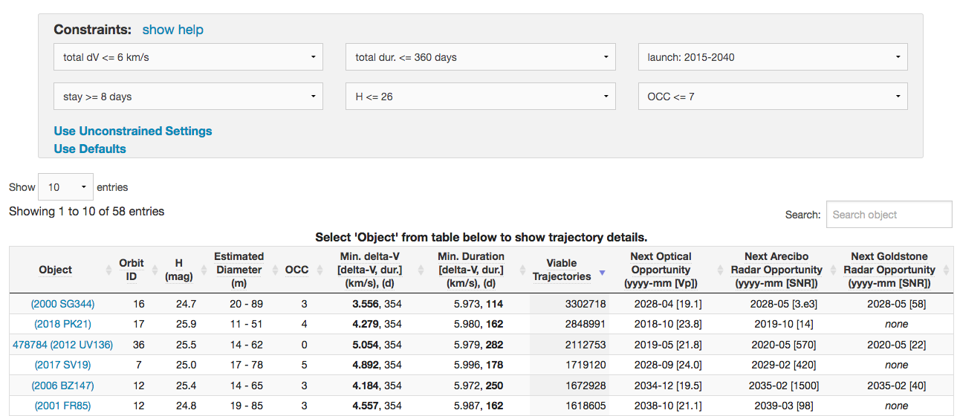
NHATS: Accessible NEAs
NHATS processing has now transitioned from GSFC to JPL/CNEOS
Implement a sliding mission time window instead of fixed?

Slide 16
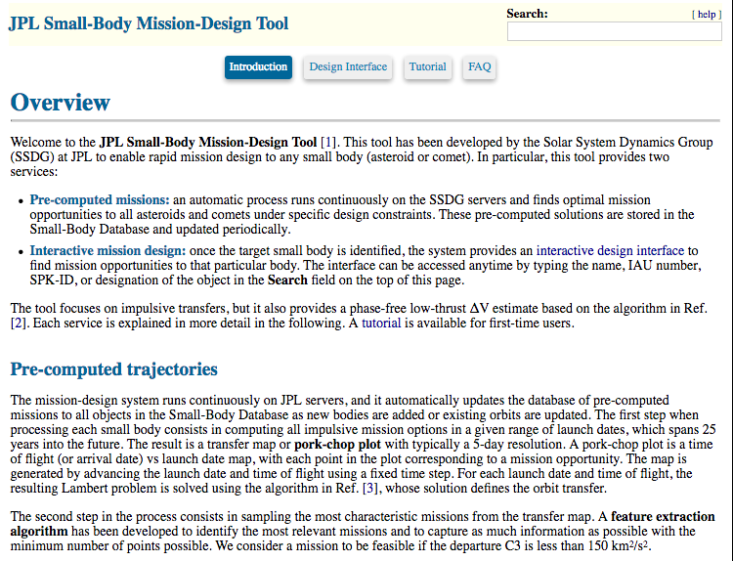
New Small-Body Mission-Design Tool

Slide 17
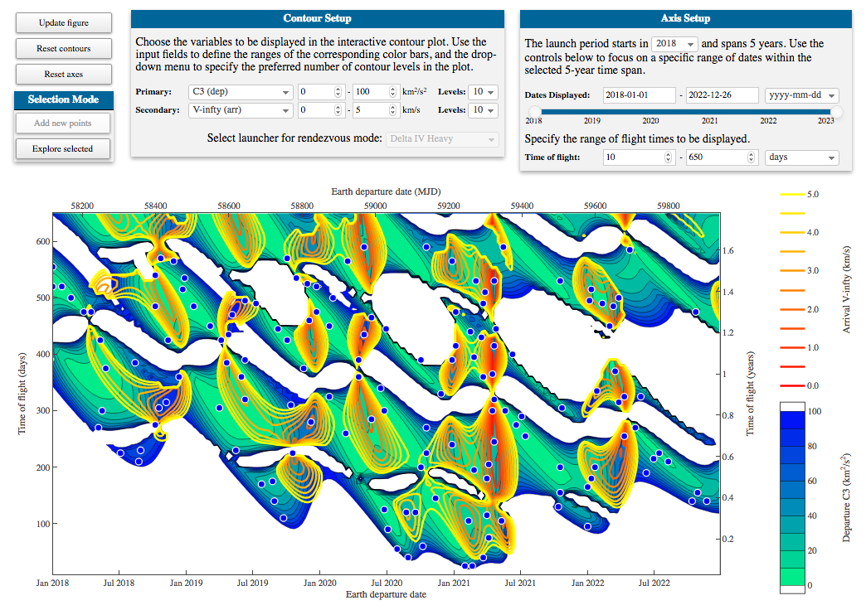
Interactive Interface to Find Mission Opportunities to Any Small Body

Slide 18
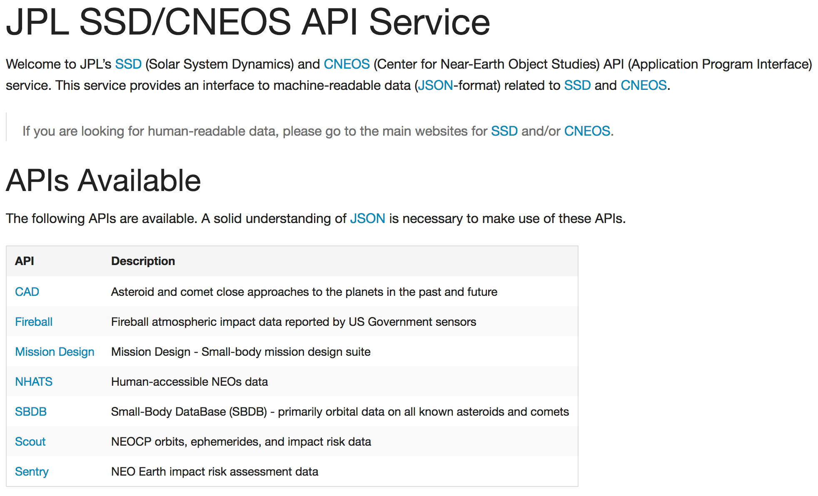
Application Program Interfaces (APIs)

Slide 19
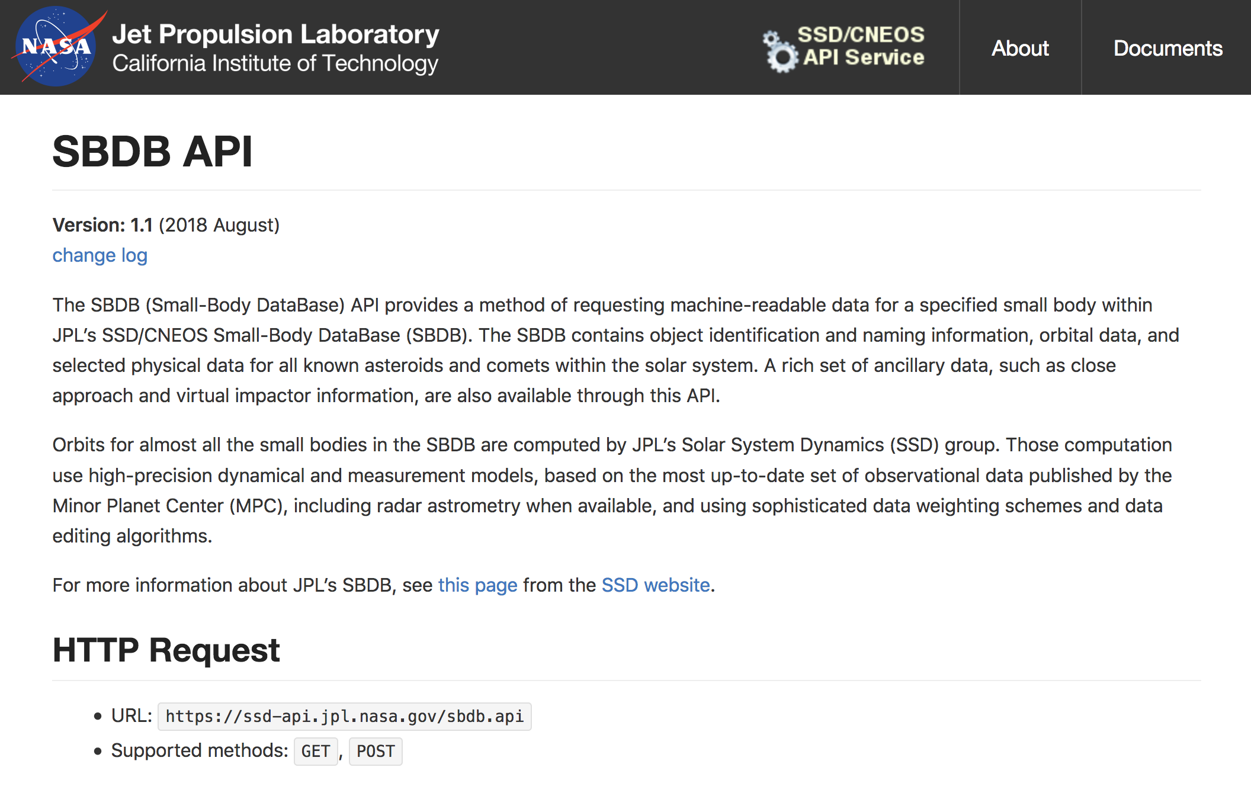
SBDB Orbit-Data API

Slide 20
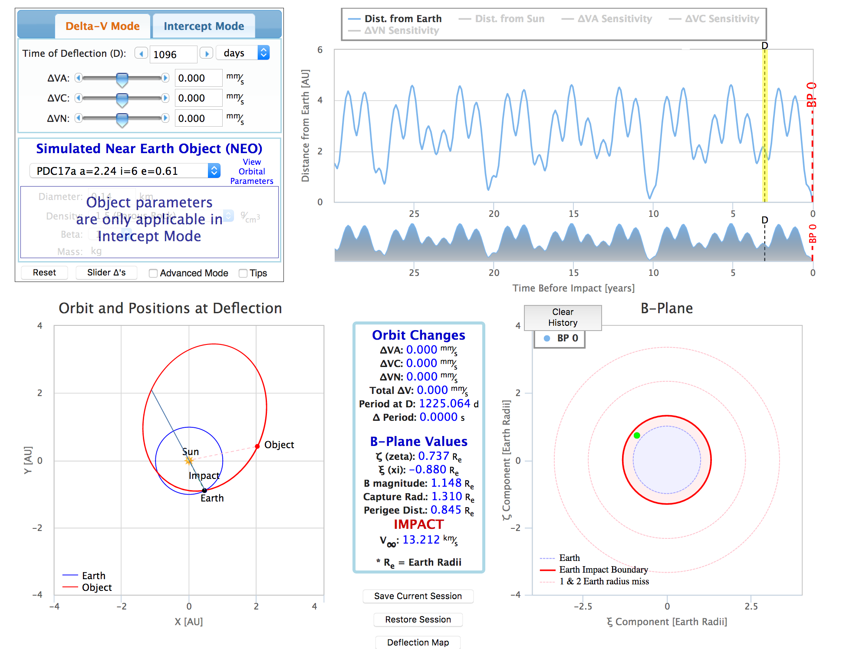
JPL/Aerospace NEO Deflection App (NDA)
https://cneos.jpl.nasa.gov/nda/nda.html
EXERCISE ONLY!!

Slide 21
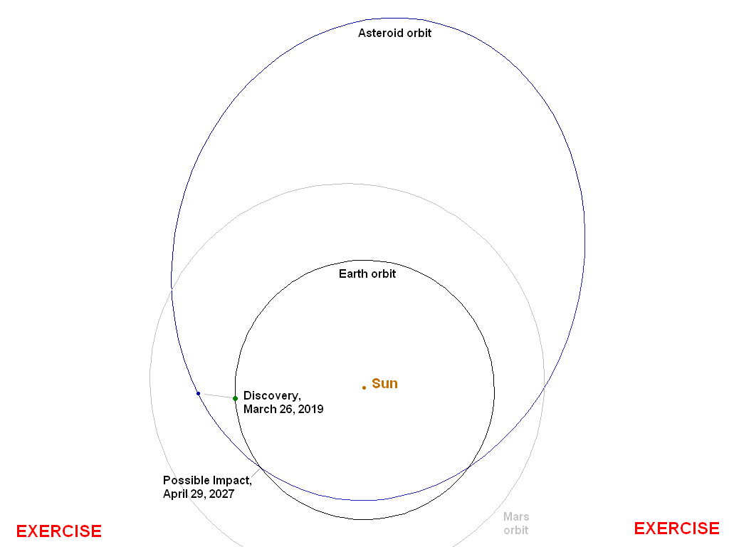
Orbit of Asteroid 2019 PDC
Perihelion: 0.9 au
Aphelion: 2.9 au
Orbit period: 2.66 yr
Inclination: 18 deg
H = 21.7
Size: ~100 – >300 m
Possible impact
occurs 3 orbits
after discovery, on April 29, 2027

Slide 22
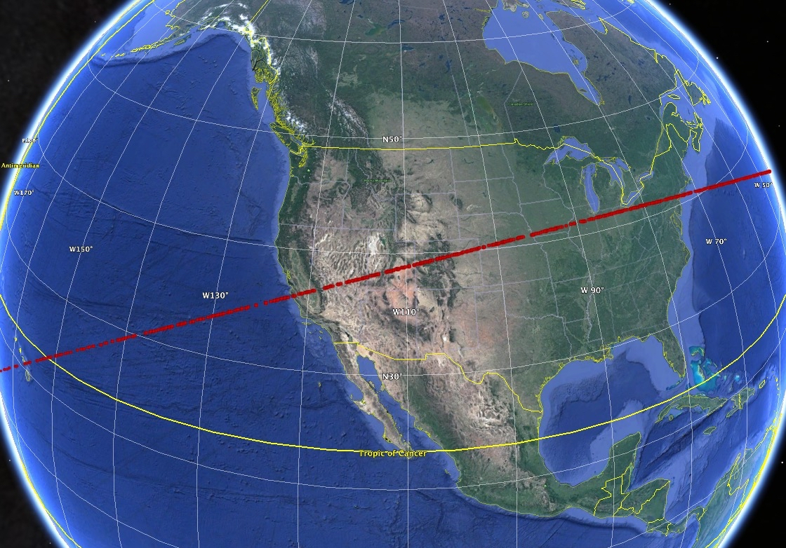
2019 PDC: Risk Corridor
EXERCISE ONLY!!

Slide 23
Future Work
ADES implementation
Observation debiasing improvements w.r.t. Gaia DR2
Continuing development of public survey simulation tools
Enhancements to NEO Deflection App
Support for National NEO Preparedness Strategy and Action Plan working groups

