Slide 1
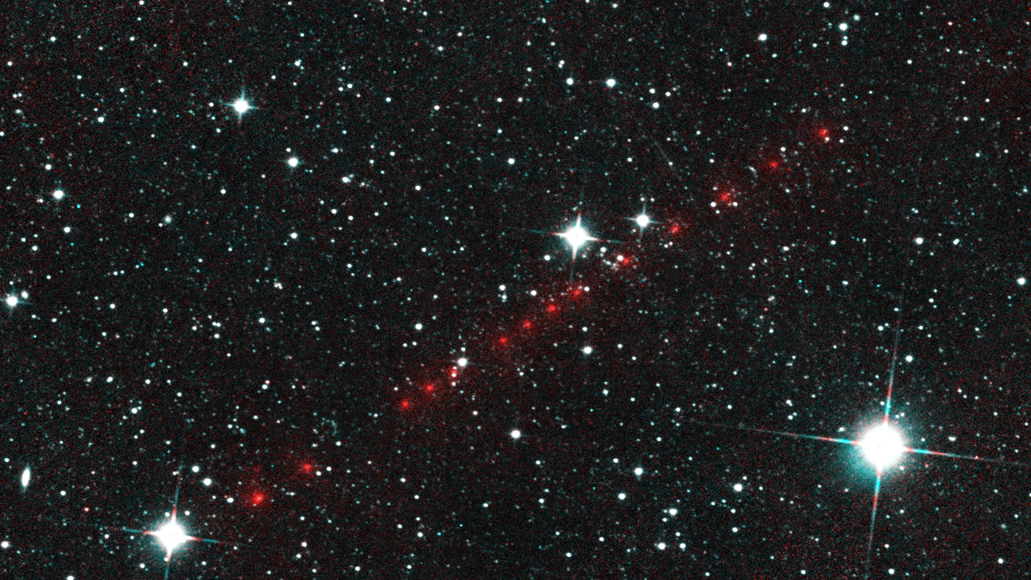
5th International Asteroid Warning Network (IAWN) Meeting
P/2014 L2
Comet NEOWISE
NASA Update
30 January 2018
Vienna, Austria

Slide 2
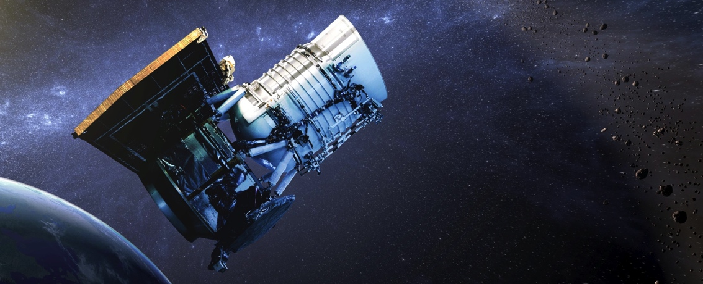
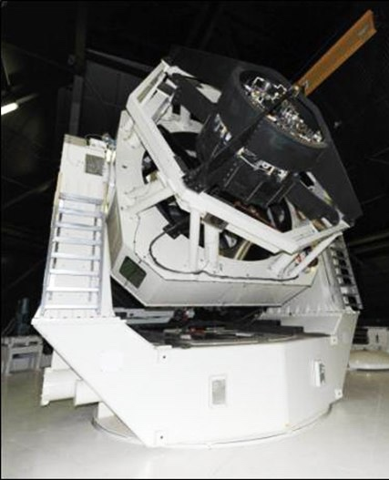
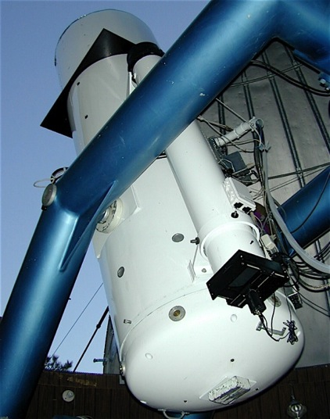
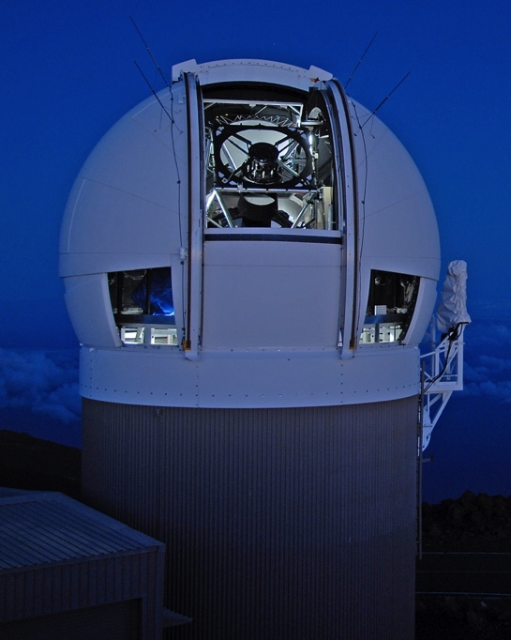
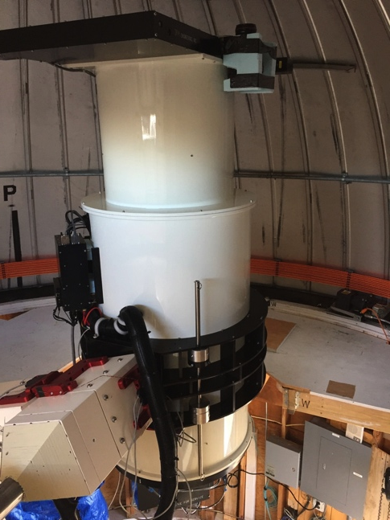
NASA’s NEO Search Program: Surveys
Current Surveys:
NEOWISE
NEOWISE
CSS
Pan-STARRS
ATLAS
LINEAR/SST (being re-assembled in Western Australia)
JPL
Sun-synch LEO
0.4 m
LINEAR/SST
Catalina Sky
Survey
Pan-STARRS
ATLAS
Two 1.8-m telescopes
Haleakalā, Maui
1.5-m
0.7-m
0.5-m Haleakalā Mauna Loa
3.5-m (to Australia)

Slide 3
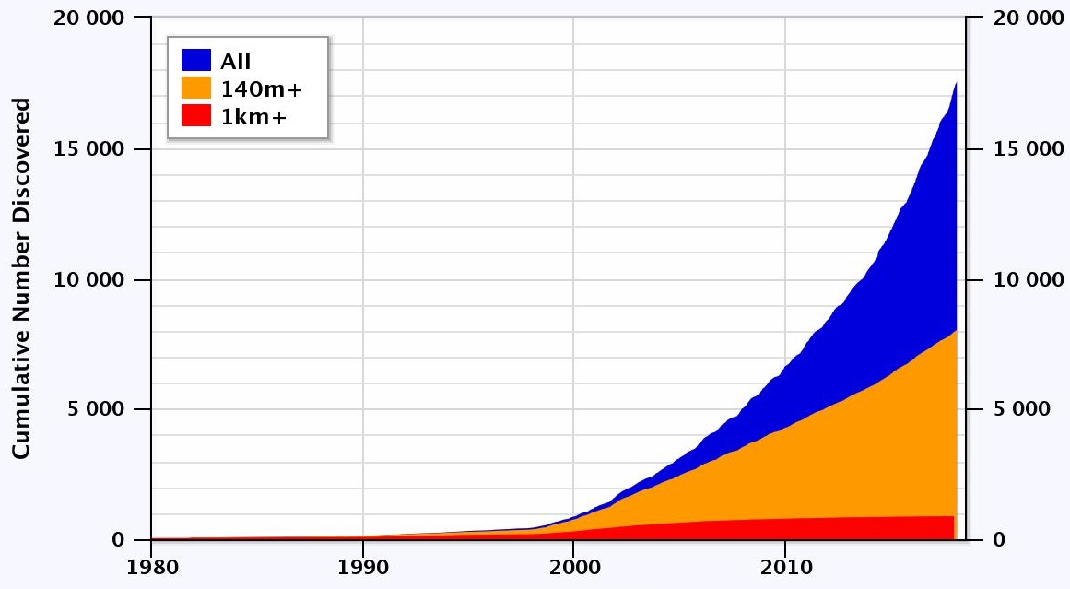
NEAs Discovered (to date)
NEA total:
17,587
PHA:
1,887
(187 > 1 km)
NEC: 106
https://cneos.jpl.nasa.gov/stats Alan Chamberlin JPL/Caltech

Slide 4
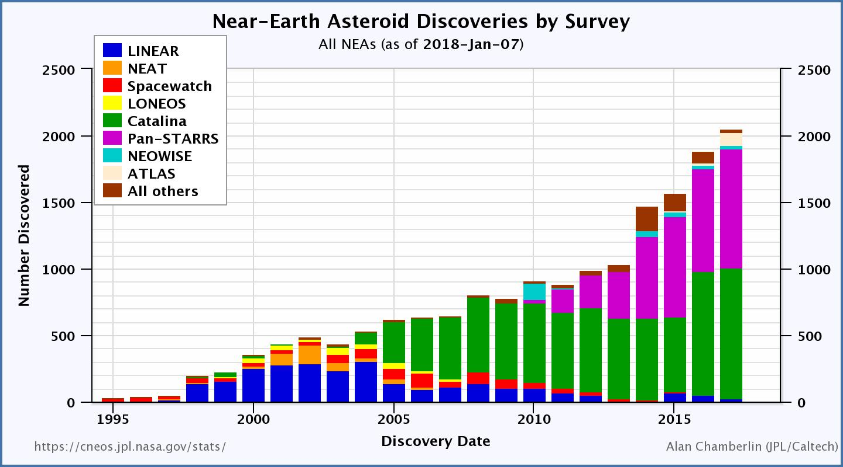
NEAs Discovered by Survey (to date)
2053 discoveries
in 2017

Slide 5
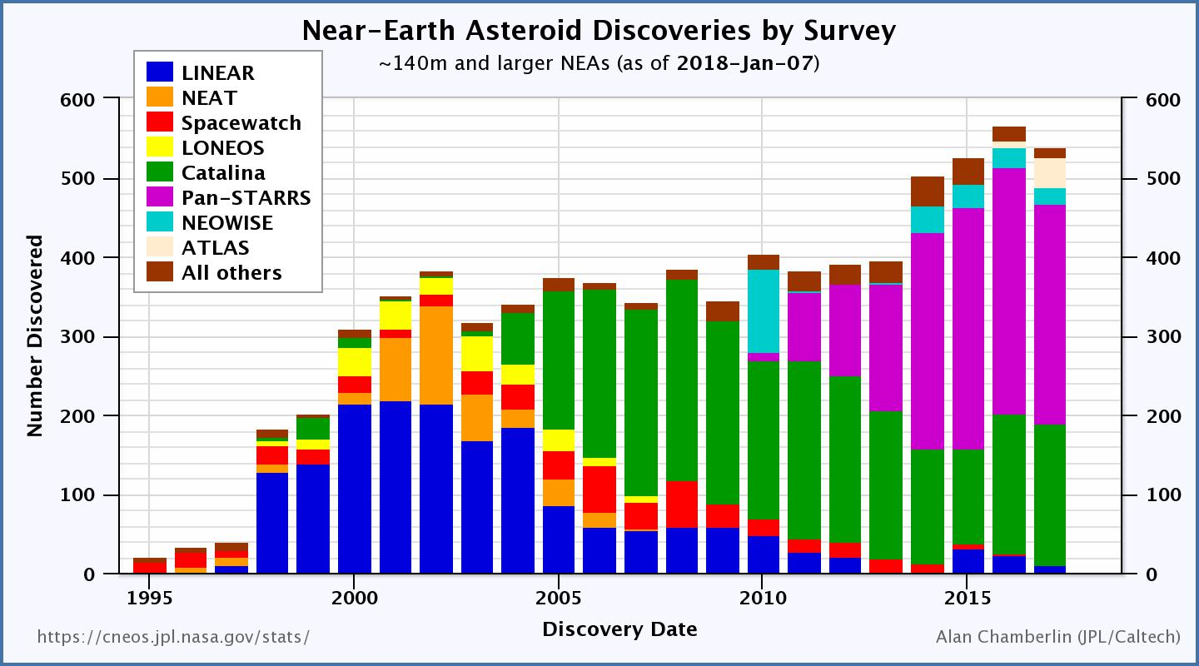
NEAs Discovered by Survey (140 m+)
538 discoveries
in 2017

Slide 6
NEO Population – 140 meters and larger*
*based on an estimated population of ~25,000

Slide 7
Recovery of 2012 TC₄
Goal - Exercise the Planetary Defense system
Recovery and Follow-up: Recovery confirmed early August 2017
Characterization: Light curves, photometry, spectroscopy, radar
Modeling: orbit determination, threat assessment and impact modeling exercises
Communications:
  NASA management, White House, other agencies
  Within the NEO community and with the public
International Asteroid Warning Network (IAWN) participation

Slide 8
Recovery of 2012 TC₄
(Initial Results)
Astronomers from the U.S., Canada, Colombia, Germany, Israel, Italy, Japan, the Netherlands, Russia and South Africa tracked TC4
Close approach occurred at about 43,700 km
Radar observations of 2012 TC₄ seem to indicate an oblong shape of about 6 x 12 meters in size
Light curve and then radar showed it tumbling with about a 12 minute period
Precision orbit determination was able to rule out any impact by TC4 for the foreseeable future
More information: http://2012tc4.astro.umd.edu/

Slide 9
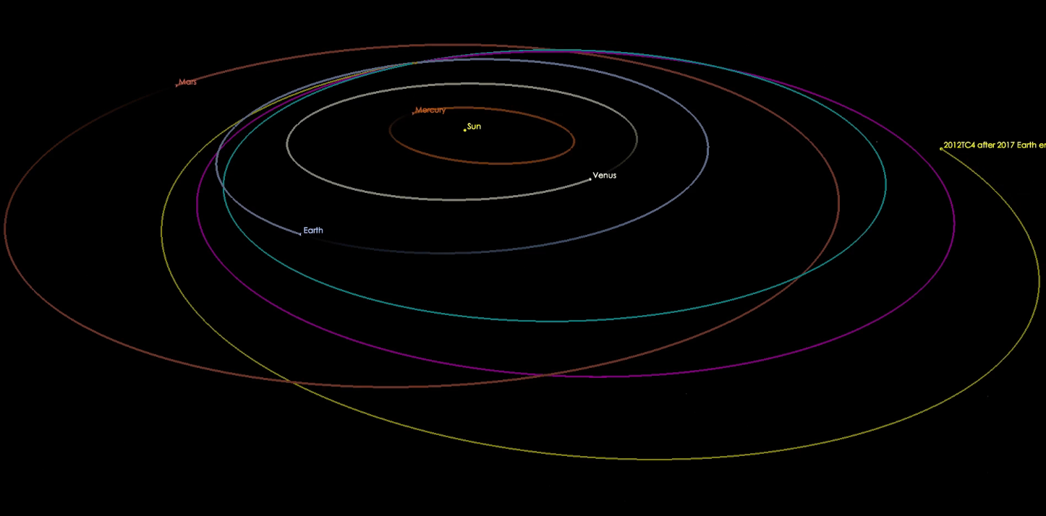
prior to 2012
Earth encounter
post-2012
flyby
post-2017
flyby

Slide 10
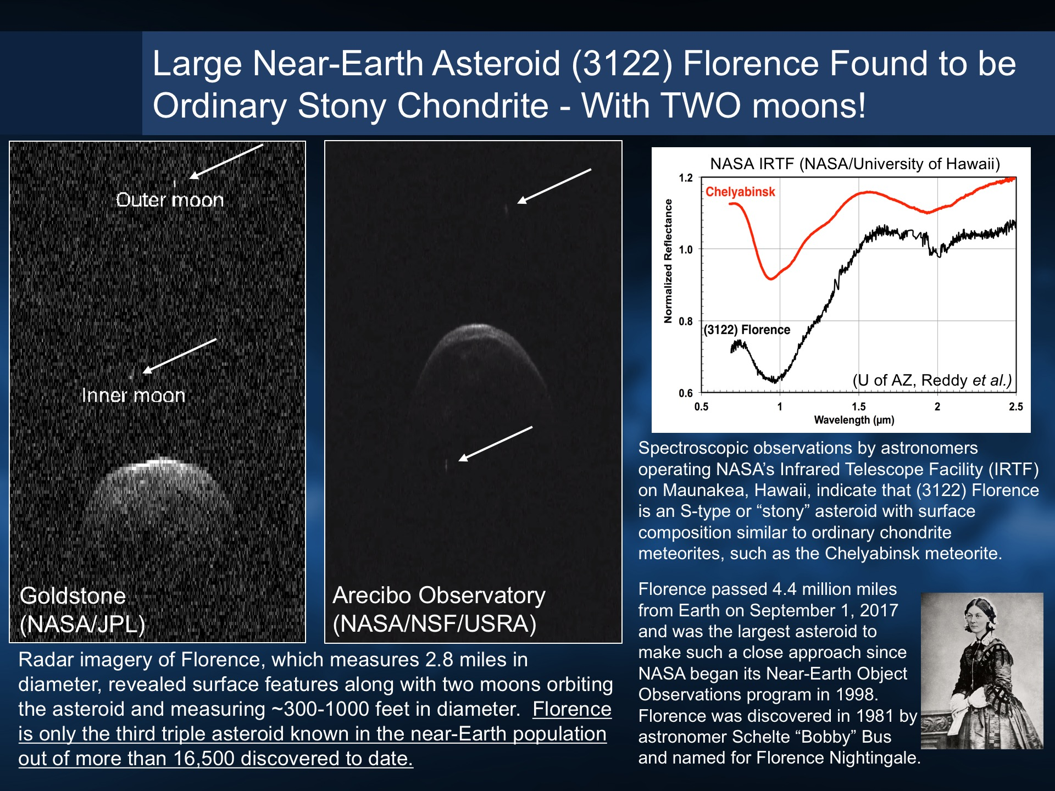
Science
Nuggets
Discovered by Bobby Bus in 1981 (1981 ET₃)
ranks 4th in size of large PHOs
Came within 0.047 AU of Earth on 1 Sept 2017
3rd NEO found to be a ternary system

Slide 11
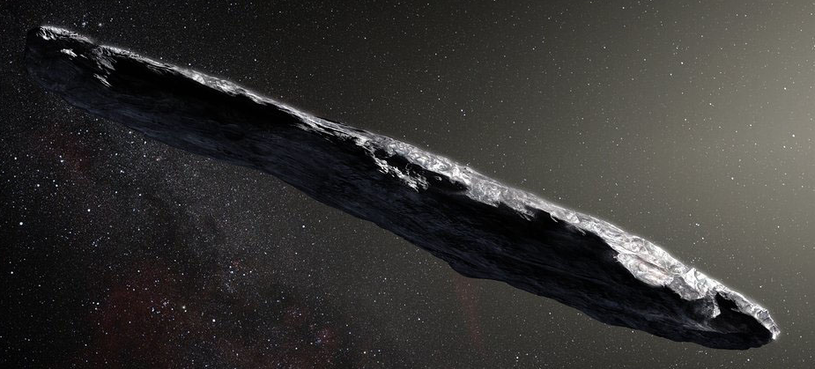
Discovery of First Interstellar Object
1I/2017 U1 (‘Oumuamua)
Discovered on 19 October 2017, by the Pan-STARRS1 telescope during near-Earth object survey operations
Speed and trajectory indicate it originated outside of and is not bound to our solar system
Object is asteroidal in nature (no coma observed)
Object is highly elongated, with an axis ratio >3:1 perhaps 10:1
(real image)
Observations suggest a surface reddened due to irradiation by cosmic rays over its history
(artist’s concept)

Slide 12
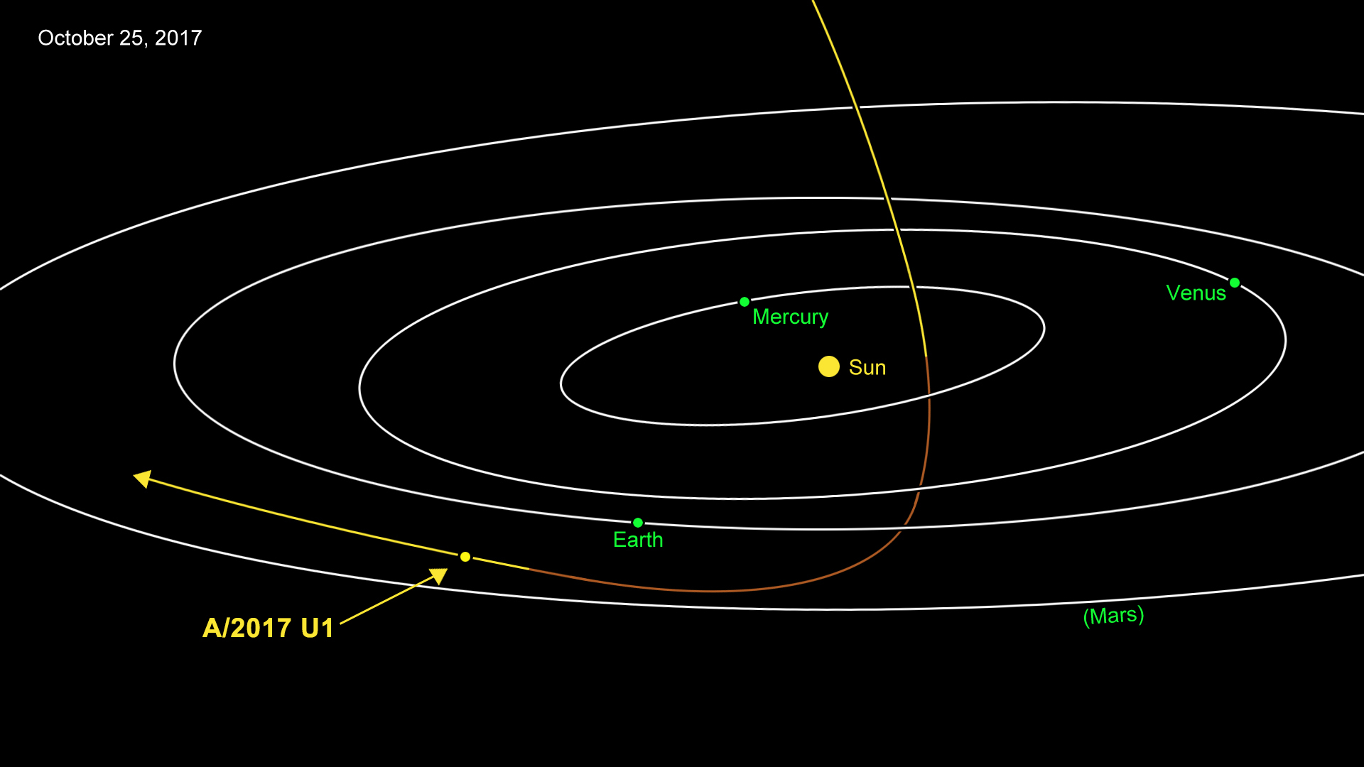

Slide 13
Sentry object of interest - 2017 YZ₁
Discovered by the Catalina Sky Survey (G96, Mt. Lemmon) on 20 December 2017
43 observations over two weeks
Diameter 250 meters
Impact probability < 1/20,000 on 20 June 2047
1 (Green) on the Torino scale due to size, and was re-assigned to 0 with further observations on 18 January 2018.

Slide 14
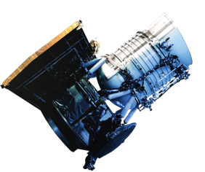
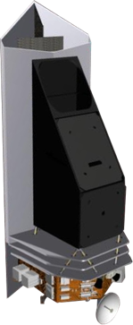
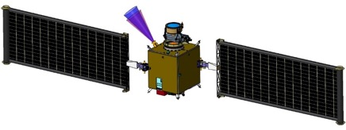
PDCO Flight Mission Projects
NEOWISE
Continues in extended NEO survey operations
NEOCam: Near-Earth Object Camera
Infrared survey telescope optimized for meeting congressional mandate to find and characterize NEOs down to 140 meters in size
Continues in extended Phase A
DART: Double Asteroid Redirection Test
Demonstration of kinetic impactor technique
Target - Moon of 65803 Didymos
Launch 2020, impact 2022
Continues in Phase B

Slide 15
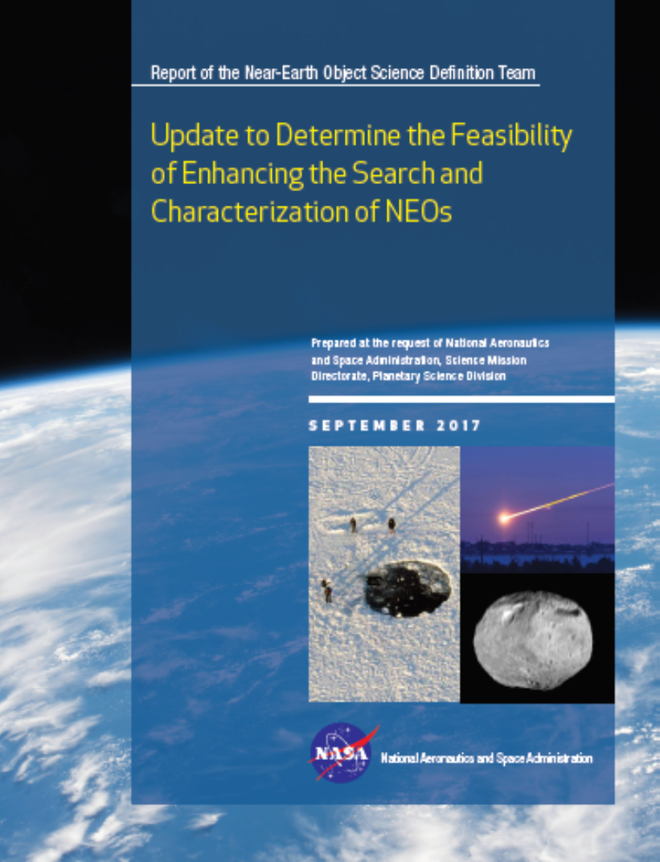
NEO Survey Science Definition Team Report*
Findings
Finding 1. Future goals related to searching for potential Earth‐impacting objects are best stated explicitly in terms of the statistical risk characterized and should be firmly based on cost/benefit analyses. Such a search would best be executed in a way that eliminates the maximum amount of statistical risk uncertainty per dollar of investment.
Finding 2. It would be most productive to develop and operate a NEO search program with the goal of discovering and cataloging the potentially hazardous population sufficiently well to eliminate 90% of the uncharacterized risk from sub‐kilometer objects (i.e., sub‐global impact effects). Over a period of 9 to 25 years, a number of system approaches are capable of meeting this search metric with quite good cost/benefit ratios.
Finding 3. The satisfaction of the 140‐meter cataloging objective will require space‐based search system(s). Infrared (IR) and visible sensors in the 0.5‐ to 1.0‐meter aperture range are credible and cost/benefit‐favorable options that use available technology.
*https://www.nasa.gov/sites/default/files/atoms/files/2017_neo_sdt_final_e-version.pdf

Slide 16
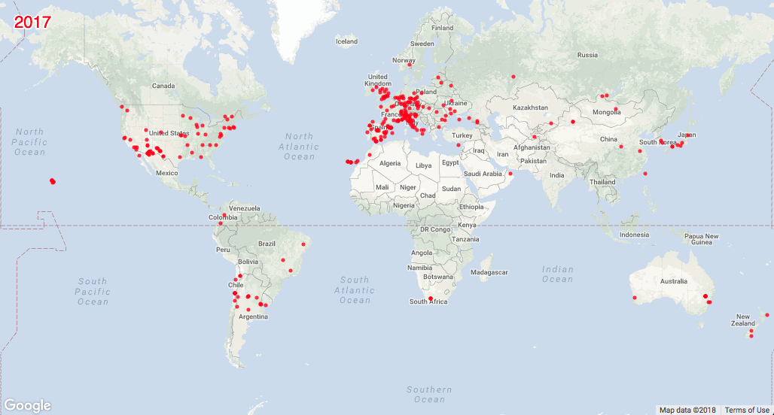
Observations Worldwide
(as tallied by the MPC)
22 million observations world wide
(of which 201,000 of NEOs)
47 countries + 1 observatory in space

