Slide 1
Introduction
UN-SPIDER: Technical Advisory Missions, Global Network, Future Cooperation
Shirish Ravan
United Nations Office for Outer Space Affairs
United Nations Offices at Vienna
www.unoosa.org

Slide 2
UN-SPIDER and IAWN: Connection
 | Risks emerging from earth environment | Risks emerging from space to earth and space based systems
Global framework | Sendai framework for disaster risk reduction 2015-2030 | …
Agencies providing strategic support | Disaster management authorities (well established) | Space community in cooperation with disaster management authorities (to be established)
Early warning | Technical agencies (such as meteorology, geology, hydrology) along with disaster management authorities (well established in most countries) | Specialised space community such as space agencies/ institutions/ universities (missing in the countries that not yet space faring nations)
Response agencies | Civil protection agencies Dedicated ministers for disaster management in some countries | Awareness needs to be generated
Early warning networks | Global Disaster Alert and Coordination System (GDACS), Pacific Disaster Centre, networks at regional and national level | IAWN, SMPAG, …. (regional/national level ???)
Emergency response mechanisms | International Charter Copernicus emergency management service Sentinel Asia, UN-SPIDER, UNOSAT | …
Knowledge management | Several existing portals using UN-SPIDER knowledge portal | …

Slide 3
UN-SPIDER @ UNOOSA

Slide 4
Background
United Nations Office for Outer Space Affairs (UNOOSA) - established in 1962
UNISPACE Conferences - 3 (1968, 1982, 1999)
UNISPACE-3 in 1999 lead to the Creation of the International Charter on Space and Major Disasters (voluntary) and initiated discussions for establishing the UN-SPIDER programme in the framework of the UN General Assembly
In 2006, all 193 UN Member States mandated OOSA to establish and implement UN-SPIDER
UNISPACE+50 : Opportunity to launch similar programme for IAWN

Slide 5
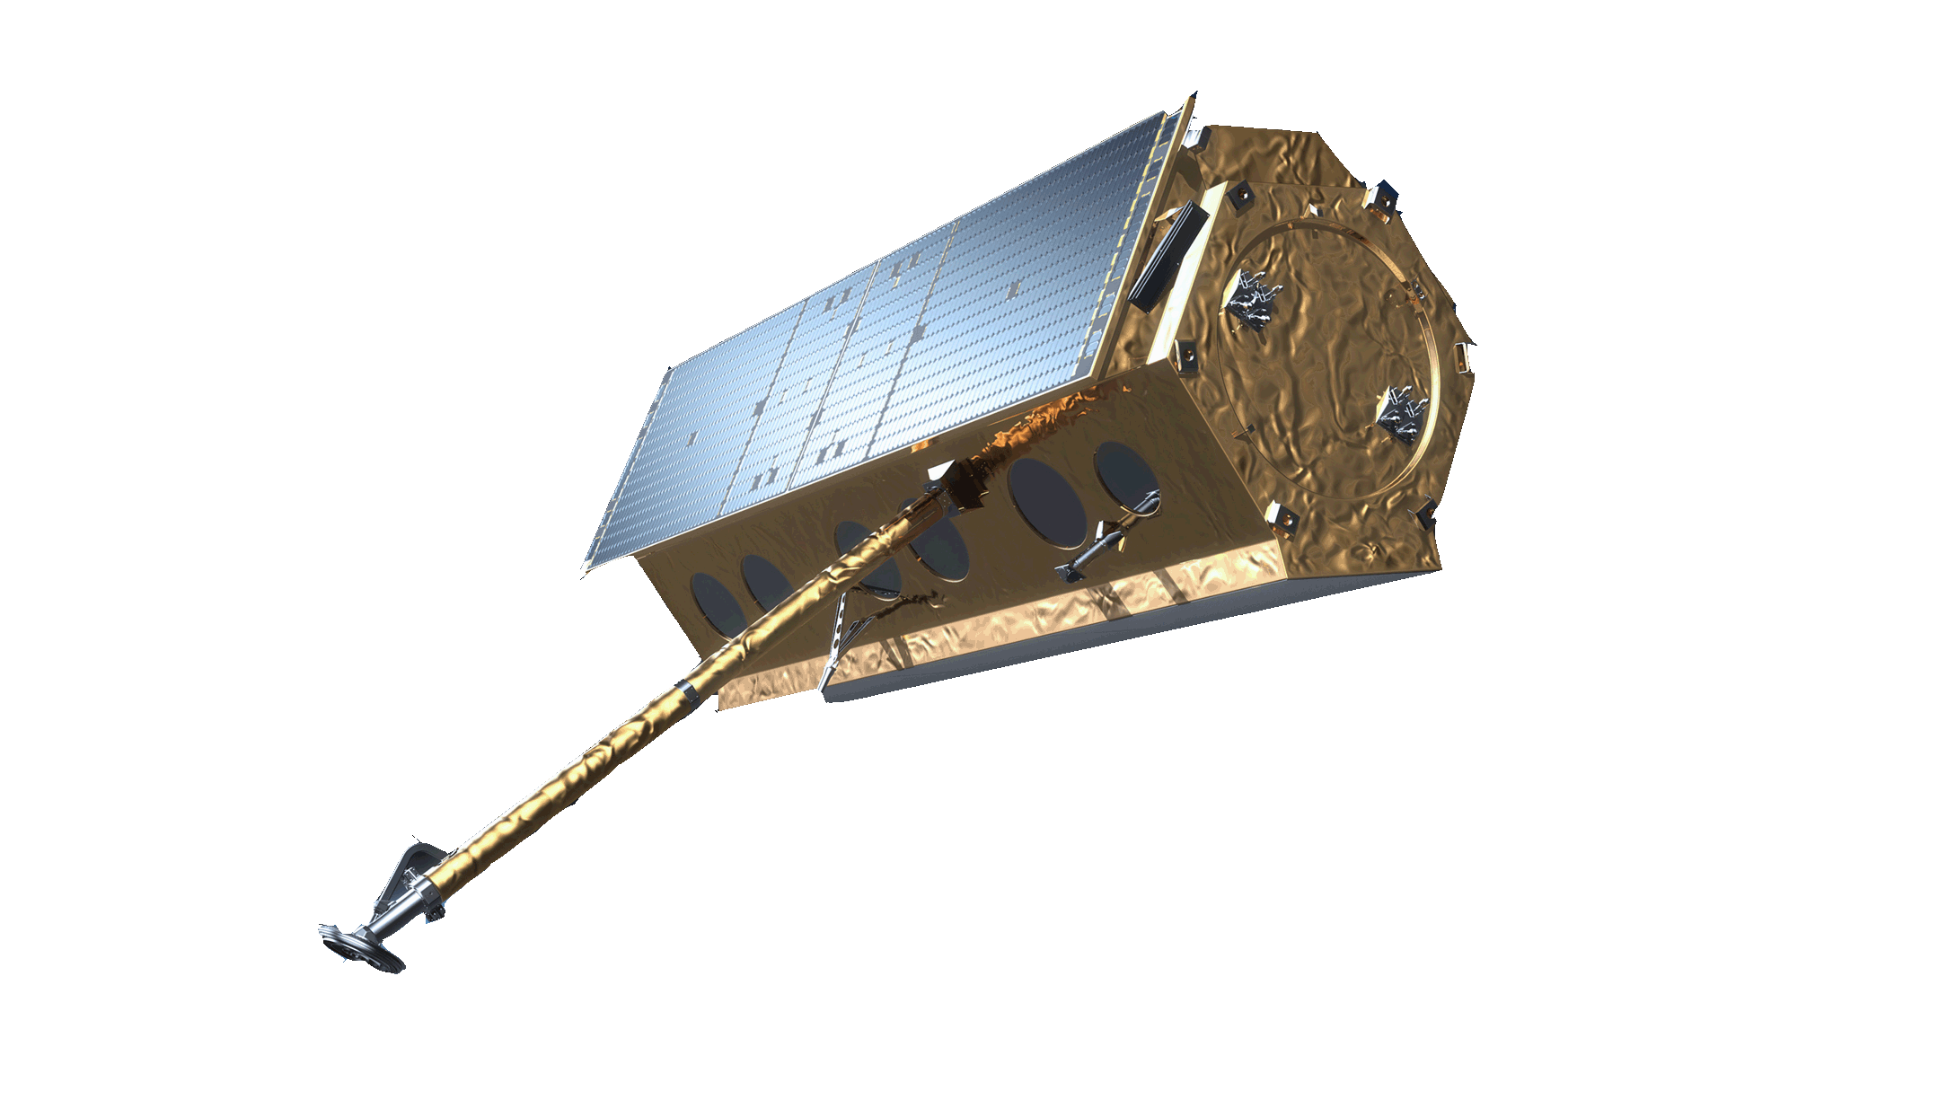
Mission statement
“Ensure that all countries have access to and develop the capacity to use all types of space-based information
to support the full disaster management cycle.”

Slide 6
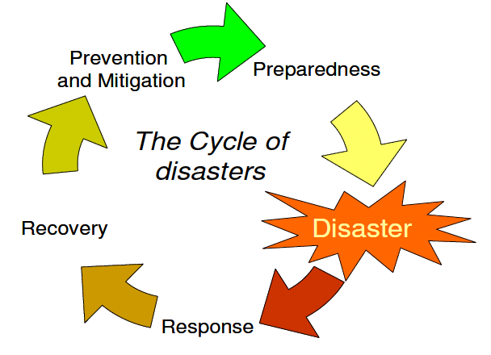
... to support the full disaster management cycle
Geoinformation for
Hazard, exposure, vulnerability, and risk assessment
Geoinformation for
Early Warning systems
Disaster management cycle
Geoinformation for
Post Disaster Needs Assessment (PDNA)/ Damage and Loss Assessment (DaLA)
Geoinformation for
Rapid mapping: Extent and impact

Slide 7
UN-SPIDER
Knowledge Portal
The UN-SPIDER Knowledge Portal is a web-based tool for information, communication and process support
Fostering Cooperation
UN-SPIDER fosters alliances and creates forums where both space and disaster management communities can meet
Capacity Building
UN-SPIDER facilitates capacity building and institutional strengthening, including the development of curricula and an e-learning platform (e-SPIDER)
Technical Advisory Support
UN-SPIDER provides support to countries in assessing national capacity and in evaluating disaster and risk reduction activities, policies and plans
and many more…

Slide 8
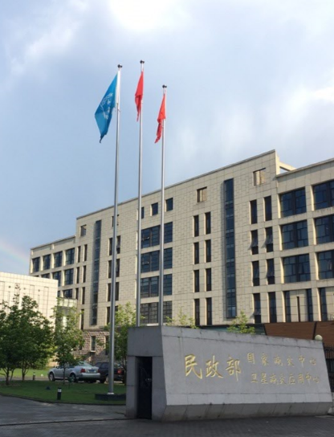
UN-SPIDER Offices
Vienna
Bonn
Beijing

Slide 9
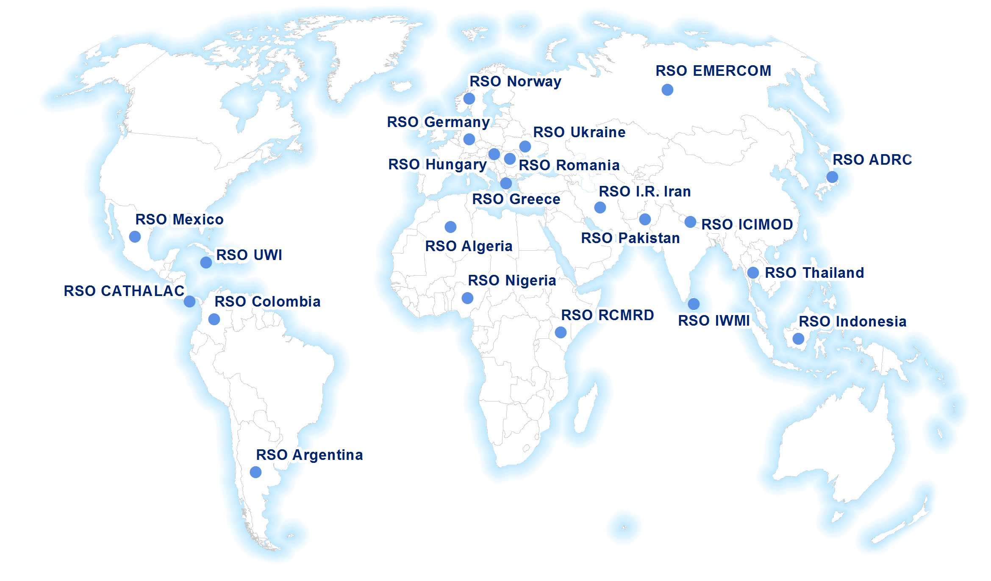
Network of Regional Support Offices

Slide 10
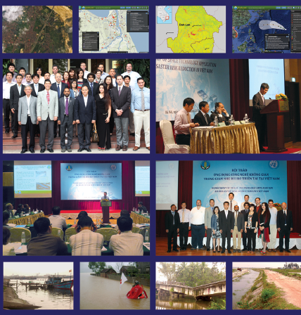
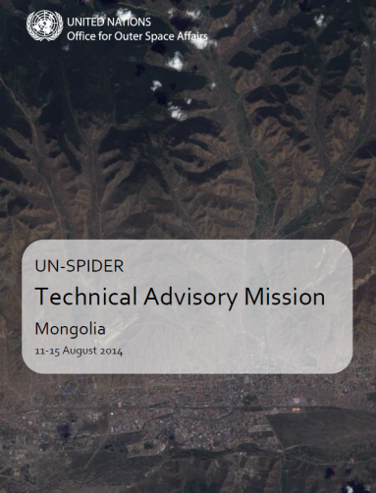
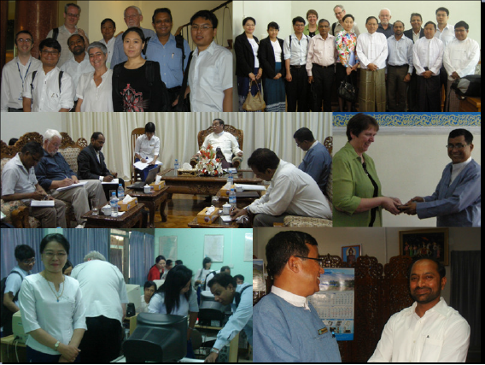
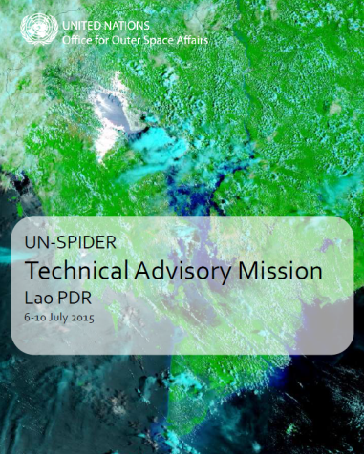
Technical Advisory Support
Over 55 countries supported
34 national Technical Advisory Missions
Over 350 recommendations

Slide 11
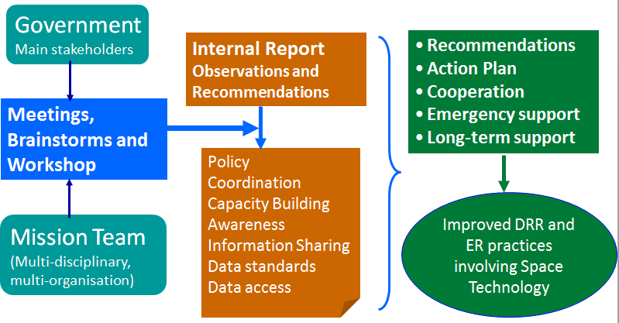
Technical Advisory Missions

Slide 12
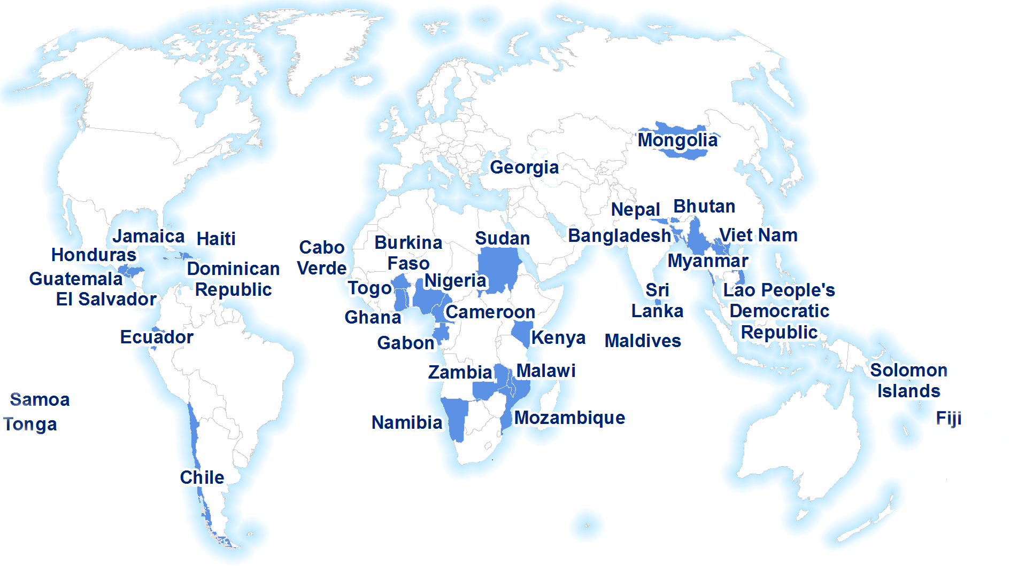
Technical Advisory Missions (2008 - 2017)

Slide 13
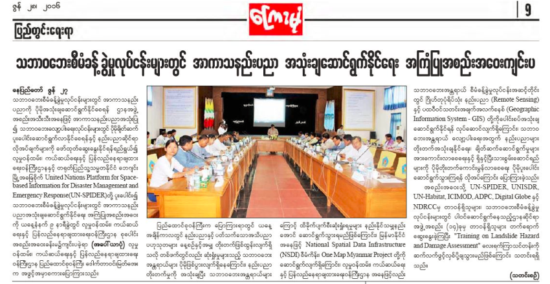
Myanmar
2012 – UN-SPIDER Technical Advisory Mission
Key recommendation: Establishment of "Hazard Response and Operations Centre"
Follow up programmes jointly with Government, UNDP, OCHA and HABITAT
Impact:
Emergency Operation Centre (EOC) established with "Remote Sensing Unit";
Trained personnel in remote sensing/GIS are available at EOC;
Disaster Management Training Centre conducts courses in remote sensing/GIS
NSDI and one map policy under consideration
Over 100 personnel trained
RRD became Authorised User of the International Charter

Slide 14
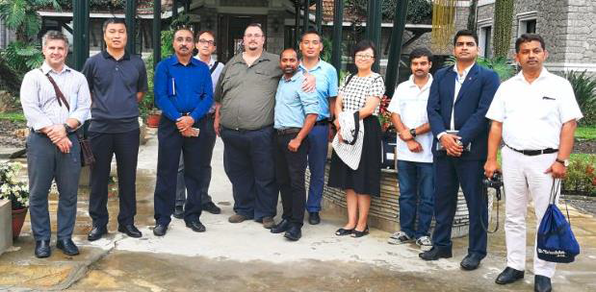
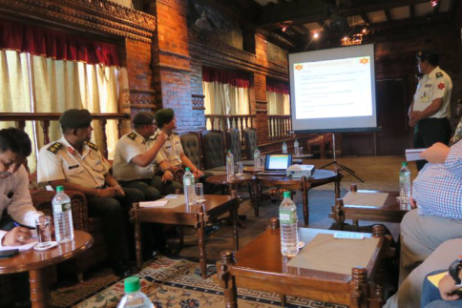
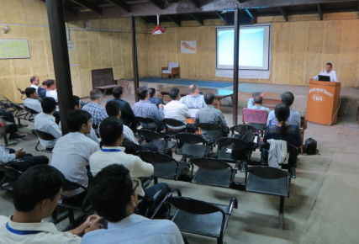
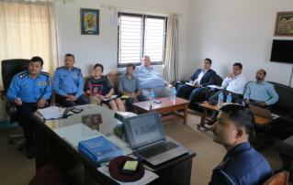
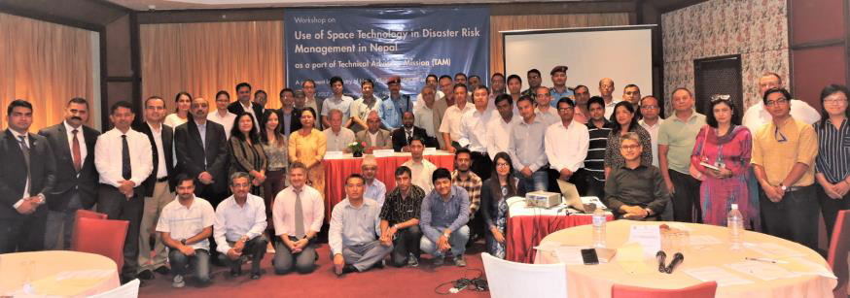
UN-SPIDER Technical Advisory Mission, Nepal
National Emergency Operations Centre (NEOC), Ministry of Home Affairs
Armed Police Force (APF), Ministry of Home Affairs
Survey Department, Ministry of Land Reform and Management (MoLRM)
Department of Water Induced Disaster Management (DWIDM), Ministry of Irrigation
Nepalese Army, Ministry of Defence
Nepal Police, Ministry of Home Affairs
Department of Hydrology and Meteorology (DHM), Ministry of Environment
Department of Geology and Mines (DGM), Ministry of Industry
Kathmandu Living Labs (KLL)
Nepal Red Cross Society (NRCS)
International Centre for Integrated Mountain Development (ICIMOD)
Nepal GIS Society
31 July to 4 August, 2017

Slide 15
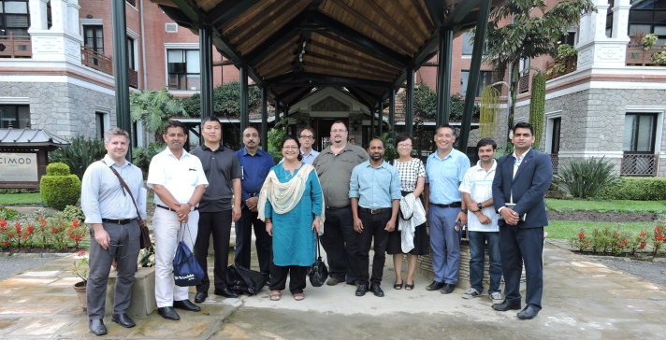
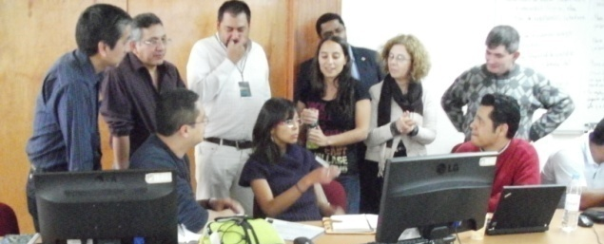
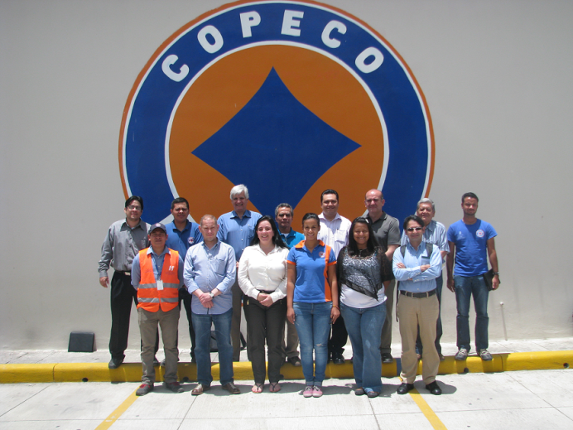
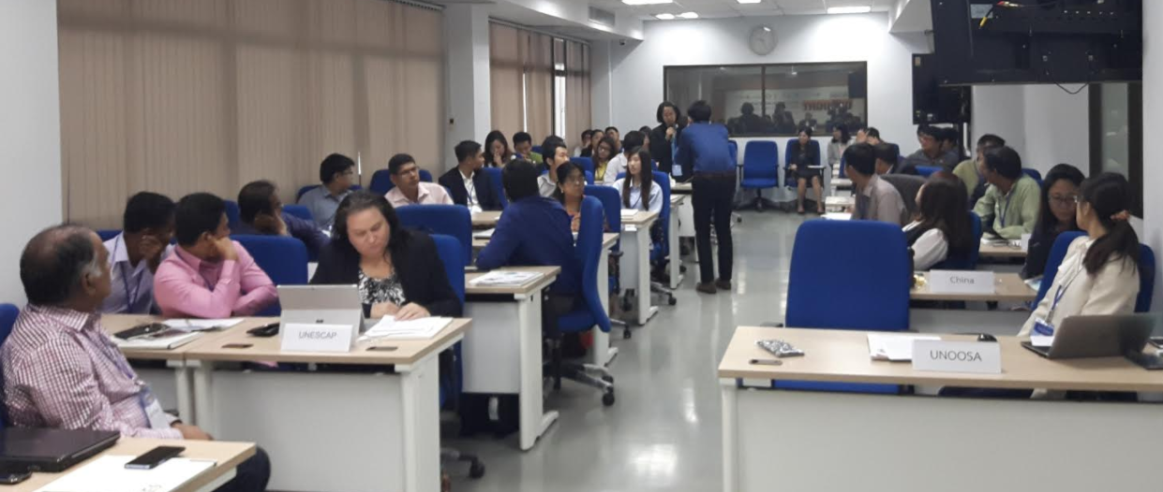
UN-SPIDER capacity building efforts
UN-SPIDER
Technical Advisory Missions
Follow up actions
(Capacity Building):
Institutional Strengthening
Technical Training Workshops
Mexico
Nepal
Honduras
Thailand (Regional)

Slide 16
Knowledge Portal
Space Application Guides including scientific papers, best practices and experience reports
News and Events from the space and the disaster/risk management community
Guides on Technologies, institutions and organizational mechanisms
Notes:
Mention Scientific partnerships/mentorships

Slide 17
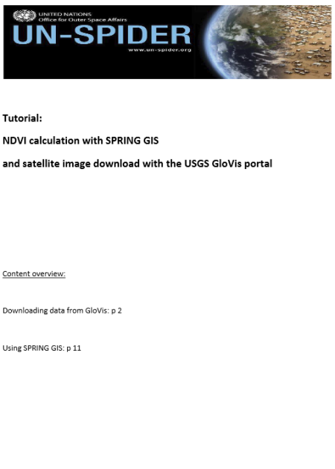
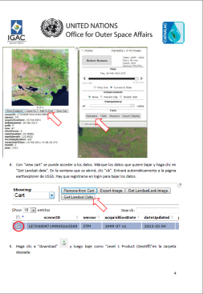
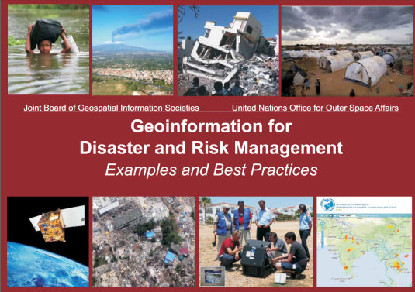
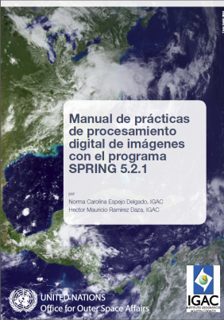
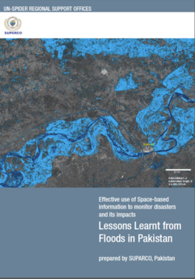
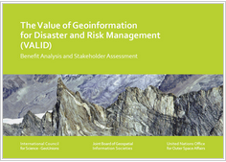
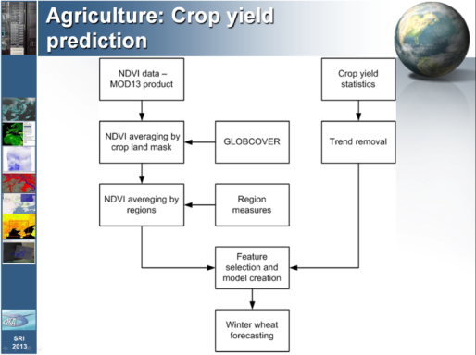
Knowledge Generation
Training material, tutorials
Publications
Recommended
practices
Lessons learned

Slide 18
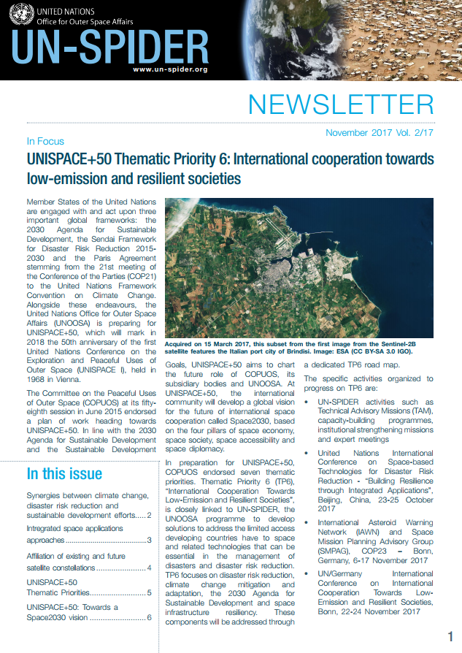
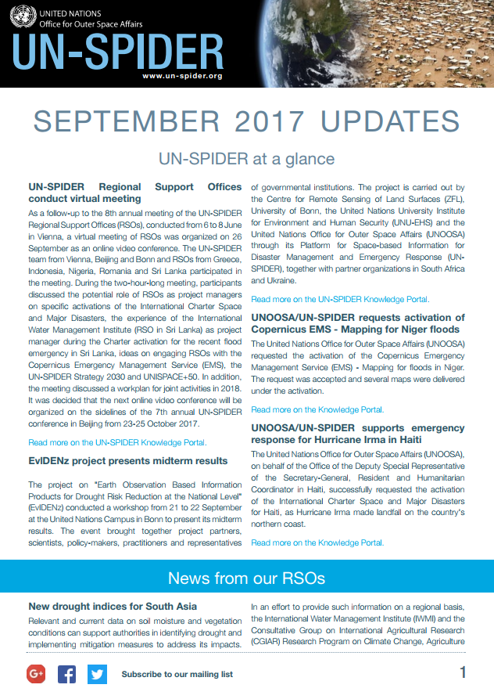

Slide 20
Recommended practice: step-by-step procedures

Slide 21
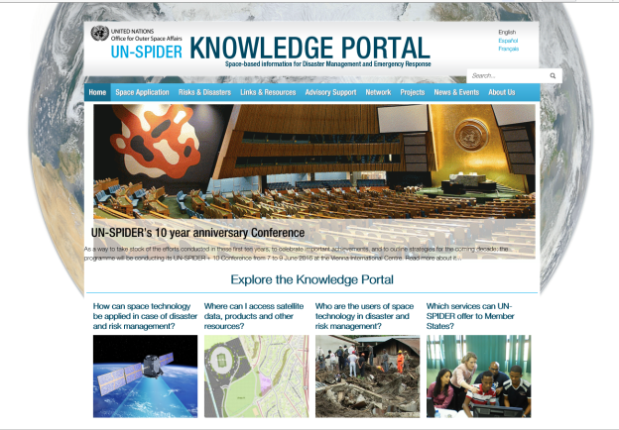
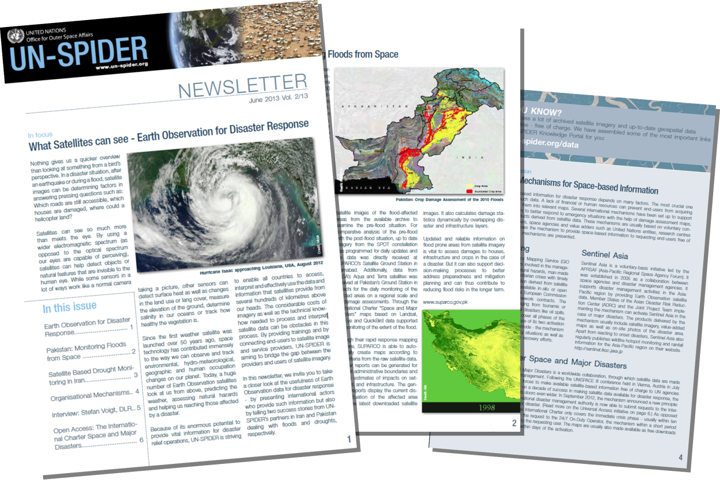
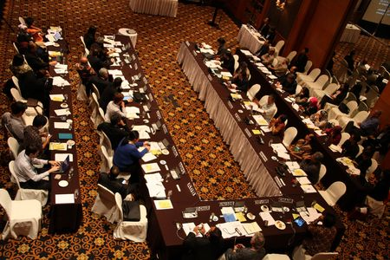
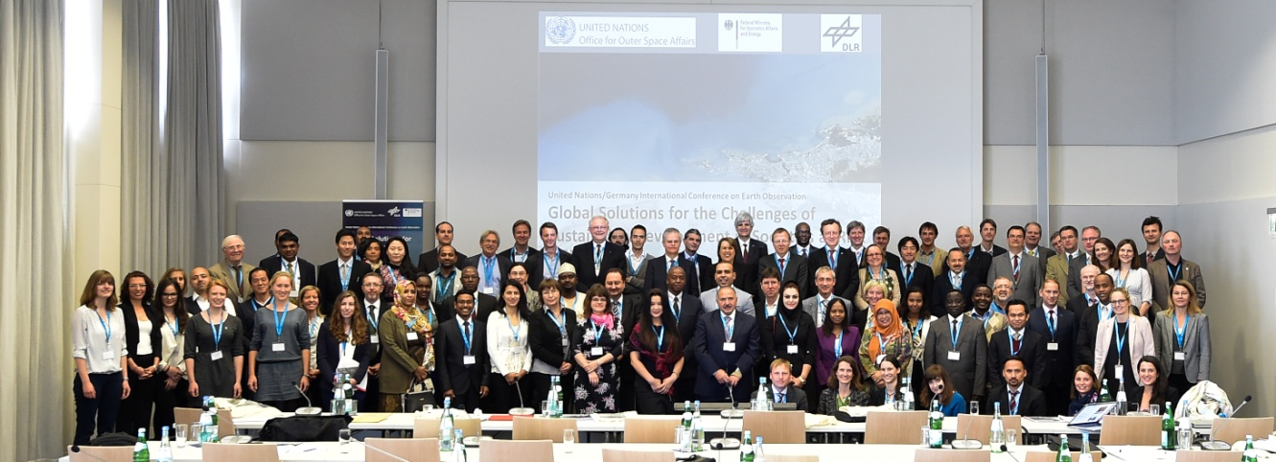
Outreach & Awareness Raising efforts
Outreach & Awareness
UN-SPIDER Knowledge Portal
Newsletters, Monthly Updates and other publications
Social media
International Conferences, Regional Expert Meetings
Participation in events organised by partners

Slide 22
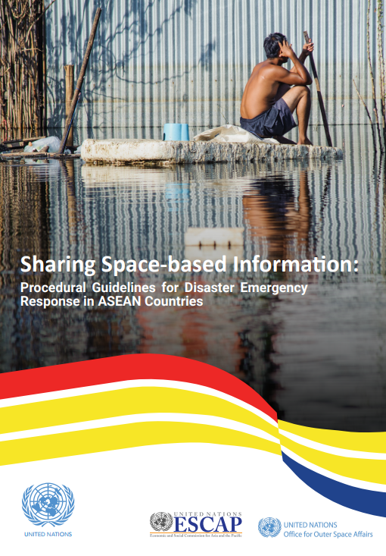
Emergency response mapping support
Emergency response
International Charter Space and Major Disasters

Slide 23
Sendai framework for DRR (2015 – 2030)
Priorities for Action:
Understanding disaster risk;
Strengthening [governance / institutional arrangements / organizational, legal and policy frameworks] to manage disaster risk;
Investing in disaster risk reduction for resilience;
Enhancing disaster preparedness for effective response, and to Build Back Better in recovery, rehabilitation and reconstruction.
Support from space technologies

Slide 24
Global partnership – Space Technology Applications for Risk Reduction (GP-STAR)

Slide 25
International Network on Multi-Hazard Early Warning Systems (IN-MHEWS): A Voluntary commitment
To identify effective strategies and actions to promote and strengthen MHEWS in support of the implementation of the Sendai Framework;
To facilitate the sharing of good practice and making available to governments and key stakeholders expertise and policy-relevant guidance to enhance and sustain MHEWS and related services;
To promote synergies and partnerships between and among stakeholders at national, regional and international levels and those in charge of MHEWS at the national and local levels;
To advocate the usefulness of MHEWS in regional and international platforms and among key stakeholders.

Slide 26
International Network on Multi-Hazard Early Warning Systems (IN-MHEWS)

Slide 27
Agreements with VHR Imagery Providers (free data for disasters, emergencies, full cycle - facilities in other applications)
MoU with DigitalGlobe – completed
MoU with China National Space Agency (5-7 sensors, 30m LC data) – completed
MoU with UAE Space Agency (DubaiSat) – in preparation
MoU with Kazakhstan (KazSat) – in preparation
MoU with Israel Space Agency (EROS) – in preparation
MoU with Italian Space Agency (Cosmo-Skymed) – in preparation
MoU with Planet (and Terra Bella) – under discussion
MoU with Airbus – under discussion
MoU with BlackSky – under discussion
Informal arrangements also with Thailand, Venezuela, India and others on free access

Slide 28
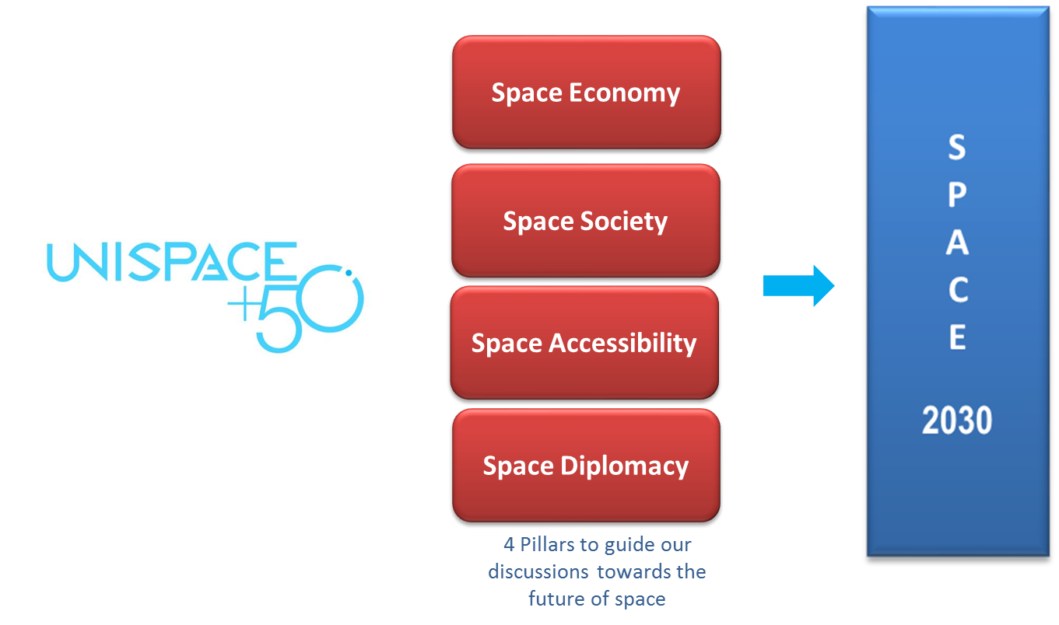
UNISPACE+50: The Process and beyond
UN-SPIDER
Resiliency of space based systems (IAWN and SMPAG)

Slide 29
UN-SPIDER and IAWN: Connection
 | Risks emerging from earth environment | Risks emerging from space to earth and space based systems
Global framework | Sendai framework for disaster risk reduction 2015-2030 | …
Agencies providing strategic support | Disaster management authorities (well established) | Space community in cooperation with disaster management authorities (to be established)
Early warning | Technical agencies (such as meteorology, geology, hydrology) along with disaster management authorities (well established in most countries) | Specialised space community such as space agencies/ institutions/ universities (missing in the countries that not yet space faring nations)
Response agencies | Civil protection agencies Dedicated ministers for disaster management in some countries | Awareness needs to be generated
Early warning networks | Global Disaster Alert and Coordination System (GDACS), Pacific Disaster Centre, networks at regional and national level | IAWN, SMPAG, …. (regional/national level ???)
Emergency response mechanisms | International Charter Copernicus emergency management service Sentinel Asia, UN-SPIDER, UNOSAT | …
Knowledge management | Several existing portals using UN-SPIDER knowledge portal | …

Slide 30
UN-SPIDER and IAWN: Synergy
IAWN to use UN-SPIDER Experience in
building network/community similar to regional support offices
conducting technical advisory support – as a model
developing and working with response mechanisms – as a model
dissemination of information (Knowledge portal – as a model)
UN-SPIDER to
integrate IAWN aspects in UN-SPIDER activities
technical advisory missions
capacity-building activities
emergency response
promote awareness about disasters emerging from space at international platforms (UNISDR, OCHA, UNESCO-IOC)

Slide 31
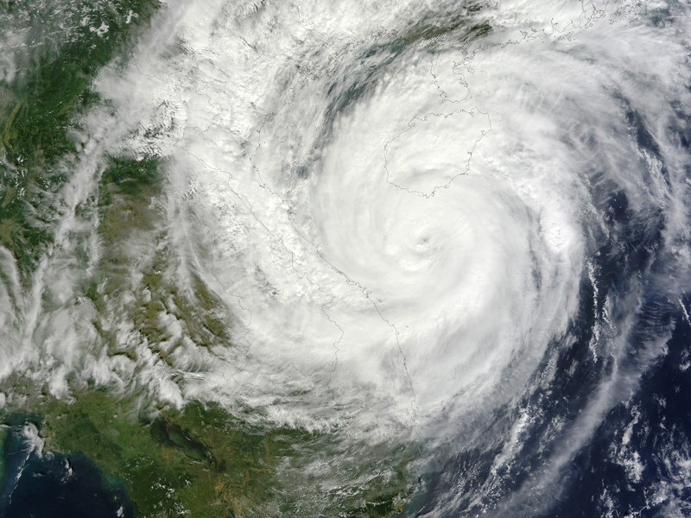
THANK YOU
United Nations Office for Outer Space Affairs
United Nations Office at Vienna
Shirish Ravan
shirish.ravan@un.org

