Slide 1
Future Opportunities for Planetary Defense Exercises
Movie by Marina Brozovic
Vishnu Reddy, University of Arizona
Davide Farnocchia, JPL, Tim Spahr, NEO Sciences LLC,
Michael Kelley, NASA HQ

Slide 2
TC4 Campaign
Near-Earth Asteroid 2012 TC4 will make a close flyby on the Earth on Oct. 12, 2017 at a distance of 6825 km. The goal of TC4 Observing Campaign is to recover, track, and characterize TC4 as a potential impactor in order to exercise the entire Planetary Defense system from observations, modeling, prediction, and communication.

Slide 3
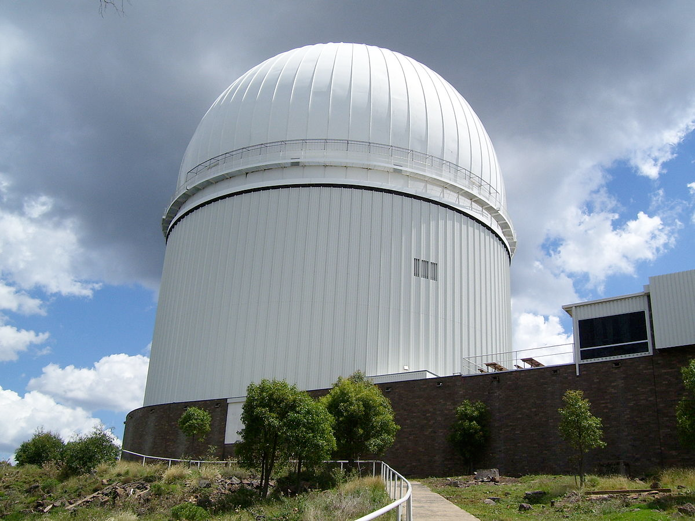
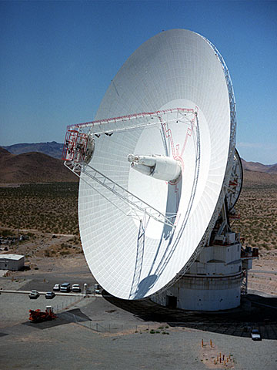
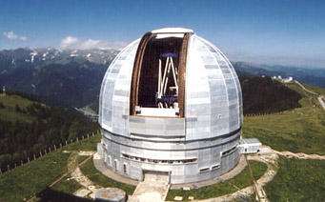
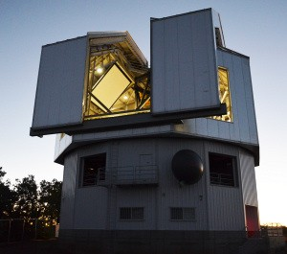
Coalition of the willing
South Africa
Goldstone
LBT
BTA-6
VLT
NASA IRTF
DCT
30 observational assets around the world

Slide 4
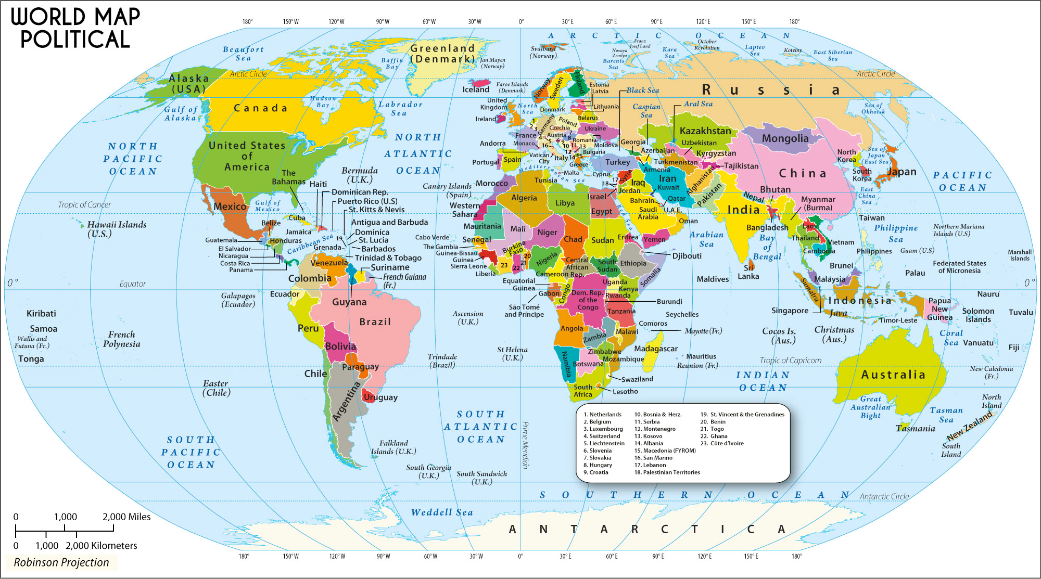
Coalition of the willing
12 countries contributed scientific data

Slide 5
Key Lessons
Operational timelines and science timelines need to be defined and enforced
Identify key actors with media training to interact with media. Media interaction should be centralized
Contingency plans for natural disasters. Arecibo taken offline by hurricane.
Key assets (NASA IRTF) remain single point failures with no backup capabilities elsewhere on Earth.
Science paper in review in The Astronomical Journal. PDC paper planned on lessons learnt.

Slide 6
Next opportunity
Double Asteroid Rendezvous Test (DART) mission is slated to launch in 2020s and will use a kinetic impactor to nudge moon (Didymoon) of binary NEA Didymos in 2022.
2022 apparition to favorable for ground-based observations of the kinetic impactor experiment
Can we do precursor observational campaigns focused on binary NEAs making close flybys of the Earth to prepare for DART?

Slide 7
Binary Opportunities
 | Didymos | 1999 KW4 | 2004 FG11
Primary Diameter | 0.75±0.1 km | 1.317±0.04 km | 0.15±0.03 km
Secondary Diameter | 0.17±0.03 km | 0.451±0.027 km | <0.08 km
Comp. Mag. Diff. | 3.3±0.2 | 2.5 | 1.4
Period/Tax. Type | 2.259 hrs/Xk | 2.7645/S | <4 hrs/?
Flyby V. Mag. | 19.8/14.4 | 13.9 | 18.0
Flyby Distance | 0.99/0.075 AU | 0.035 AU | 0.049 AU
Flyby Date | March 13, 2019 Sept. 27, 2022 | May 26, 2019 | April 12, 2020

Slide 8
NEA Opportunities
Designation | Close Approach | Uncertainty | V. Mag. | Recovery Date
2015 TH145 | March 20, 2021 | 5 deg | 17.3 | May 2020
2016 DV1 | March 06, 2021 | 1 deg | 20.5 | Dec. 2020
2018 BA3 | Jan. 28, 2021 | 3.5 deg | 17.5 | Nov. 2020
2015 HA177 | April 20, 2021 | 10s deg | 23.2 | March 2021
2017 MF7 | June 13, 2020 | 13.9 | 19.5 | Jan. 2020
2018 LB | June 01, 2021 | 1 deg | 19.8 | Feb. 2021
2012 KT12 | May 13, 2019 | 1 deg | 20.6 | Jan. 2019
2016 GE1 | April 05, 2019 | 4 deg | 16.4 | Jan. 2019

