Slide 1
NEOCam Briefing SBAG June 2018
Amy Mainzer, Principal Investigator

Slide 2
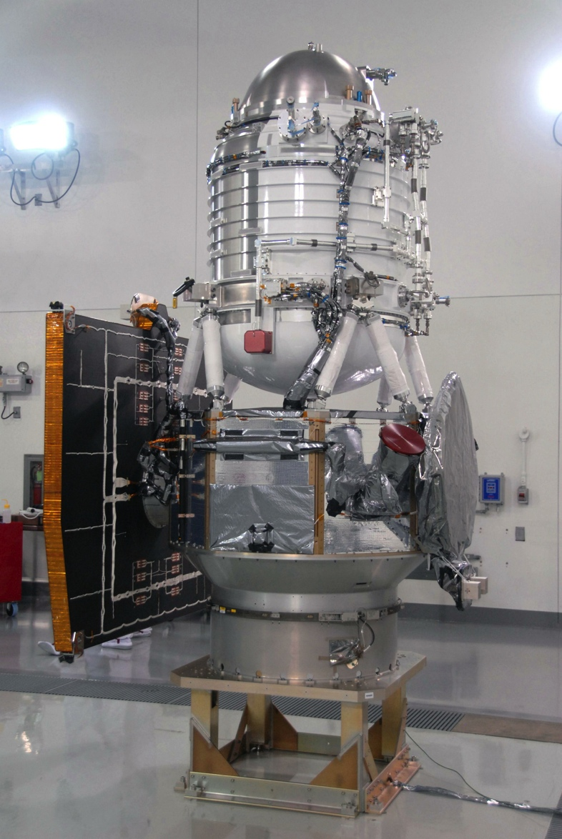
Wide-field Infrared Survey Explorer (WISE)
40 cm telescope orbiting Earth launched 2009
Design life 7 months
Primary science objectives NOT asteroids
PI Prof. Ned Wright, UCLA
Four channels: 3.4, 4.6, 12 and 22 um
3.4 & 4.6 um channels still operating today as NEOWISE
~160,000 small bodies detected to date, including ~1300 NEOs
Notes:
Scientists have been able to acquire a great deal of infrared measurements of asteroids using a new NASA space telescope, called WISE.

Slide 3
NEOWISE NEO Discoveries Tend to Be Large & Dark

Slide 4
Independent Confirmation of Diameters
1.02+11%-9% 0.97+9%-7%
Occultation diameters taken after 2011 agree with the NEOWISE diameters to ~10%

Slide 5
Comparison of ~2000 WISE Asteroids to IRAS

Slide 6
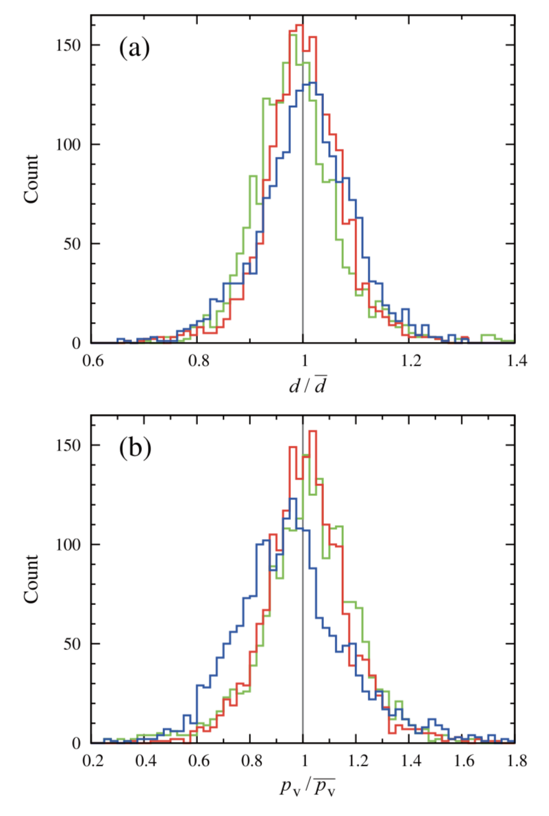
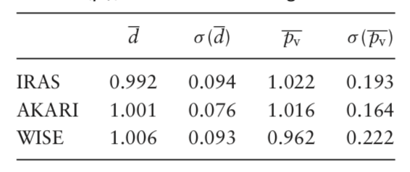
Comparing WISE with IRAS and Akari
Usui et al. 2014
1993 objects in common
Akari
IRAS
WISE

Slide 7
NEOs: The Critical Questions
Need to know when impacts could occur and how bad they will be
When: Comes from finding objects & determining good orbits for them
How bad: Comes from measuring the impact energy (KE)
Impact energy scales as KE = ½ mass x velocity²
Velocity comes from orbit
Mass = density x volume = density x diameter³
Impact energy depends strongly on diameter (size)

Slide 8
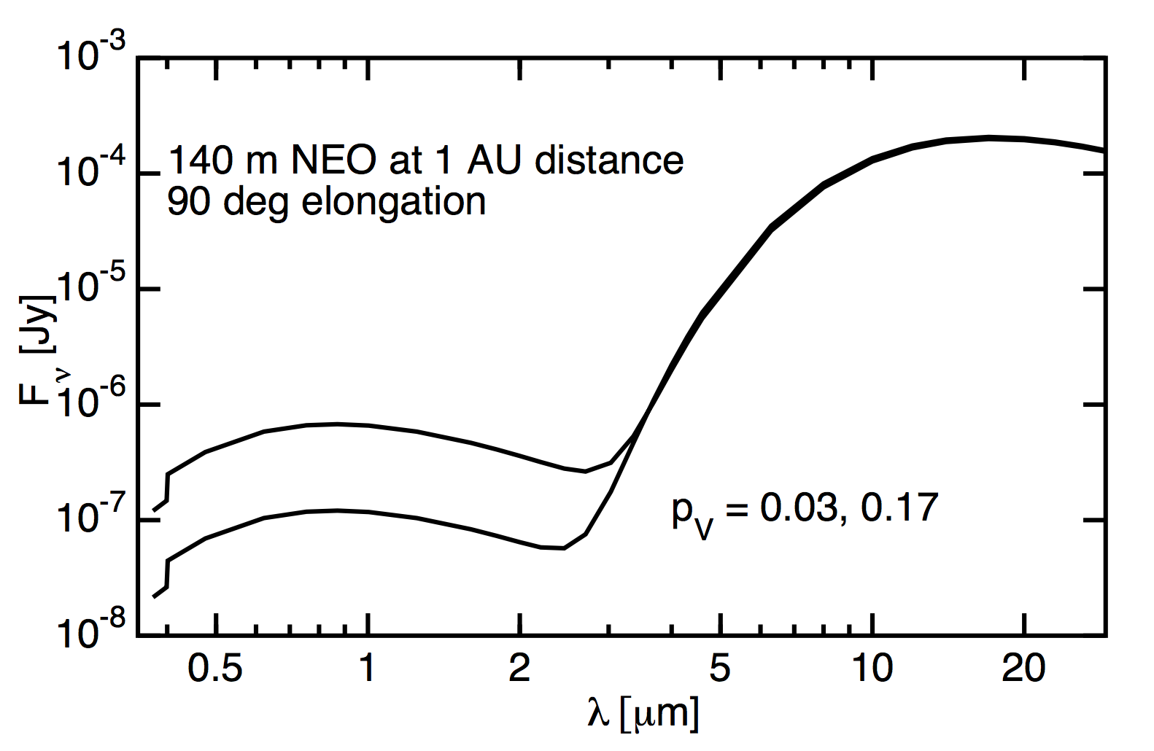
Asteroid Spectral Energy Distributions Peak in the Infrared
Flux (Jy)
Albedo = 17%
Albedo = 3%
Wavelength (μm)

Slide 9
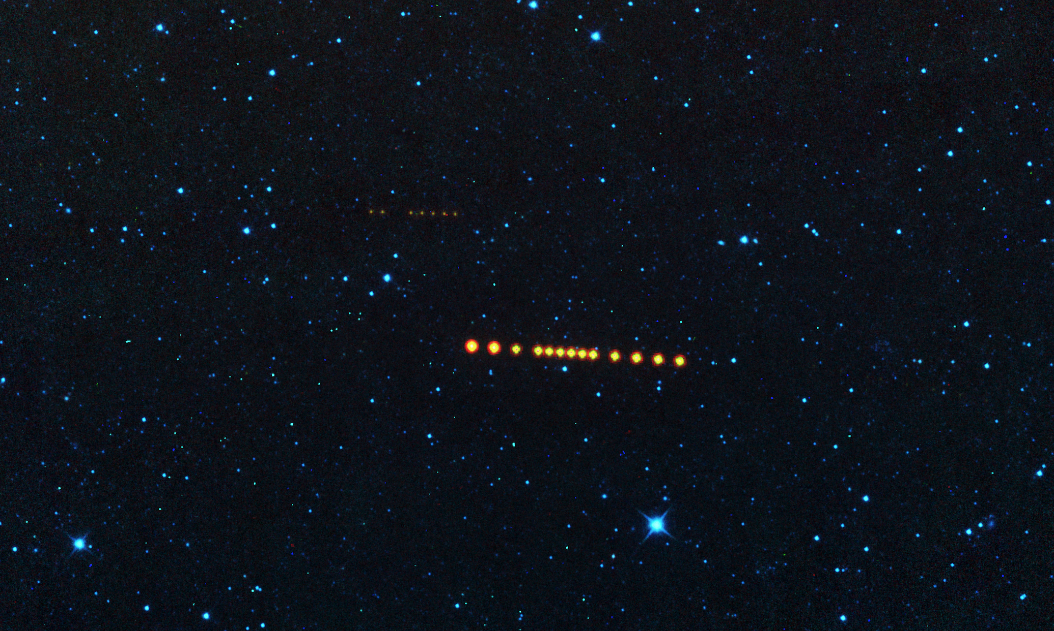
NEOs Are Bright in IR; Stars Less So
Cyan = 3.4 microns
Yellow = 12 microns
Red = 22 microns

Slide 10
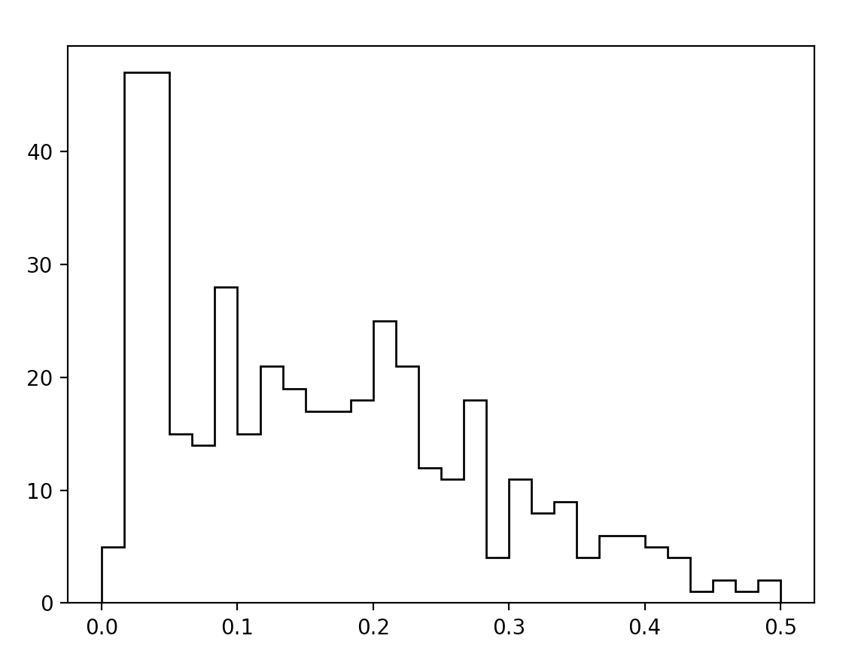
NEO Albedo Distribution
There is a population of very dark NEOs (3% albedo), and a population of less dark ones (17% albedo)
Data from NEOWISE
Recent results from Ryugu and Bennu confirm very low albedos
From Wright et al. (2016)
Number of Objects
Albedo
3% albedo
17% albedo

Slide 11
Mission Summary: NEOCam Is a Planetary Defense Mission
NEOCam is designed to respond to the objectives of NASA’s Planetary Defense Coordination Office by discovering, tracking, and characterizing NEOs
NEOCam is optimized for the task of finding and characterizing the risks posed by potentially hazardous objects (PHOs), both as individual objects and as populations
NEOCam provides critical decision support for stakeholders who must assess the risks of NEO impacts to Earth and must identify potential mitigation strategies

Slide 12
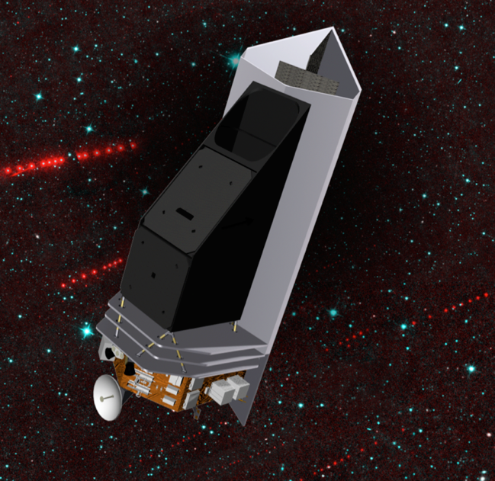
NEOCam
NEOCam is a dual-channel imager operating in a single step-and-stare survey mode.
50 cm telescope
Two 16 megapixel HgCdTe focal planes at 4-5.4 & 6-10 μm simultaneously imaged
Detectors passively cooled to 40K
Sun-Earth L1 orbit
First proposed 2005
Awarded technology development funding in 2011 Discovery
Awarded Extended Phase A in 2016
System Requirements Review/Mission Definition Review passed 2/18
Pre-KDP-B review for instrument passed 11/18
Notes:
NEOCam is designed to leverage the NEOWISE experience at finding and characterizing asteroids using a space-based IR telescope.

Slide 13
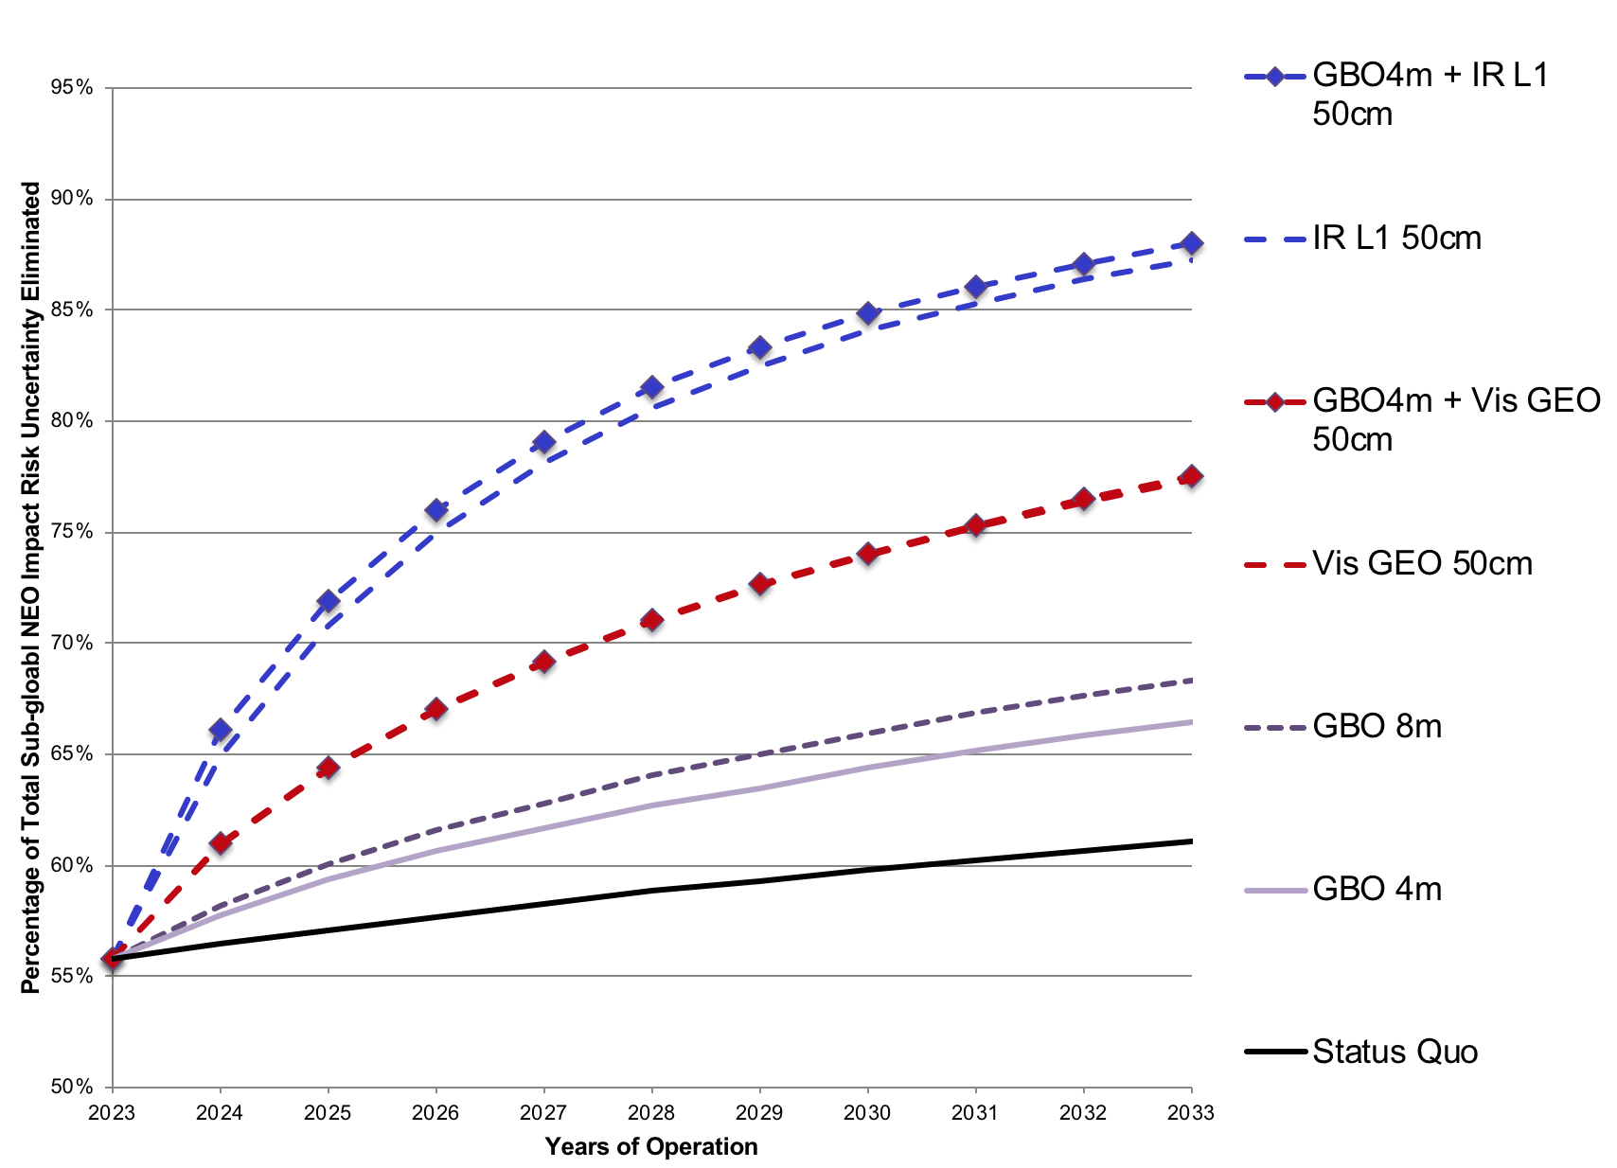
NEOCam Is Capable of Approaching 90% for PHAs >140m
From NASA NEO SDT Report (2017)
GBO = Ground-based observatory

Slide 14
Mission Objectives
Find 2/3 of PHAs >140 m in 5 years (goal: 90%)
Produce diameters & compute albedos where visible data are available
Compute cumulative chance of impact over next century from PHAs >50 m and comets
Deliver tracklet data daily; images & extracted source lists every 6 months

Slide 15
Cadence & Follow Up
The NEOCam survey cadence is designed to produce orbits good enough to distinguish an NEO from an MBA
Cadence optimized for this purpose
Most objects are detected on many epochs spanning months or years
But just in case there is an object of particular interest, we have the ability to interrupt survey & target
Survey cadence consists of a repeating pattern collected on either side of the Sun on ~2 week cycle

Slide 16
Detectors
Partnership between Teledyne Imaging Sensors, University of Rochester, JPL
4 x 1 mosaic of detectors in each channel imaging simultaneously
Long-wavelength HgCdTe material bonded to 2048² HAWAII-2RG readout
Cutoffs >10 μm demonstrated to exceed NEOCam dark current requirements
Radiation testing completed at UC Davis cyclotron
Dorn et al. 2016, McMurtry et al. 2013, 2016

