Slide 1
An IAWN Comet Observing Campaign
Gerbs Bauer (UMD), Vishnu Reddy (Univ. of Arizona), Davide Farnocchia (JPL), Marco Micheli (ESA), Dave Tholen (UHIfA)

Slide 2
Why Comets?
Comets are a challenge for astrometry, so we are planning on an IAWN campaign:
Today we will introduce the problems with comet astrometry.
In the Spring of 2025, we plan to hold a workshop to discuss methods to improve comet astrometry.
Later in 2025, we plan to conduct an observing campaign of a comet (if nature provides).

Slide 3
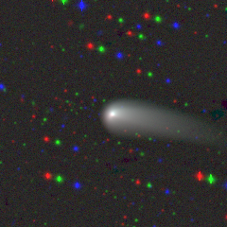
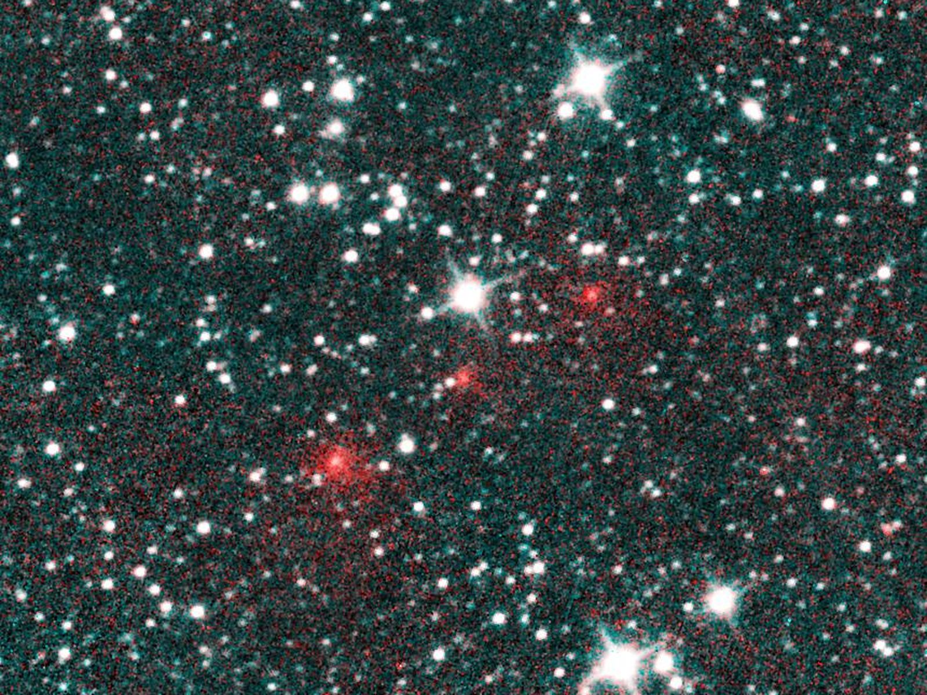
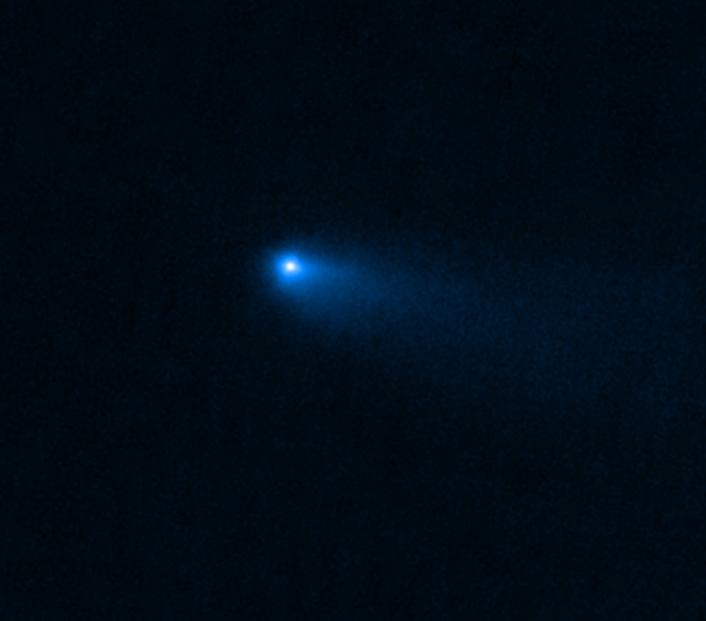
Comet Basics
“Typical” Short-period comet
“Typical” Long-period comet
“Non-Typical” Main-Belt comet
67P near 2021 perihelion, CSS from CATCH
C/2020 F3 NEOWISE discovery image
JWST image of 238P/READ
Definition of a Comet – Any small body that has a gas or dust coma (phenomenological).
Traditional Classifications:
Long-Period comets (LPCs): Comets that have an orbital period of > 200 years.
Other Subclassifications:
Inner Oort Cloud (a ~ 2000-20000 AU), Oort Cloud Comets (a~ 20000-200000 AU), Inter-Stellar Comets.
Short Period Comets (SPCs): Comets that have an orbital period of < 200 years.
Other Subclassifications:
Jupiter Family Comets (JFCs, i<40º, P< 20 years), Halley Type Comets (HTCs, Period > 20 years), Active Centaurs (about 13% of all Centaurs), Main Belt Comets, Sungrazing comets.

Slide 4
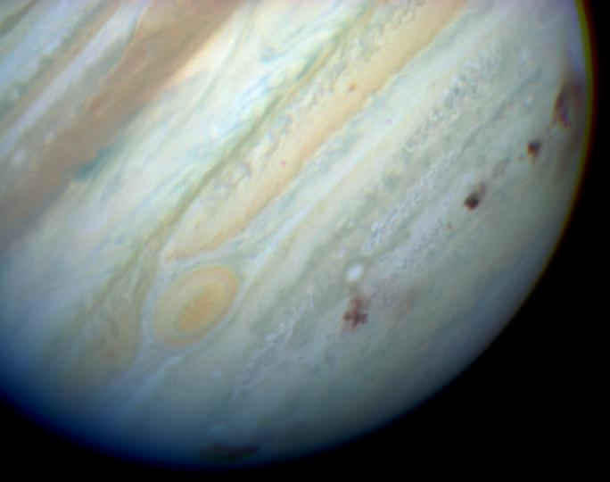
Comets and Planetary Defense
Collision Risks:
NECs – For impact purposes, a subclass of NEOs. Similar Size and velocity Distribution down to 1km objects, with a ~10⁻⁷ chance of collision¹, with a similar number of known NECs as NEAs in this size range. About 1/6th less mass for the same size, though. May or may not have a significant disruption rate below ~700m in size.
LPCs – are generally larger (up to several 10s of km), and possibly lower density may be offset by the higher impact velocity. Fortunately, these happen once every ~100 million years (c.f. NAS 2019 study¹).
ISOs – unknown, but if a few per year, about 1/3rd the impact freq. of comets (so once every few billion years).
¹National Academies of Sciences, Engineering, and Medicine 2019. Finding Hazardous Asteroids Using Infrared and Visible Wavelength Telescopes. Washington, DC: The National Academies Press. https://doi.org/10.17226/25476.

Slide 5
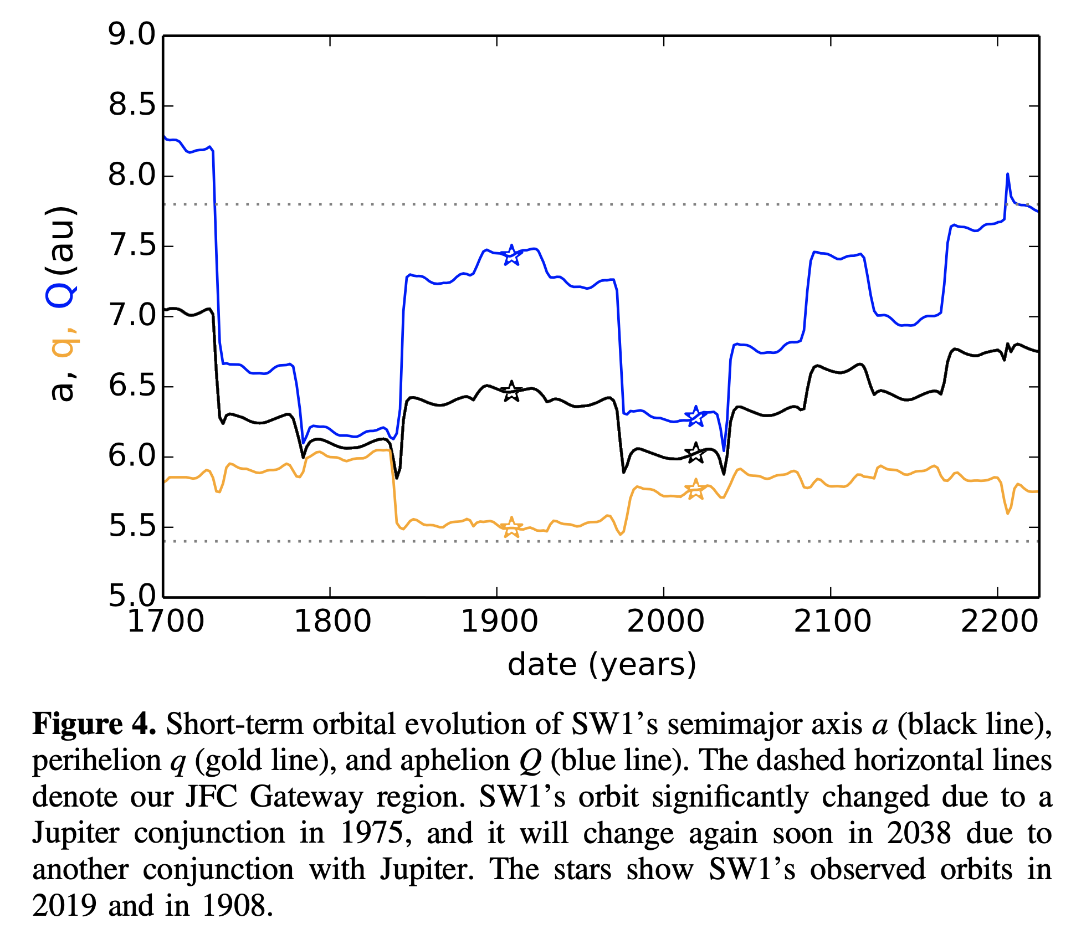
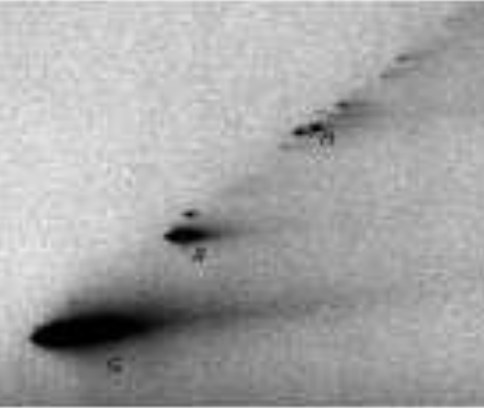
Comets and Planetary Defense
29P Orbit Evolution (Sarid et al. 2019)
Orbit Modifications: Comet orbits Change on short time scales owing to:
Non-gravitational acceleration from mass ejection;
Interaction with Jupiter, and other giant planets.
Comets also shed fragments, which in turn can quickly evolve off from the parent body’s orbit.

Slide 6
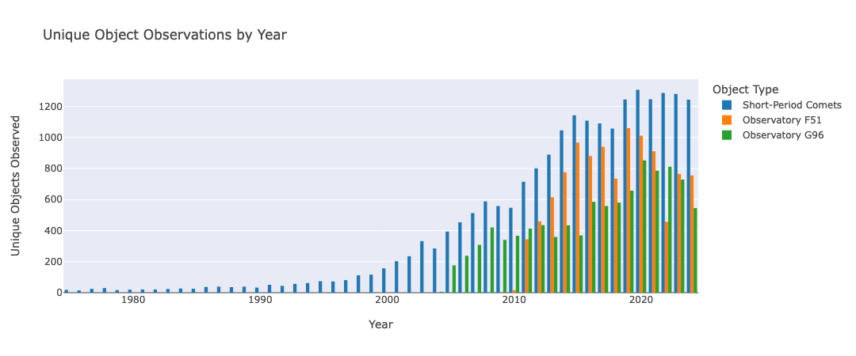
Comets and Planetary Defense
Unique Comet Observations by Year
Surveys:
are the most productive observers and discovers of (non-sun-grazing) comets,
are not great at measuring their astrometry because they are extended, have irregular morphology (jets, shells, etc.), and their nucleus can be obscured by coma.
Most astrometry is poor for comets, hence the need for a campaign…

Slide 7
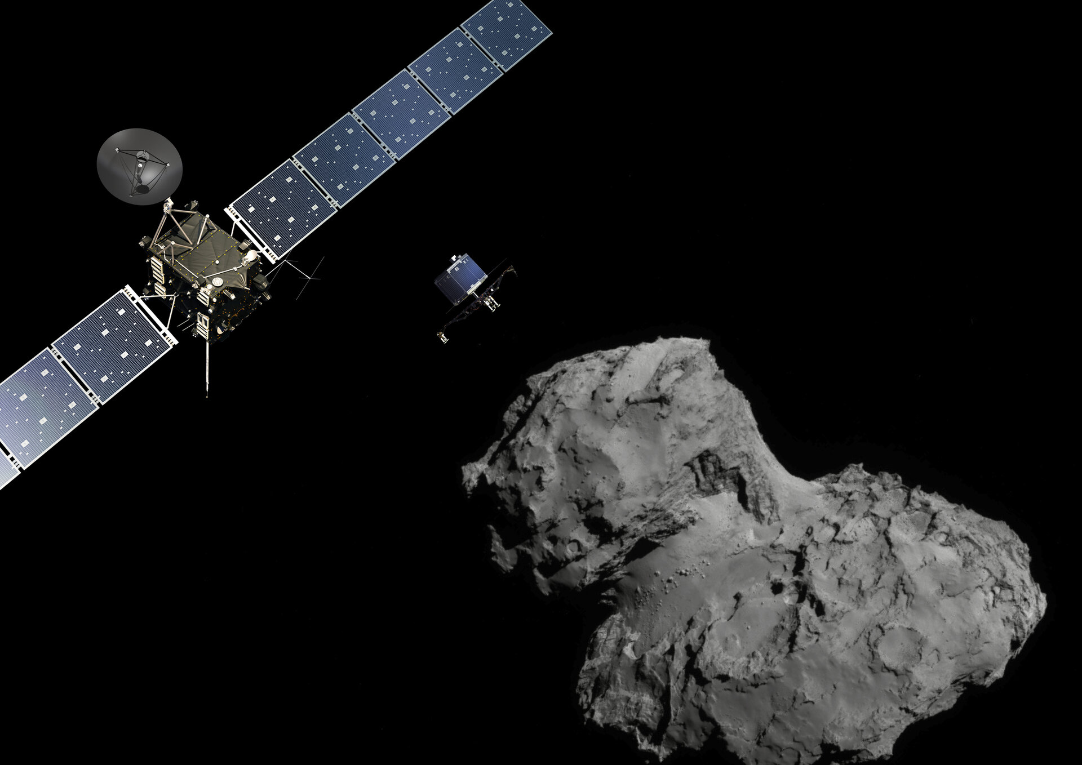
Rosetta Mission at comet 67P
2014 – 2016 proximity operations
Radiometric tracking constrains range to the comet to ~10 m
Credit: ESA

Slide 8
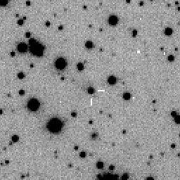
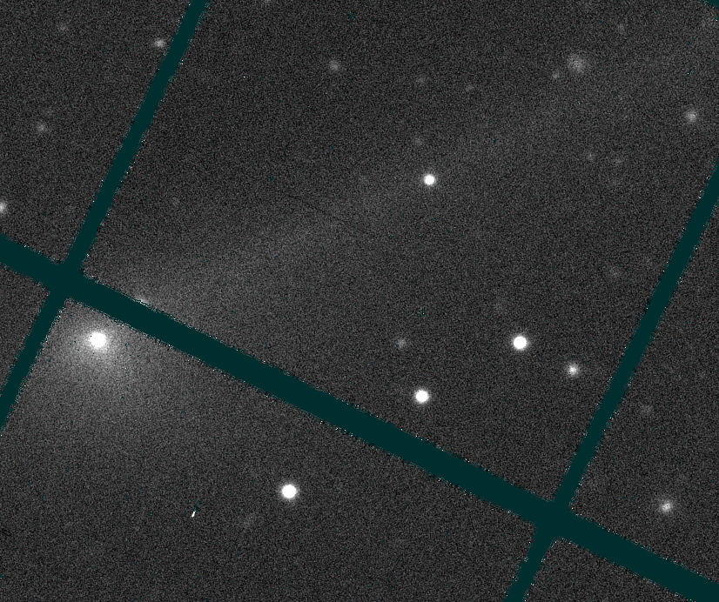
VLT
PAN-STARRS
High-quality astrometry from VLT, Pan-STARRS, and Catalina.
Measured by M. Micheli and Rob Weryk.

Slide 9
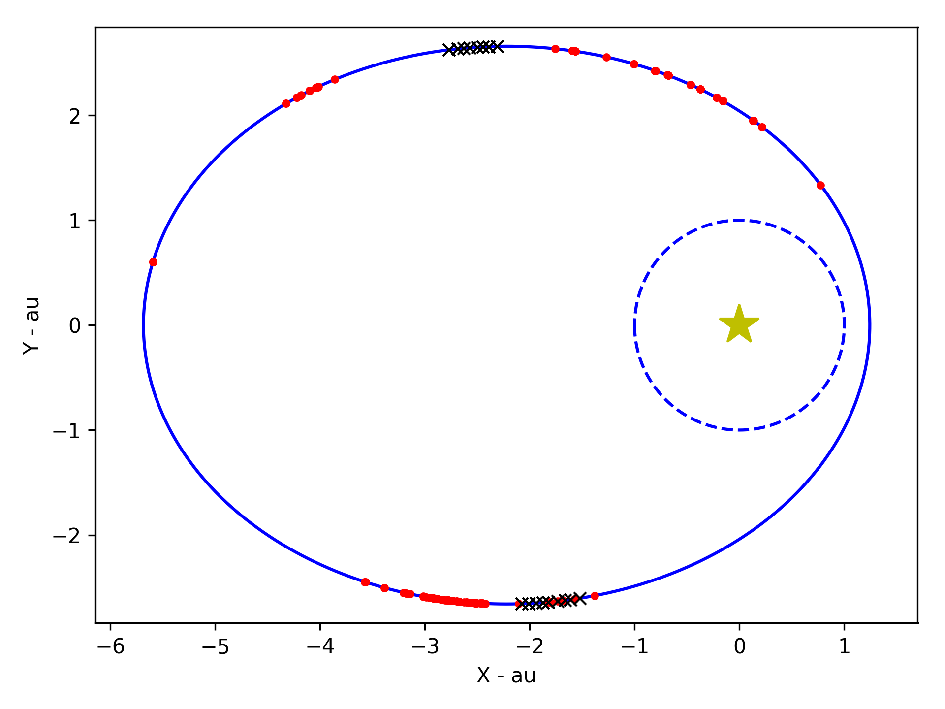
Radio
Optical
Earth
Sun
67P
Credit: ESA

Slide 10
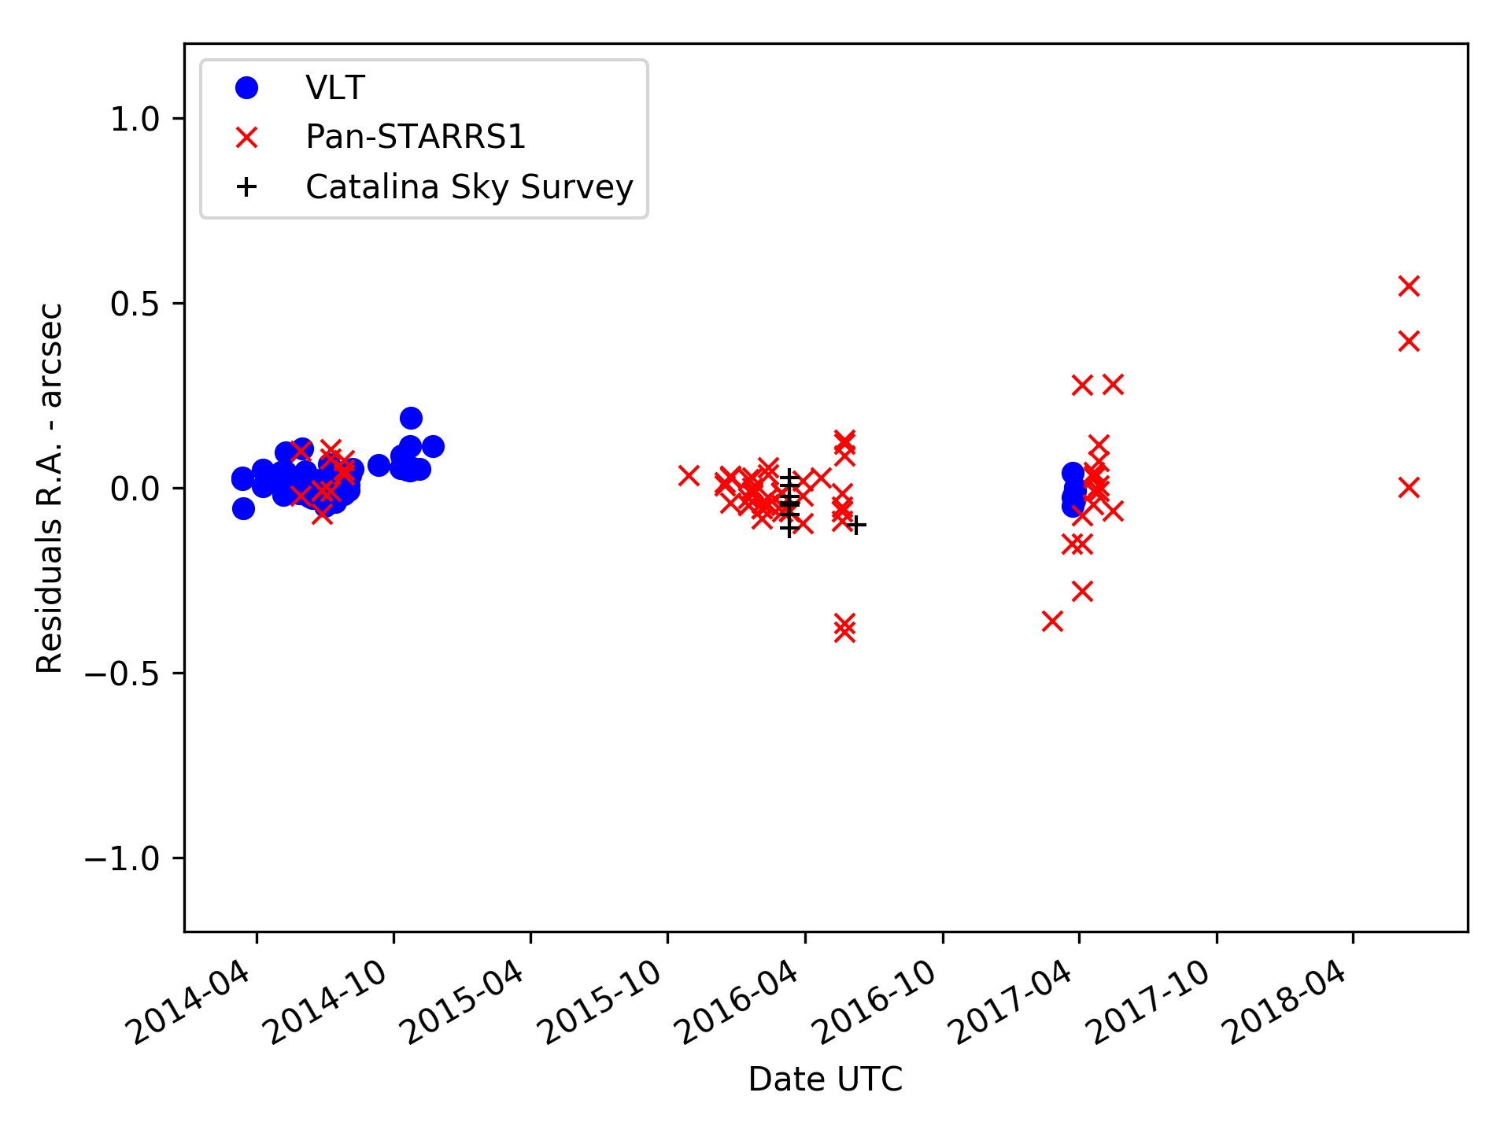
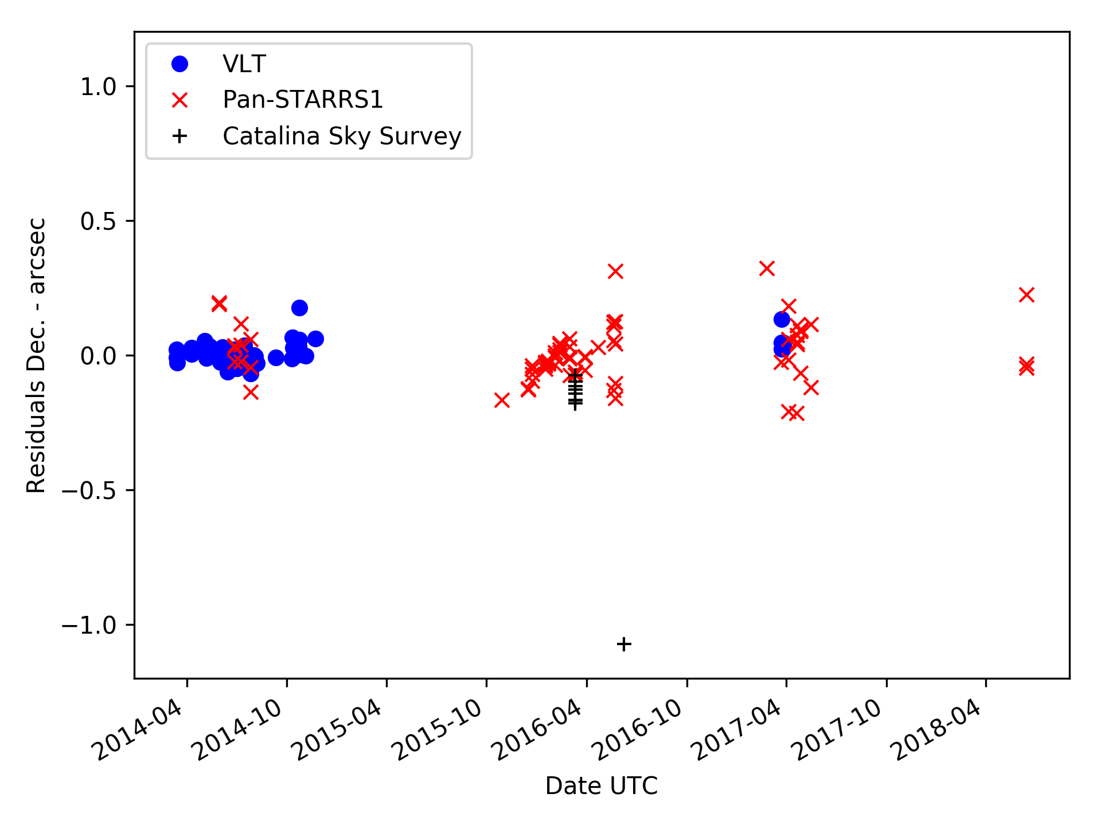
“Good” astrometry

Slide 11
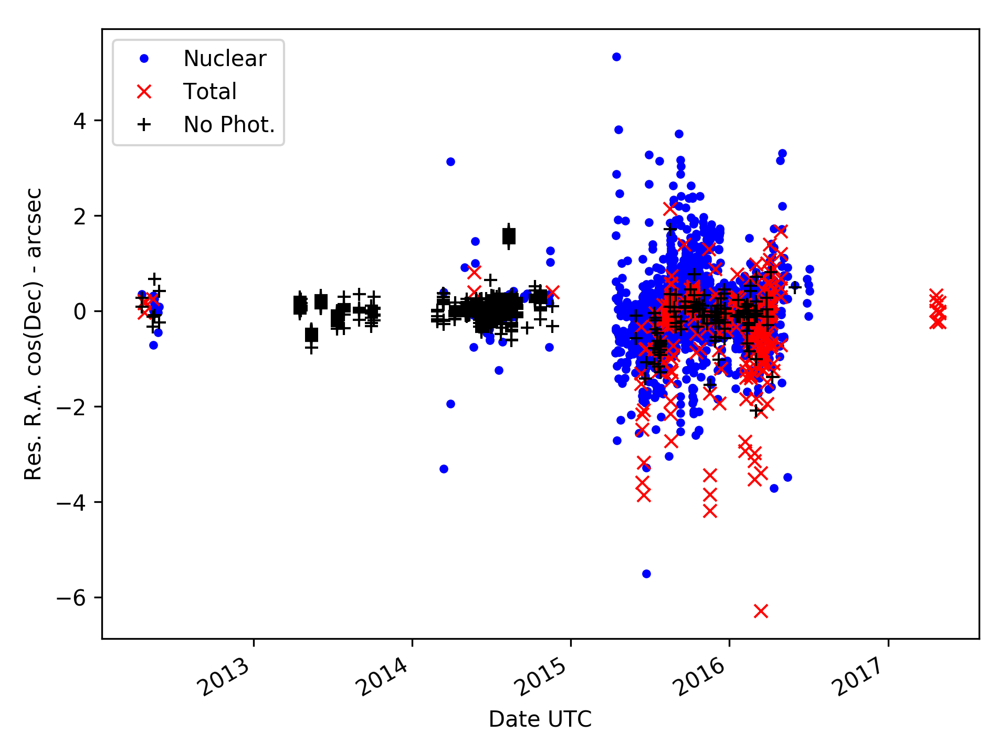
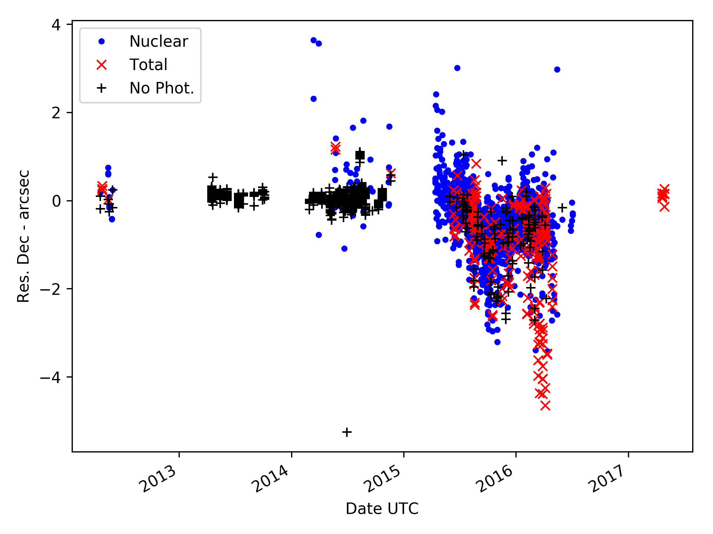
“Generic” astrometry

Slide 12
An intrinsic limitation
Comet astrometry requires good imaging resolution, to properly locate the “false nucleus”.
Good resolution, in turns, requires good seeing! Here’s why:
Small-scale features of the comet coma are blurred by seeing.
If they are asymmetric, this shifts the centroid!
NASA, ESA, D. Jewitt (UCLA)

Slide 13
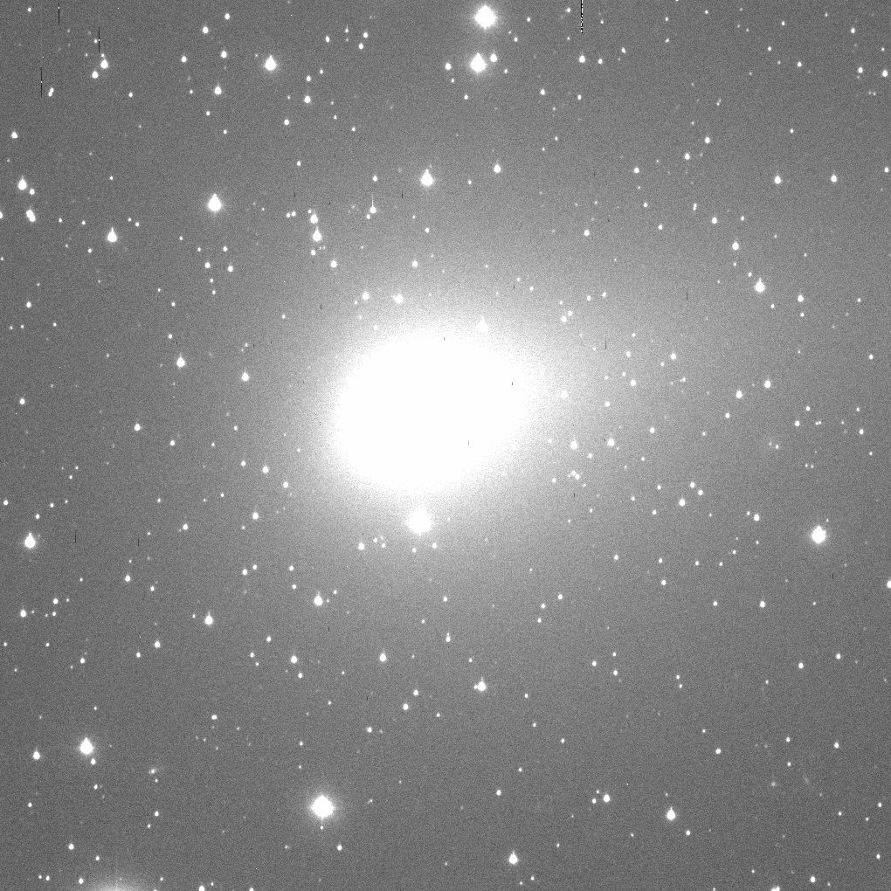
103P/Hartley on 2010 November 1
Aperture
Radius x y dx dy
pixels pixel pixel pixel pixel flux SNR Right Ascension Declination
5.0 457.93 547.74 0.07 0.07 571776.9 746.86 06 56 29.502 +11 48 57.64
4.9 457.93 547.74 0.07 0.06 561781.0 742.41 06 56 29.502 +11 48 57.64
4.8 457.92 547.75 0.07 0.06 554534.5 741.46 06 56 29.502 +11 48 57.64
4.7 457.91 547.74 0.07 0.06 537056.2 727.41 06 56 29.502 +11 48 57.64
4.6 457.90 547.73 0.07 0.06 527547.4 720.75 06 56 29.503 +11 48 57.63
4.5 457.89 547.72 0.07 0.06 516630.5 711.59 06 56 29.503 +11 48 57.63
4.4 457.87 547.72 0.06 0.06 508411.7 707.61 06 56 29.503 +11 48 57.63
4.3 457.86 547.69 0.06 0.06 493136.6 700.88 06 56 29.504 +11 48 57.62
4.2 457.86 547.70 0.06 0.06 486585.9 698.67 06 56 29.504 +11 48 57.62
4.1 457.82 547.70 0.06 0.05 467277.4 686.76 06 56 29.505 +11 48 57.62
4.0 457.82 547.69 0.05 0.05 455231.3 669.60 06 56 29.505 +11 48 57.62
3.9 457.80 547.67 0.05 0.05 444869.3 663.28 06 56 29.506 +11 48 57.61
3.8 457.81 547.67 0.05 0.05 430415.5 657.56 06 56 29.505 +11 48 57.61
3.7 457.81 547.67 0.05 0.05 420681.9 649.92 06 56 29.505 +11 48 57.61
3.6 457.80 547.66 0.05 0.05 407299.6 642.73 06 56 29.506 +11 48 57.60
3.5 457.79 547.65 0.05 0.05 393633.3 622.53 06 56 29.506 +11 48 57.60
3.4 457.76 547.64 0.05 0.05 378889.1 615.14 06 56 29.507 +11 48 57.59
3.3 457.74 547.63 0.05 0.05 367940.4 609.39 06 56 29.507 +11 48 57.59
3.2 457.70 547.61 0.04 0.04 353450.3 597.43 06 56 29.509 +11 48 57.58
3.1 457.71 547.60 0.04 0.04 339323.1 581.86 06 56 29.508 +11 48 57.58
3.0 457.71 547.60 0.04 0.04 333665.3 578.01 06 56 29.508 +11 48 57.58
2.9 457.71 547.60 0.04 0.04 320351.7 566.35 06 56 29.508 +11 48 57.58
2.8 457.71 547.60 0.04 0.04 312374.0 548.42 06 56 29.508 +11 48 57.58
2.7 457.67 547.57 0.04 0.04 282065.0 532.82 06 56 29.509 +11 48 57.56
2.6 457.67 547.57 0.04 0.04 272435.8 519.77 06 56 29.509 +11 48 57.56
2.5 457.67 547.55 0.04 0.04 258472.3 509.21 06 56 29.509 +11 48 57.55
2.4 457.67 547.53 0.04 0.04 247262.7 494.93 06 56 29.509 +11 48 57.54
2.3 457.63 547.53 0.03 0.03 223467.3 462.68 06 56 29.511 +11 48 57.54
2.2 457.62 547.52 0.03 0.03 212628.4 447.79 06 56 29.511 +11 48 57.54
2.1 457.62 547.52 0.04 0.04 205986.2 444.58 06 56 29.511 +11 48 57.54
2.0 457.60 547.50 0.03 0.04 187058.7 427.38 06 56 29.512 +11 48 57.53
1.9 457.60 547.50 0.03 0.04 180076.4 407.28 06 56 29.512 +11 48 57.53
1.8 457.60 547.50 0.04 0.04 171499.8 383.19 06 56 29.512 +11 48 57.53
1.7 457.60 547.50 0.04 0.04 164126.2 362.98 06 56 29.512 +11 48 57.53
1.6 457.59 547.50 0.04 0.04 149584.2 340.24 06 56 29.512 +11 48 57.53

Slide 14
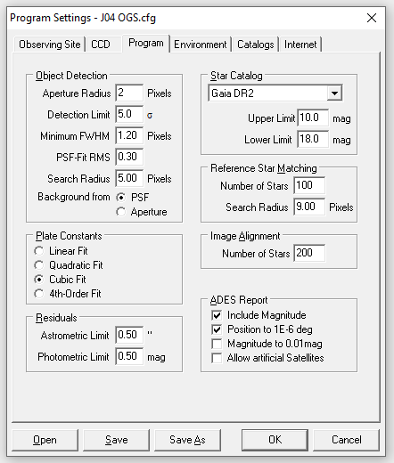
Can we do this with common tools?
A lot of astrometrists nowadays use pre-made tools (e.g. Astrometrica, Tycho Tracker), which cannot be modified to automatically implement the technique just presented.
Can we obtain a good approximation anyway? Yes!
Most programs allow the user to change the aperture used to extract the astrometry.
For example, Astrometrica offers this setting:
A user can replicate the shrinking aperture method by changing the aperture in the program settings, and repeating the same astrometric measurement with different radii.
The measurements can then be extrapolated to zero aperture.
H. Raab

