Slide 1
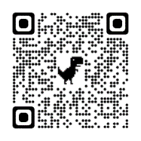
Lessons Learned
2024 YR4
Todd Borzych
borzychmil@gmail.com
2 Oct 25

Slide 2
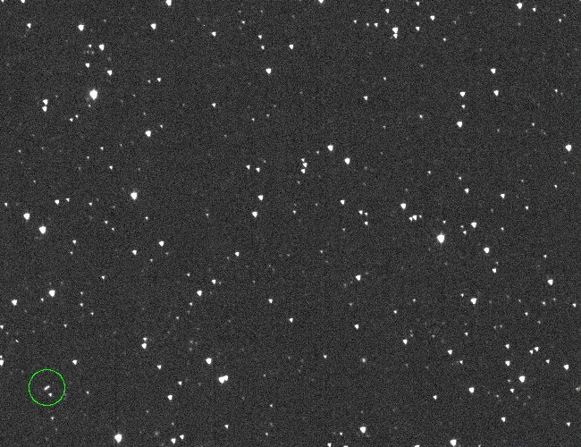
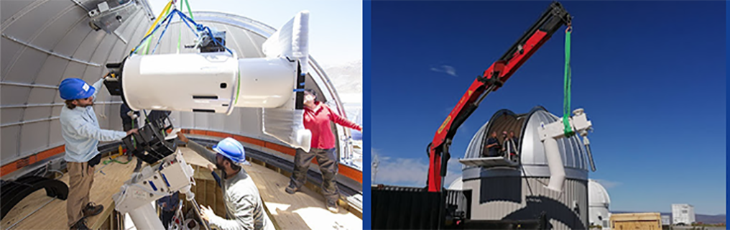
Discovery- 27 Dec 2024
Asteroid Terrestrial-impact Last Alert System (ATLAS) station
in Chile (W68)
Relatively new 50 cm survey telescope
ATLAS conducts broad surveys of entire night sky
Strategic implementation by PD community
4 observations over 50 min--16 Vmag
Approached from the sunward direction
Visible as it rapidly receded from 25 Dec
closest approach
Discovery images of 2024 YR4 on Dec. 27, 2024. Credit: NASA/ATLAS/U of Hawai’i
Not understood as unusual until CNEOS/NEOCC analyses
2022 ATLAS telescope installation

Slide 3
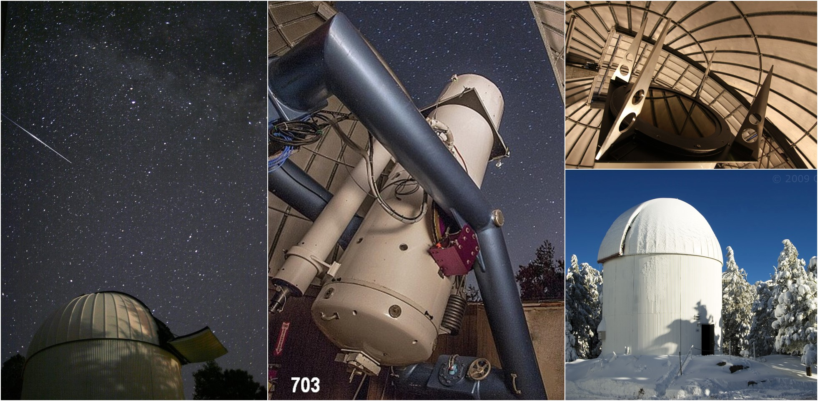
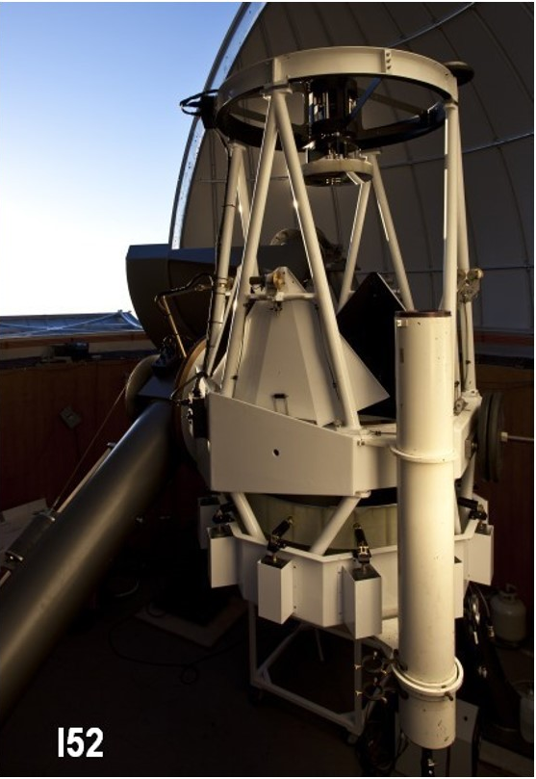
Confirmation- 27 Dec 24
ATLAS notification automatically listed on the MPC’s
NEO Confirmation Page (NEOCP), triggering confirmation observations
Confirmation posted in a Minor Planet Electronic Circular (MPEC):
26 Dec 2024 precovery from .7 m Catalina Sky Survey (CSS) Schmidt telescope (703), Mt Bigelow, AZ
1.0 m CSS Steward Observatory (I52), Mt Lemmon, AZ
.3 m iTelescope Observatory (Q62), Siding Spring, AU
.26 m reflector (amateur observer) Y. Ikari (900), Moriyama Japan
Confirmation fully automated through the NEO Confirmation Page Automated
Processing (NAP) system.
Schmidt Telescope
CSS Steward Observatory

Slide 4
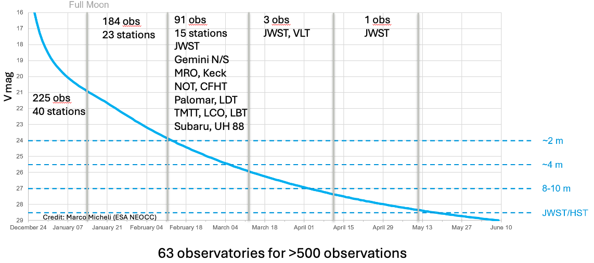
and D. Farnocchia (NASA/JPL/CNEOS)
4

Slide 5
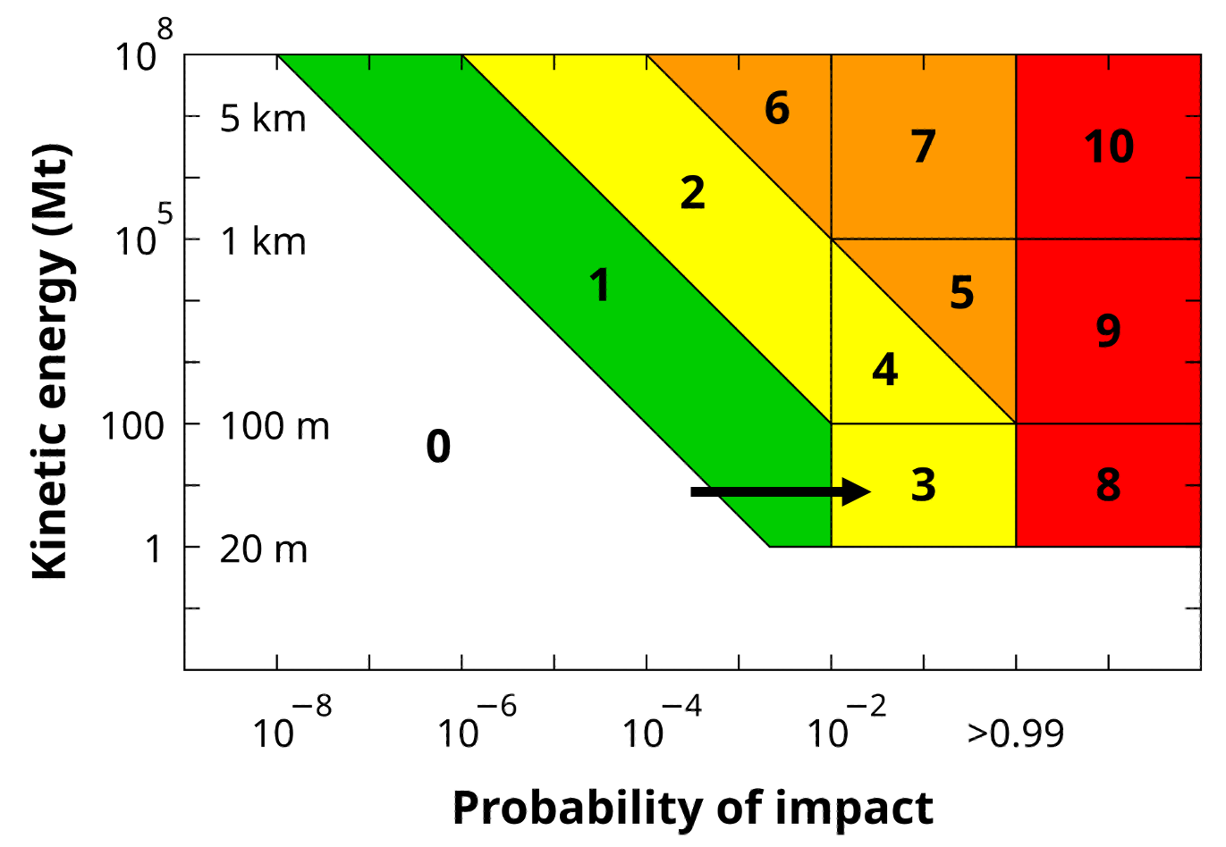
Overview of 2024 YR4 Campaign
27 Dec 2024 Discovery and Confirmation
29 Dec 2024 Torino Scale 1
Follow-up observations - astrometry and physical characterization- progressively larger telescopes (see additional slides)
27 Jan 2025 Torino 3 (IP > 1%, 50 m+ estimate)
28/29 Jan 2025 Interagency and IAWN Notifications
4 Feb 2025 20th Meeting of IAWN Steering Committee
18 Feb 2025 Earth IP peaked (3.1%)
20 Feb 2025 IP dropped below 1%
24 Feb– IP .004% and dropping; follow-up notifications giving All Clear

Slide 6
Key notes
2024 YR 4- for almost 2 months, most apparent near-term risk since 2004 discovery of Apophis
Astrometric Campaign required little initiation; occurred due to in-place global architecture, highly trained and experienced personnel throughout PD community.
Progression of observations, orbital calculations, notifications: Torino 0 to 3 to 0 in this apparition
Physical characterization- areas for growth, although redundancy of assets fulfilled most needs
Coordination and communication largely successful, with improvements for future Torino scale events
More information can be found NASA’s Technical Reports Server: “Lessons Learned from the Near-Earth Asteroid 2024 YR4 and the International Coordination that Retired the 2032 Earth Impact Risk”
https://ntrs.nasa.gov/citations/20250006886

Slide 7
Lessons Learned- Inconvenient Asteroid Timing
25 Dec 24- 7 Jan 25 holiday period
- Closest approach Christmas day, discovered 27 Dec, Torino 1 by 29 Dec
- Personnel globally on leave, some until 7 Jan (6 Jan Three Kings’ Day- Italian holiday)
8-27 Jan 25- JPL/CNEOS- Wild fires in CA
- forced evacuation
- 150 staff members lost their homes
- highly unusual closure of JPL server (Davide, Chamberlain, Giorginii remotely allowed continuity ops)
Also in Jan- Ames High Performance Computing center limited access due to scheduled down time
20 Jan 25- Inauguration until the present
- Transition of political appointees and leadership throughout PD chain
- Executive orders-- RTW, travel cuts, contract reviews, budget reviews, etc . . .

Slide 8
Lessons Learned- Alerts and Coordination
Goal: striking appropriate balance between early alerts of Torino 1 versus oversaturation
Astrometric community has more time to react than characterization community
Physical characterization community can improve performance if alerted earlier.
Survey observatory community benefits from early alerts; can help with precoveries.
Orbital analysts- the “glue”- communicated well with observers, and w/ NASA/ESA
MPC benefits from early alerts of Torino 1– preparing for increased focus on one object, correcting/replacing observations, vetting of precoveries
CNEOS/Small Bodies Node/PDCO experimented with automation and Slack channel for 2025 FA22
DoD assets may assist for astrometric and characterization in some situations, but non-DoD sufficed
IAWN notifications of 1% IP occurred IAW agreements.
NASA and interagency notifications occurred IAW NASA Policy Directive 8740.1.

Slide 9
Lessons Learned- Alerts and Coordination
IAWN and PDCO notifications- first real use of formal notification
Observation coordination:
Email/calls between PDCO, IAWN, ESA, observers (~900 PDCO emails)
Informal Slack Channel facilitated key technical coordination
Manual prompting of key follow-up observations
JWST, teams also investigated potential for Lucy, and some look at Hubble
Large ground-based observatories
Notes:
The PDCO has notification responsibilities for NEOs once they reach notification thresholds established in NASA NPD 8740.1 (27 Jan 2017) Notification and Communications Regarding Potential NEO Threats. NPD 8740.1 provides broad discretion to the PDCO to determine when implementation of required notifications should take place.
PDCO, as the coordinator of IAWN, with concurrence by the IAWN Steering Committee, sends notification to the program officer for planetary defense at UNOOSA for dissemination to member states, as noted by the UNCOPUOS in its annual reports (e.g., A/78/20, para. 119). PDCO, on behalf of IAWN, also notifies the chair (ESA) of the SMPAG, which is the forum for national space agencies and space offices to develop and make recommendations for any in-space response to an asteroid impact threat.
The notification was in accordance with criteria and thresholds for impact response actions in report A/AC.105/C.1/2017/CRP.25 to the Scientific and Technical Subcommittee of the UNCOPUOS, which states, “(1) IAWN shall warn of predicted impacts exceeding a probability of 1 percent for all objects characterized to be greater than 10 meters in size, or roughly equivalent to absolute magnitude of 28 if only brightness data can be collected.” Dr. Fast also made sure the observers for the upcoming 4 Feb 2025 IAWN meeting were all notified of 2024 YR4, ensuring wide knowledge of the object’s Torino level 3 status.

Slide 10
Lessons Learned- Alerts and Coordination
Some struggled with what to post; confusion over data that is already publicly accessible
CNEOS suggestion: Preapprove certain basic data for release on a webpage, including:
Current orbit IP
Discovery date
Telescope that discovered the object
Basic orbit information
Rough magnitude and size estimates
Close approach information
Torino Scale level
When the object will be observable
JWST successful coordination (concurrent denial of ToO proposal)
Hubble explored. Spacecraft Lucy explored.

Slide 11
Lessons Learned- Astrometry, Orbital Estimates
Established practice of reporting uncertainties was helpful; bring more observers into use of ADES
Best practice- more than one telescope during each observational period (don’t need more than 3)
Inaccurate/old star catalogs- more use of Gaia
Having pre-awarded time helps (e.g. Keck- M. Brucker)
Language barriers (long term)- Japan, Korea, other potential present and future global contributors.
Precoveries- vetting necessary
Negative Precoveries- peer review/particular caution necessary
Potential for Amateur Astronomy community contribution for similar objects
Spacecraft (e.g.- Lucy)- keeping in mind these unusual possibilities may yield future results
Simulating possible future IPs helped PDCO to inform chain of command
Improvements in mathematics of IP calculations aided process
Notes:
ADES: Astrometric Data Exchange Standard
Novel approaches to Asteroid Impact Monitoring (J. Roa, D. Farnocchia, S. Chesley-2021)
Saves computation cost w/smaller sampling requirement (10k); uses impact as observable

Slide 12
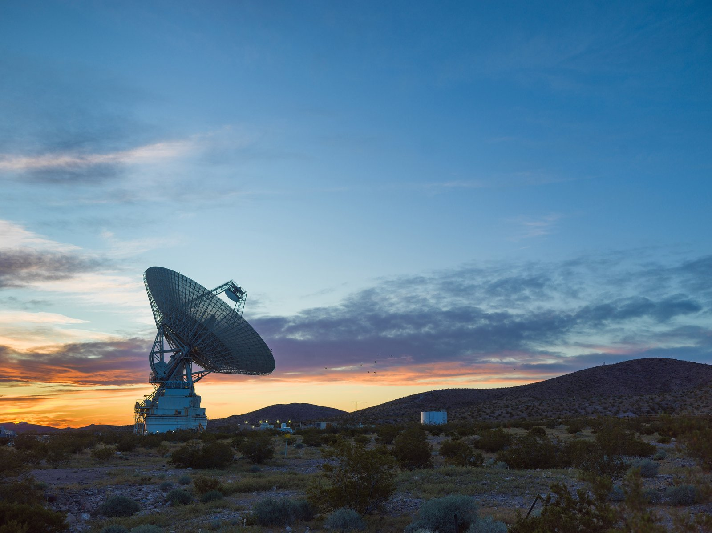
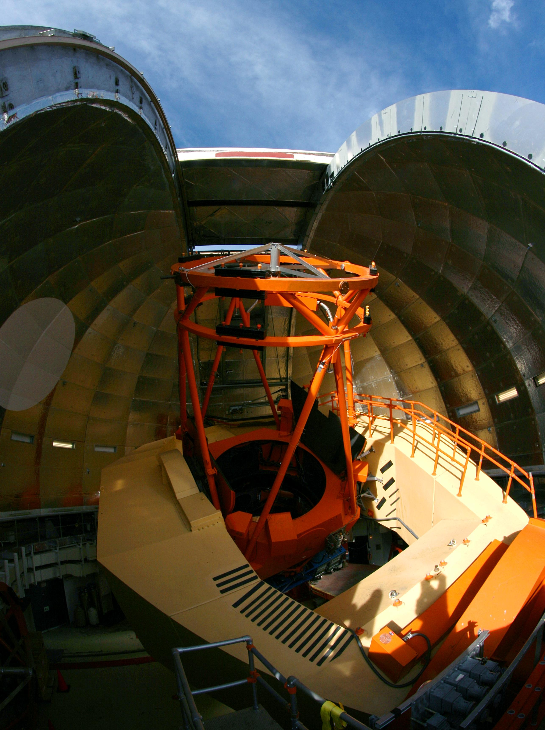
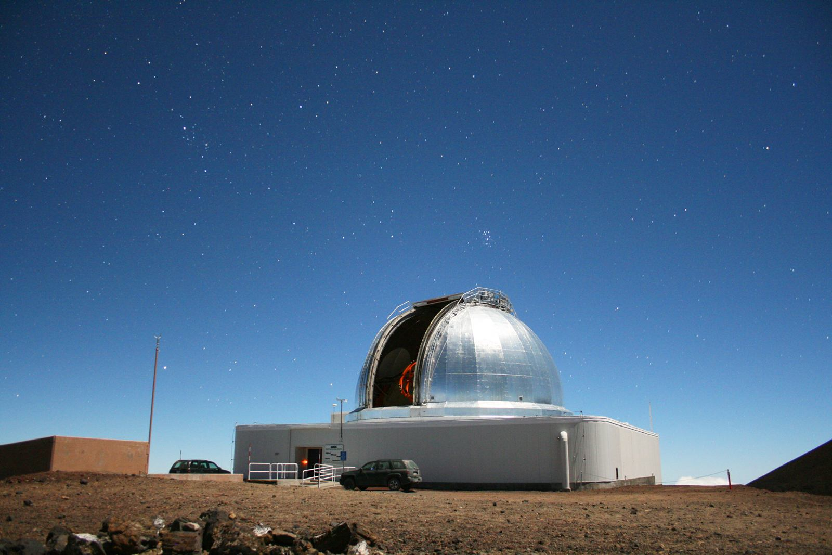
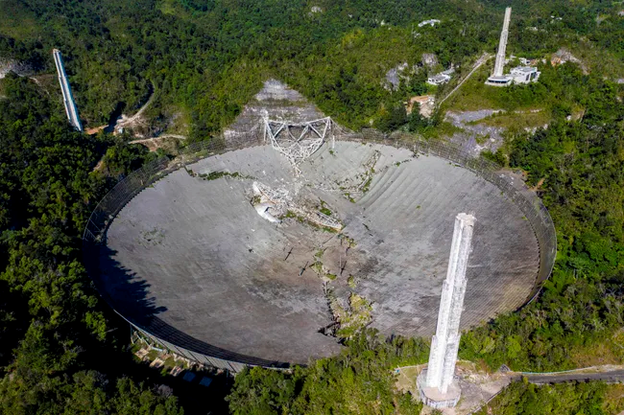
Lessons Learned: Physical Characterization
Technologies not employed
Goldstone Solar System Radar-extremely narrow window -29 Dec
Arecibo - potentially 2 Jan if not for 2020 catastrophic collapse
Polarimetry- only 24 hours for small cameras; VLT wrong phase angle
NASA’s InfraRed Telescope Facility (IRTF), Mauna Kea HI- until 2 Jan
Goldstone Solar System Radar, Ft. Irwin, CA
InfraRed Telescope Facility, Mauna Kea, HI
Arecibo’s collapse, 2020

Slide 13
Lessons Learned- Physical Characterization
Less coordination infrastructure for physical characterization exists than for astrometry
Coordination happened in clusters with sufficient redundancy to get the job done for 2024 YR4:
CSS — Danish Telescope—GTC—LDT—VLT — LBT — JWST
Gemini South — Keck
Other opportunities:
Polarimetry (NLT 27 Dec) and radar (NLT 29 Dec) would have required automated alerts via texts
Loss of Arecibo (potentially until early Jan)
IRTF would have required at least an email alert
MRO could have contributed at 16 Vmag (light curves, spin rate, spectroscopic)
Suggestions: IAWN Slack channel, automated alerts, “MPC for Physical characterization”

Slide 14
Lessons Learned- Modeling and Mitigation
NITEP: 2017 SMPAG adopted Recommended Criteria/Thresholds, including IAWN warning at 1% & 50 m and SMPAG starting mission options planning at 1% & 50 m.
Exercises mirror these recommendations
NASA directives do not dictate when to begin impact modeling or mission planning; PDCO/IAWN/SMGAP decision.
For 2024 YR4, PDCO and SMPAG agreed formal mission planning initiation not needed unless IP projections continued to increase as apparition continued.
Organizations proactively conducted impact modeling and studied mitigation anyway in US and internationally; ATAP run on HPC before shutdown, and using smaller workstations
JAXA simulated hitting 2024 YR4 with Hayabusa 2 (PDC)
Possible modification of exercises & guidance to match reality; but, every object will be different.
Rapid dual reconnaissance/mitigation mission (sitting on the shelf) suggested. (Dr. Barbee)

Slide 15
Lessons Learned- Future technologies
NEO Surveyor planned for launch 2027. Had it been flying already, according to Dr. Ryan Park, it would have likely detected YR4 in Oct-Nov 24, extending the observation arc by a few weeks.
NEO Surveyor + LSST may yield 10x the number of asteroid discoveries and may provide size.
Other technologies globally improving, both ground and space-based.
Possible increase in Torino events for several years
May also result in many of these Torino events being resolved quickly to Torino 0
MPC and other orgs developing more automation, reliability, virtualization to prepare for this
Other nations involvement/motivated by 2024 YR4
JAXA efforts to refine orbit, explore Hayabusa 2 mitigation not widely known before PDC
China states it is building a planetary defense team. (CNSA’s National Space Science Center)
India Space Research Organization (ISRO)- India also had multiple articles on YR4
More in the report!

Slide 16


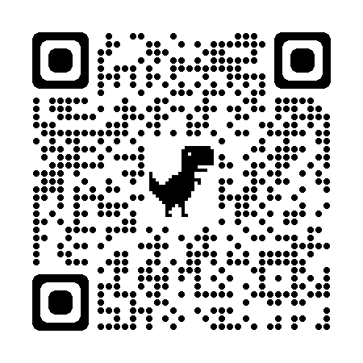

Slide 17
Additional information
More information can be found NASA’s Technical Reports Server: “Lessons Learned from the Near-Earth Asteroid 2024 YR4 and the International Coordination that Retired the 2032 Earth Impact Risk”
https://ntrs.nasa.gov/citations/20250006886

Slide 18
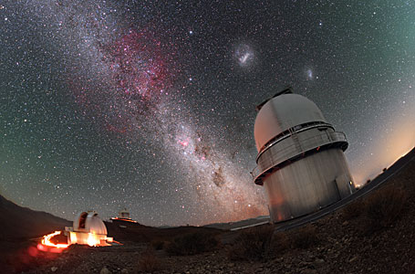
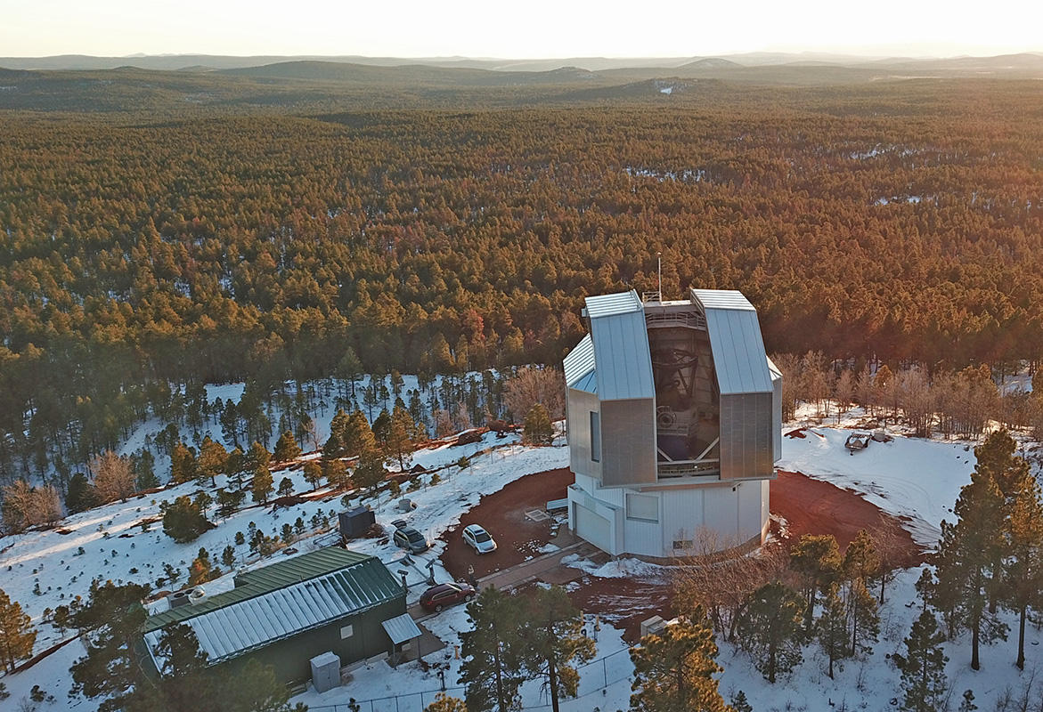
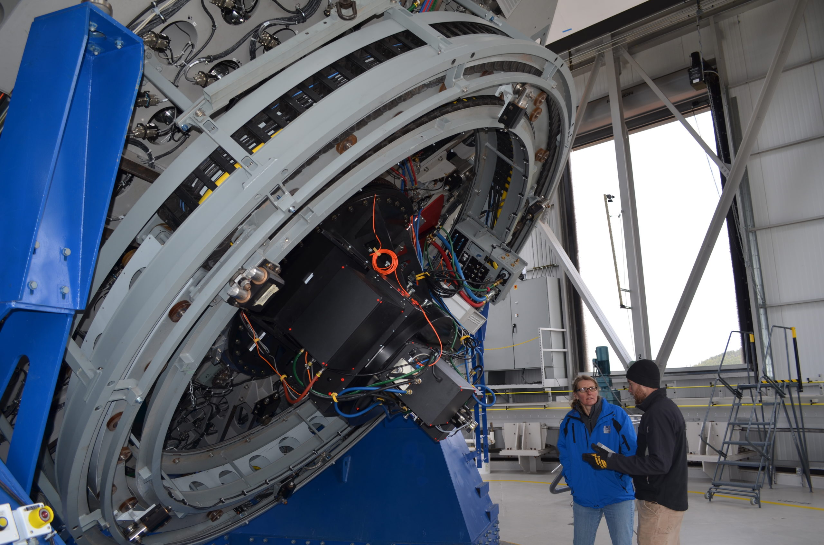
Key Follow-up 1st Lunation (25 Dec 24- 12 Jan 25) Astrometry
1.54 m Danish Telescope at La Silla, Chile (W74)- 55 high quality observations, 17 nights
2.2 m University of Hawaii 88-inch telescope, Mauna Kea, HI (UH-88; T12)
4.3 m Lowell Discovery Telescope, AZ (LDT; G37)
3.58 m La Palma TNG, Canary Islands, Spain (Galileo; Z19)
Lowell Discovery Telescope, near Happy Jack, Arizona
Danish Telescope, La Silla, Chile

Slide 19
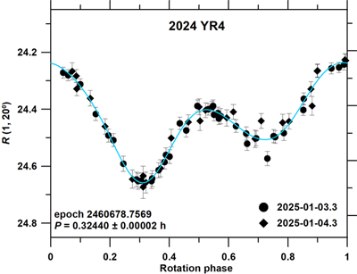
Physical Characterization- 1st Lunation (24 Dec 24- 12 Jan 25)
27-28 Dec- CSS (T. Beuden)
3- 4 Jan- Danish Telescope- Light curve, rotation (P. Pravec)
7 Jan- Mission Accessible NEO Survey (MANOS)
used 4.3 m LDT: visible colors (N. Moskovitz)
La Silla Danish Telescope
Early light curve: Rotating quickly;
not tumbling; rotating about principal
Axis only (Pravec, Devogele).
S-Type or L Type (possibly K, H)
Lowell Discovery Telescope

Slide 20
Torino 1- 29 Dec 24
IP calculations: NASA/JPL/CNEOS, ESA/NEOCC, NEODyS
CNEOS provided forecast of likelihood for IP to rise or go down- helpful for decision makers.
Later learned Japan Space Agency (JAXA) used Deep Space Multi-Object Orbit Determination Software
Each values data from observatories differently = some differences in IP estimates.
ESA/NEOCC- Aegis automated warning of Torino Scale 1 on 27 Dec 2024.
NASA CNEOS- Initially Torino 0, IP .04% but increased w/ more observations via MPEC 29 Dec.
Torino Scale 1 29 Dec– Sentry Status change; remained Torino 1 so PDCO notified the morning of NYE.

Slide 21
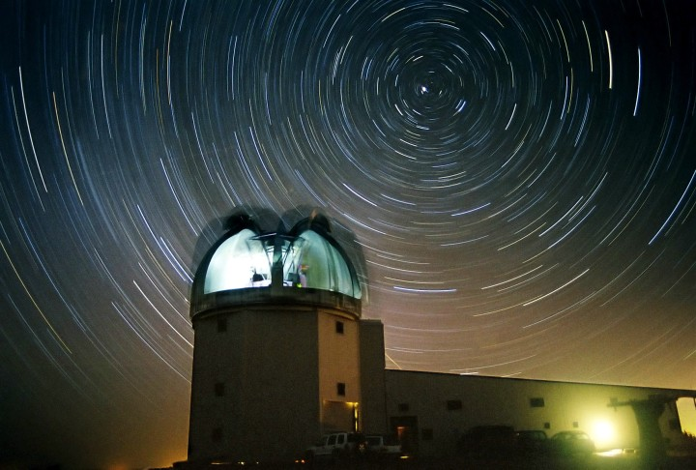
Key 2nd Lunation (13 Jan 25 – 12 Feb 25) Astrometry
1.54 m Danish Telescope (1.54 m)
8.2 m European Southern Observatory’s 8.2 Very Large Telescope (VLT) at Paranal Observatory (309)
8.1 m Gemini South, Chile (I12)
2.4 m Magdalena Ridge Observatory’s (MRO) (702)
2.56 m Nordic Optical Telescope (NOT), La Palma, Canary Islands (Z23)
2.2 m UH-88
4.3 m LDT
1m at Cerro Tololo Inter-American Las Cumbres Observatory, Chile, (LCO; W87)
Magdalena Ridge Observatory

Slide 22
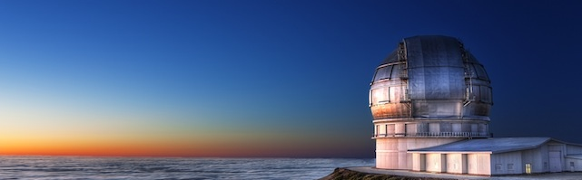
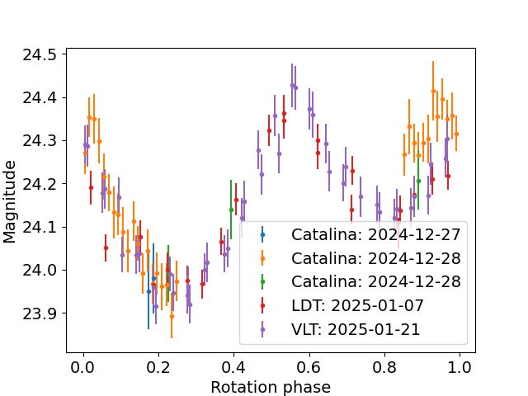
2nd Lunation (13 Jan 25 – 12 Feb 25) Physical Characterization
13 Jan- 10.4 m Gran Telescopio Canarias (Z18) imaged vis spectrum (J. Deleon)
21 Jan- VLT, NIR colors and light curve (M. Devogele)
27 Jan- Dr. Devogele spliced CSS, LDT, VLT data; rotation
period 19.5 minutes
Gran Telescopio Canarias
7 Feb- 8.1 m Gemini South Multi-object Spectrograph + 12 Feb- 10 m Keck/Multi- Object Spectrometer for IR Exploration found spectrum, confirmed rotation period, provided spin vector and shape data and size estimates (30-65 m) at that time

Slide 23
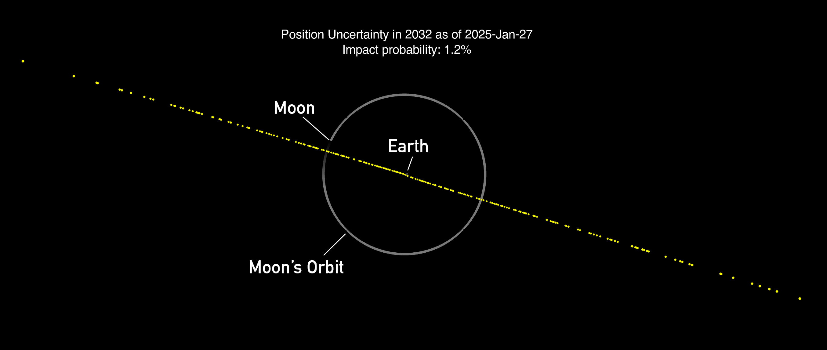
Torino 3- 27 Jan 2025
1% IP, size estimates over 50 m
CNEOS, NEOCC, and NEODys all reached consensus
Required notifications within NASA, and interagency.
Acting Administrator conducted senior leader
interagency brief
ESA and NASA coordinated on messaging
All summary webpages/messages went through coordination process (not raw data)
1% IP (for over 10 m) also triggered
IAWN notifications.
Heavy media acceleration
Notes:
A close encounter, meriting attention by astronomers.
Current calculations give a 1% or greater chance of collision
capable of localized destruction . . .Attention by public and by
public officials is merited if the encounter is less than a decade away.”

Slide 24
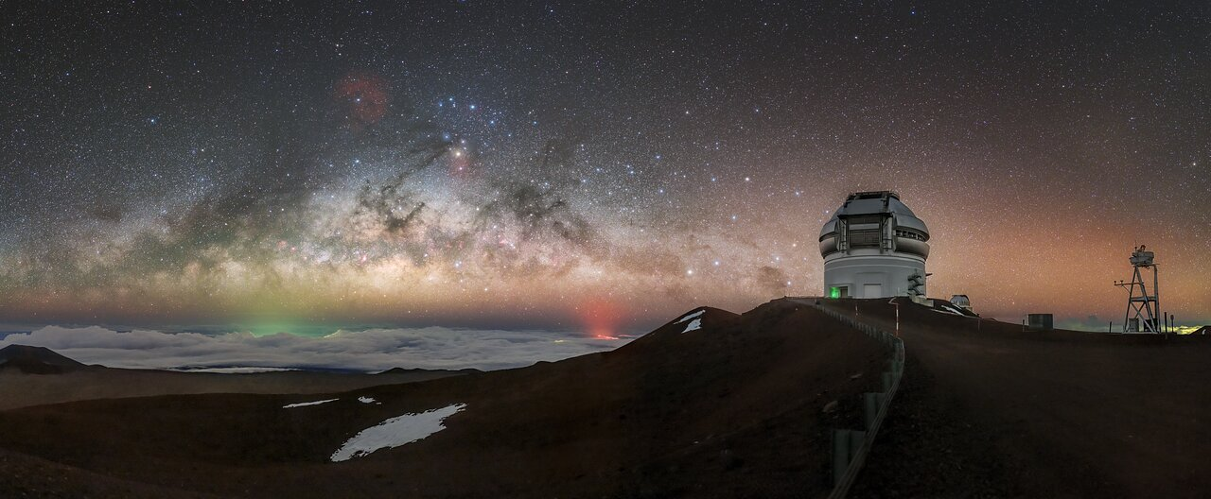
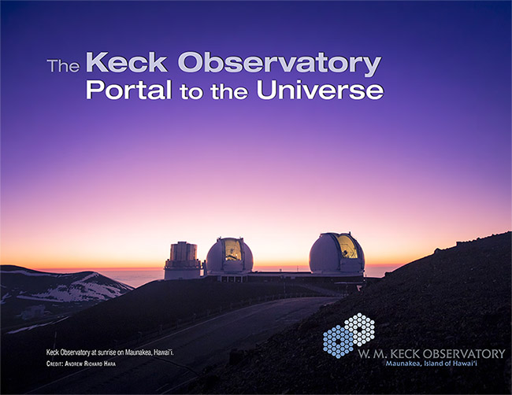
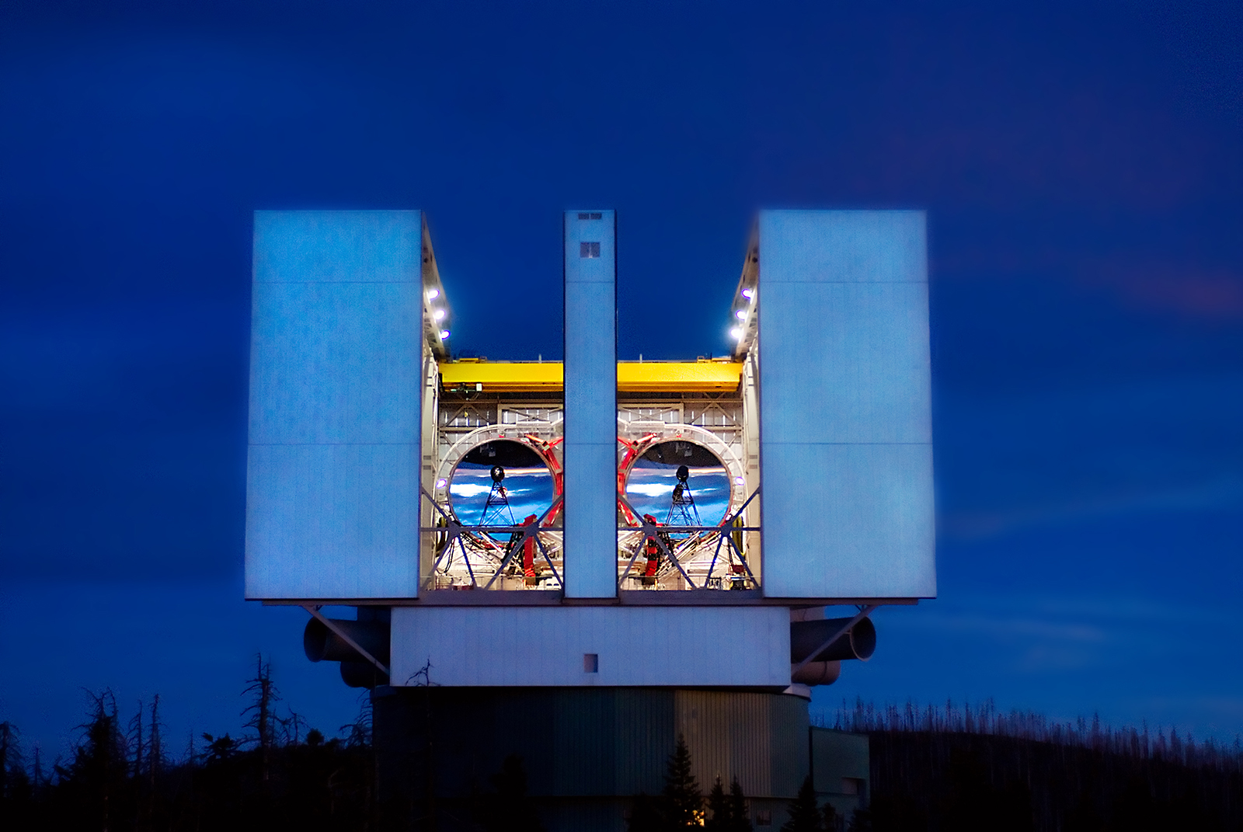
Key 3rd Lunation (12 Feb 25- 14 Mar 25) Astrometry; Peak IP 18 Feb (3.1%)
8.1 m Gemini North, Mauna Kea, HI (T15); and South, Cerro Pachon, Chile (I11)
10 m W. M. Keck Observatory Mauna Kea, HI (T16)
8.2 m Subaru Telescope Mauna Kea, HI (T09)
3.58 m Canada France Hawaii Telescope (CFHT), Mauna Kea, HI (T14)
5.08 m Hale Telescope on Palomar Mountain Observatory, California (675)
Two Meter Twin Telescope, Canary Islands (Y68-two 2m telescopes)
Mt. Graham Large Binocular Telescope Observatory (LBT), AZ (G83)
(two 8.4 m diameter mirrors equiv to large virtual single telescope).
LDT (4.3 m), NOT (2.54 m), MRO- to 25.5 mag (2.4 m), and UH 88 (2.2 m)
James Web Space Telescope (JWST)- NIRcam worked but MIRI guide-star issues
Large Binocular Telescope/

Slide 25
Key 3rd Lunation (12 Feb 25- 14 Mar 25) Physical Characterization
VLT photometry (Hainaut, Devogele, Micheli)
LBT Photometry (A. Giunta)
Gemini North light curve (A. Burdanov)
https://www.lbto.org/

Slide 26
Back to Torino 0
By 20 Feb 25, 202rYR4 was well below 1%, resulting in a drop to Torino 1.
By 23 Feb 24, it dropped to Torino Scale 0
IAWN, NASA, and ESA made follow-on notifications, informing community that sufficient observational data conclusively showed 2024 YR4 was not a threat to Earth
Further high-quality follow-on observations continued from MRO, NOT, CFHT, and the LBT

Slide 27
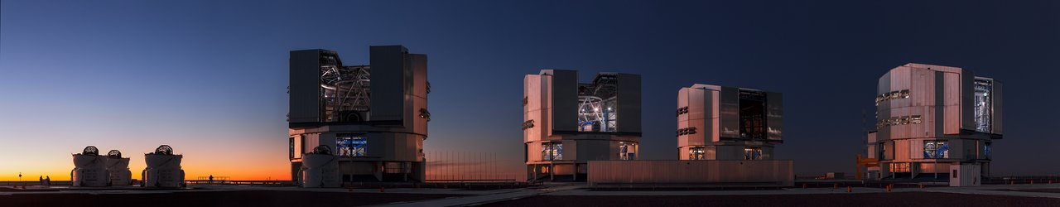
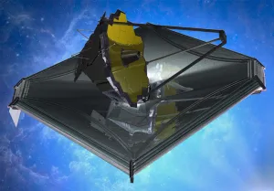
4th Lunation (14 Mar 25 – 12 Apr 25) and beyond
8.2 m Very Large Telescope at Cerro-Paranal (309)
Faintest ground-based observation at 26.5 VMag
James Webb Space Telescope (A. Rivkin)
26 Mar 25- Refined Size
Further observations 11 May 25 (~29 VMag); NIRcam worked but MIRI again aborted due to guide-star issues.
Moon IP remains elevated

Slide 28
Press: >100 articles, interviews, blogs
Wikipedia: https://en.wikipedia.org/wiki/2024_YR4#/media/File:Mmexport1738033309783.jpg
NASA: https://blogs.nasa.gov/planetarydefense/2025/01/29/nasa-shares-recently-identified-near-earth-asteroid/
ESA: https://www.esa.int/Space_Safety/Planetary_Defence/ESA_monitoring_near-Earth_asteroid_2024_YR4
Washington Times: Astronomers Keeping an Eye on Asteroid’s Odds of Hitting Earth (Robin George Andrews)
Scientific American: https://www.scientificamerican.com/article/will-asteroid-2024-yr24-strike-earth-in-2032/
Maui Now: Maui Now online story
NBC: https://www.nbcnews.com/science/space/nasa-says-yes-asteroid-buzzing-2032-hit-earth-rcna191951
Fox News: https://www.foxnews.com/us/odds-massive-asteroid-striking-earth-increase-again-nasa
CNN: https://www.cnn.com/2025/02/19/science/asteroid-2024-yr4-earth-collision-risk/index.html
Space.com: https://www.space.com/asteroid-2024yt4-impact-risk-drop-nasa
NASA: https://blogs.nasa.gov/planetarydefense/
)
Andrews)

Slide 29
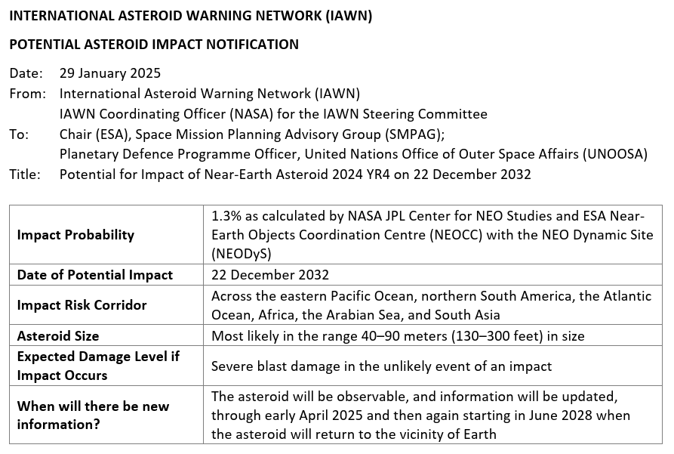
Asteroid 2024 YR4: Interagency and International Notifications
2024 YR4’s impact probability surpassing 1% triggered formal NASA notification to the U.S. interagency, per NASA’s Policy Directive 8740.1
The International Asteroid Warning Network (coordinated by NASA) issued notification to the Space Mission Planning Advisory Group (chaired by ESA) and to the United Nations Office of Outer Space Affairs
2024 YR4 marks the first time these notification policies were implemented
Header of Initial IAWN Notification Credit: https://iawn.net/
29
Discovery images of 2024 YR4. Credit: ATLAS

Slide 30
Contributors
Over 36 SMEs from across the Planetary Defense community, including but not limited to:
Dr. James “Gerbs” Bauer, Small Bodies Node
Dr. Maxime Devogele, ESA/NEOCC
Dr. Davide Farnocchia and Dr. Ryan Park (JPL/CNEOS)
Dr. Kelly Fast, Lindley Johnson, Joshua Handel, Adelle Heible
Dr. Marco Micheli, ESA/NEOCC
Dr. Matthew Payne, Dr. Frederica Spoto, and Dr. Peter Veres, MPC
Dr. Petr Pravec, Czech Republic Academy of Sciences
Dr. Andy Rivkin JHU/APL
Dr. Brent Barbee (GSFC), Dr. Lorien Wheeler and Dr. Jessie Dotson (ATAP)
Modelers, Astronomers, policy makers, more.

