Slide 1
22 June Bolide event From GOES-16 and other sources
Dwayne Free, Director, Spalding Allsky Camera Network, SkySentinel, LLC
William Straka III, SSEC/CIMSS
RAMMB Slider image from CIRA
GOES-16 ABI imagery produced at CIMSS
and interaction with Frankie Lucena

Slide 2
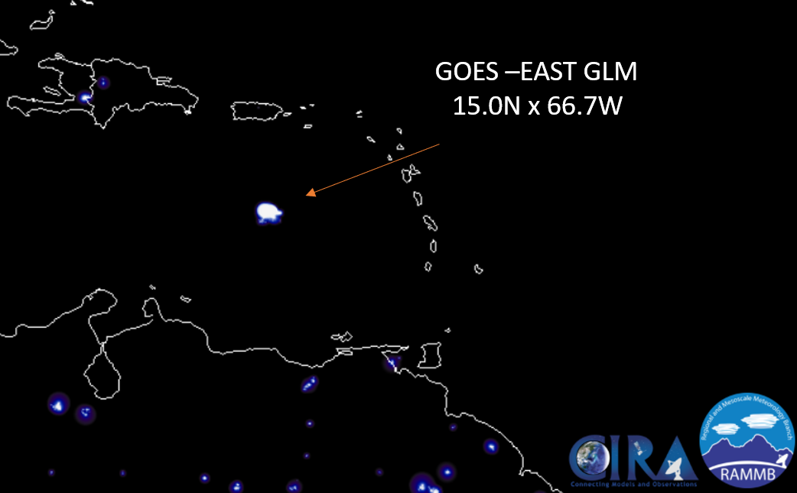
Overview
On 22 June, SSL (www.goskysentinel.com) identified a possible Bolide event utilizing the CIRA RAMMB SLIDER website, overlaying the GLM Group Energy density.
The event occurred at approximately 2125Z.
Initial look at imagery showed no convective activity in the area.
The following shows an analysis and confirmation from a variety of other sources

Slide 3
ABI
ABI caught both the explosion as well as the vapor trail which appeared after the event.
The point of the explosion was just on the southern edge of the CONUS domain, allowing for comparisons at ~5min intervals. This allowed the initial anomalous cloud and sudden appearance of a long contrail-like feature ~30minutes after the event

Slide 4
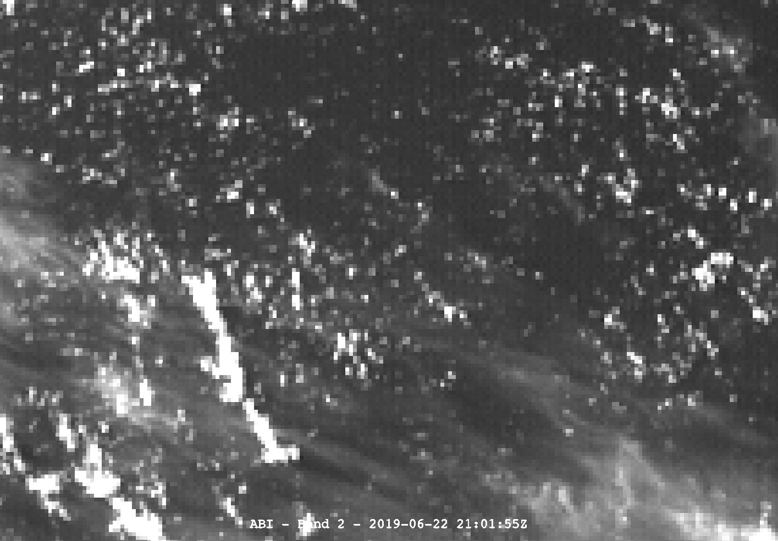
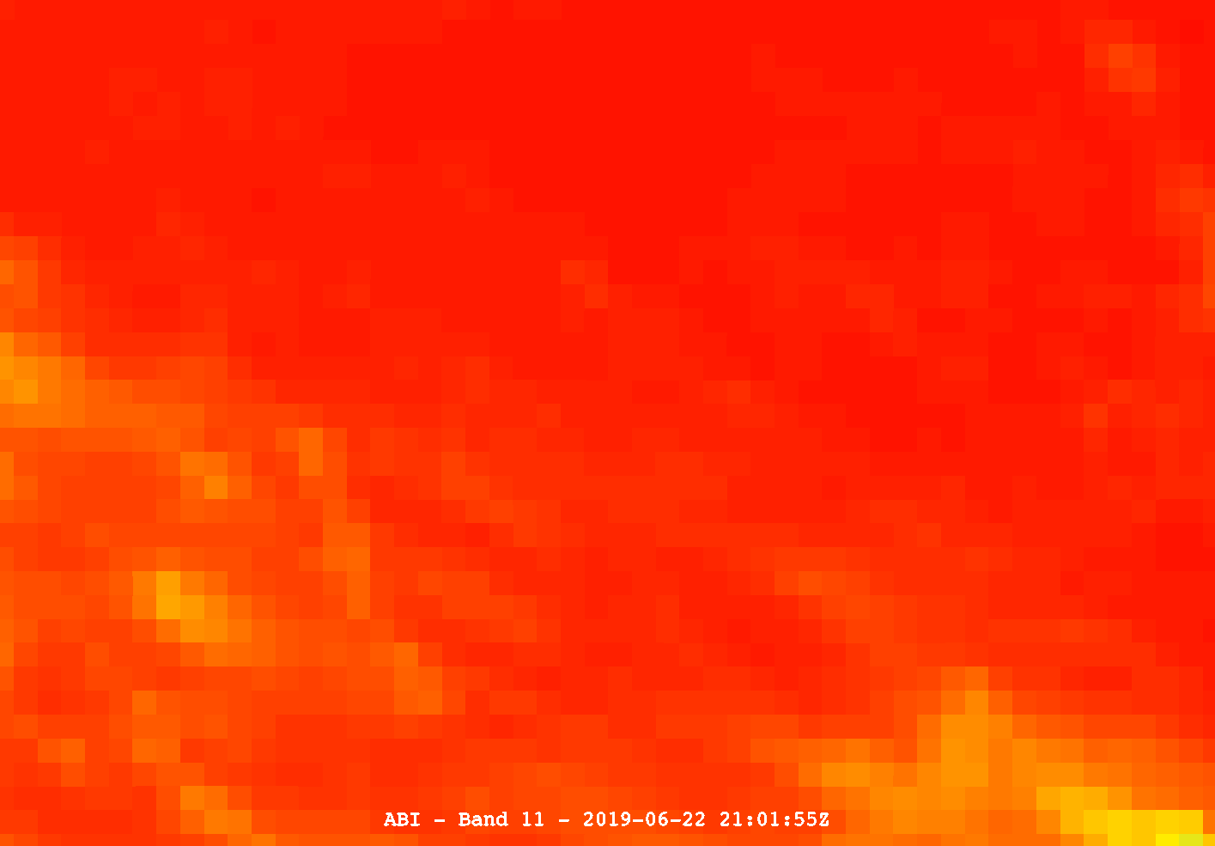
ABI
VIS
CIRRUS
WV/SO²
O³

Slide 5
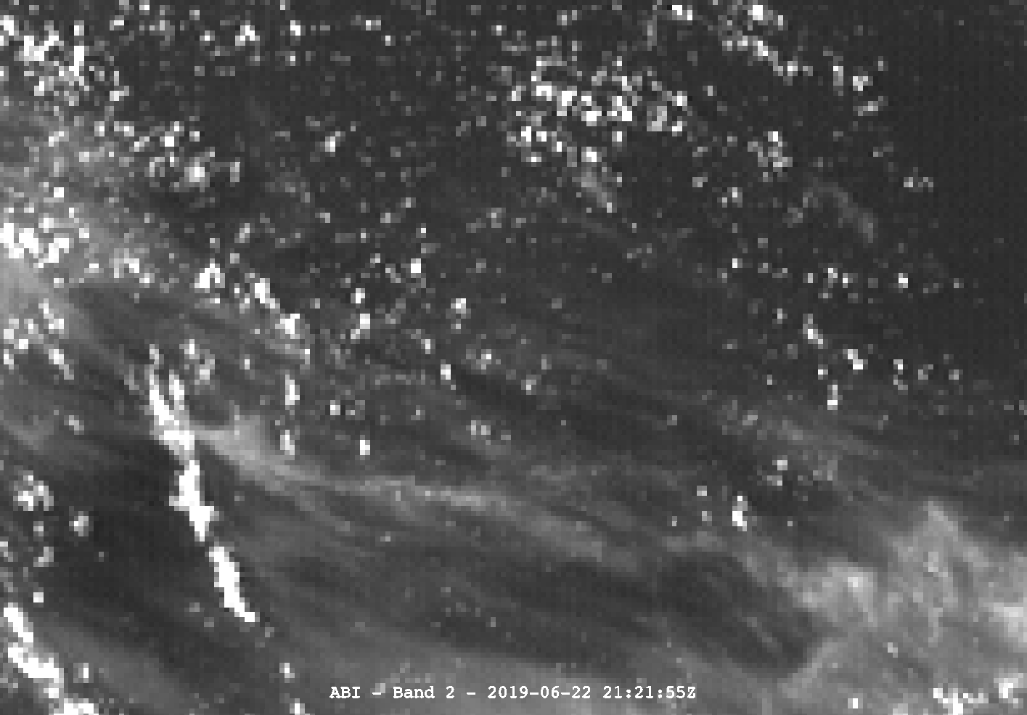
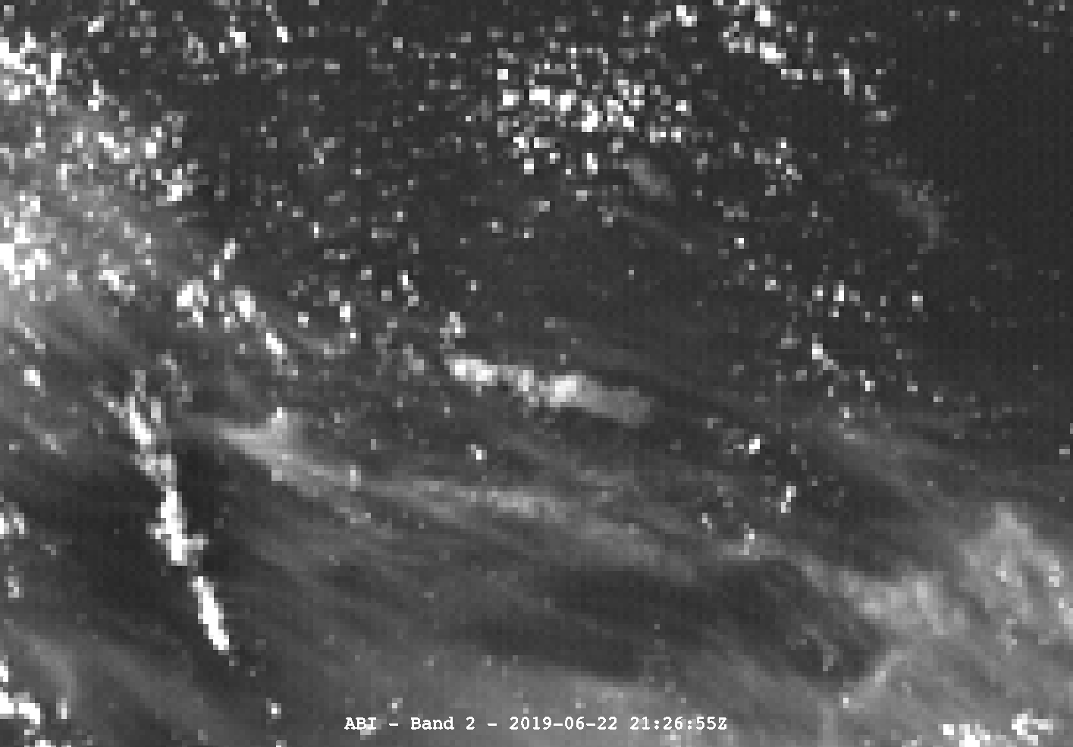
ABI
VIS
Note large cloud appearing out of nowhere in 5 minutes
O³
21:21:55Z
21:26:55Z

Slide 6
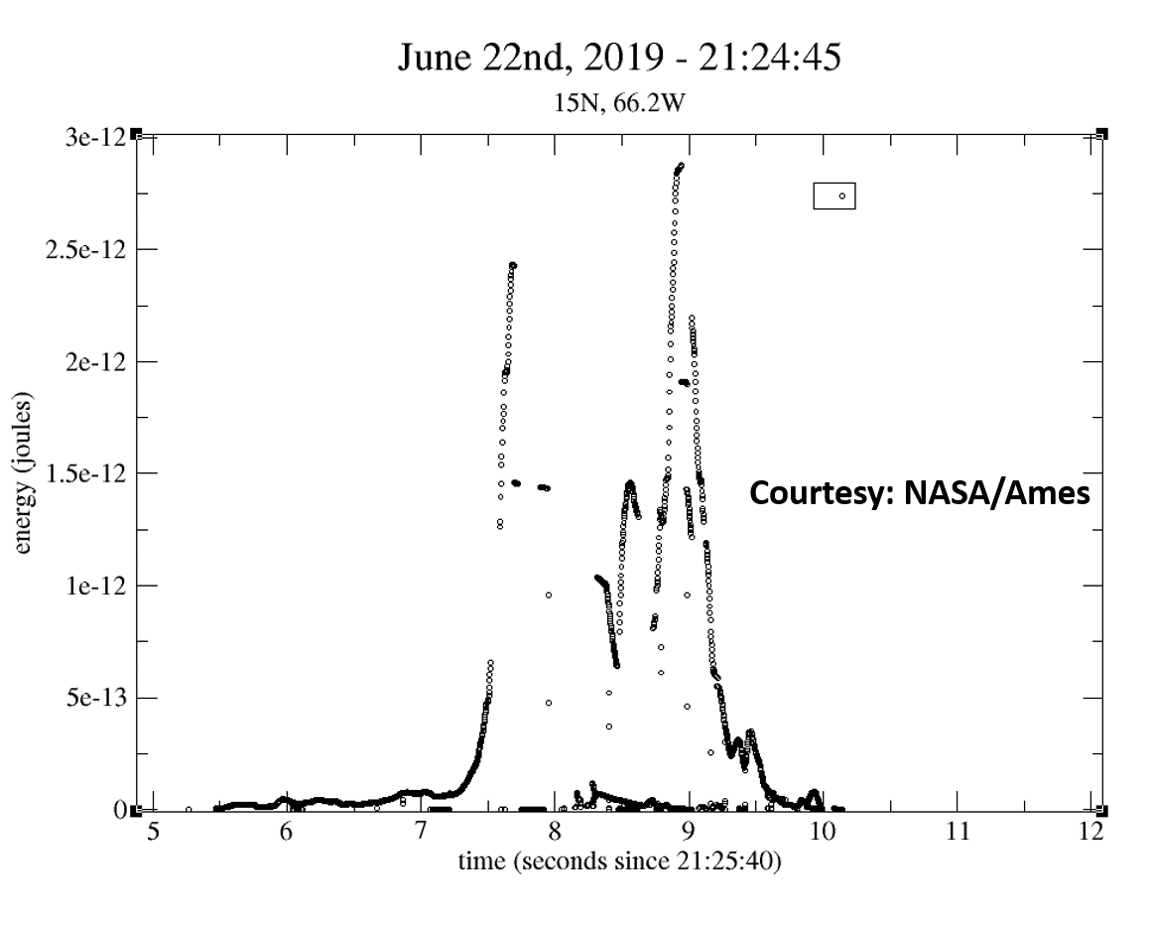
NASA light curve analysis
Further evidence of this being a bolide comes from NASA/Ames (provided to SSL) showing an light curve event occurring in that same, estimating a 5kt explosion.

Slide 7
Center for NEO Studies (CNEOS)
CNEOS also estimates that the impact was in the ~6kt range.
http://cneos.jpl.nasa.gov/fireballs/

Slide 8
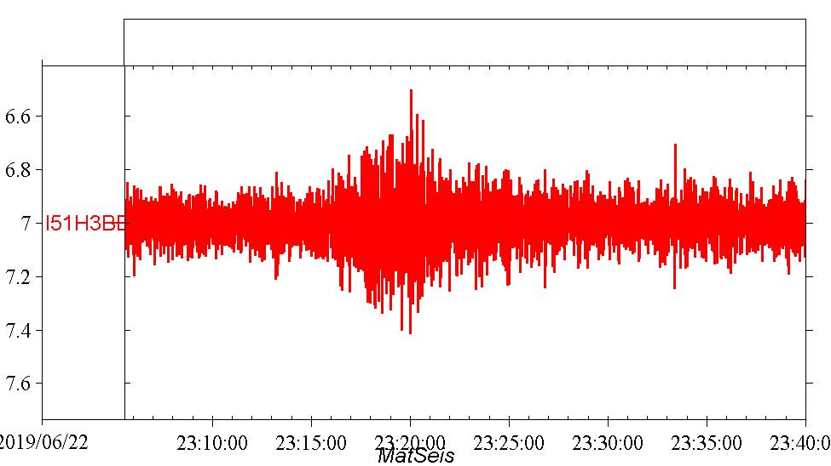
Comprehensive Test Ban Treaty Organization (CTBTO) Infrasound
Image posted by Peter Brown (@pgbrown)from Bermuda CTBTO station
https://twitter.com/pgbrown/status/1143264346837082112

Slide 9
ABI – Full Disk
Final piece from ABI shows debris trail going towards explosion site ~1-2hr after event. Note the direct intersection of the area of anomalous cloud and sudden appearance of long contrail like feature

Slide 10
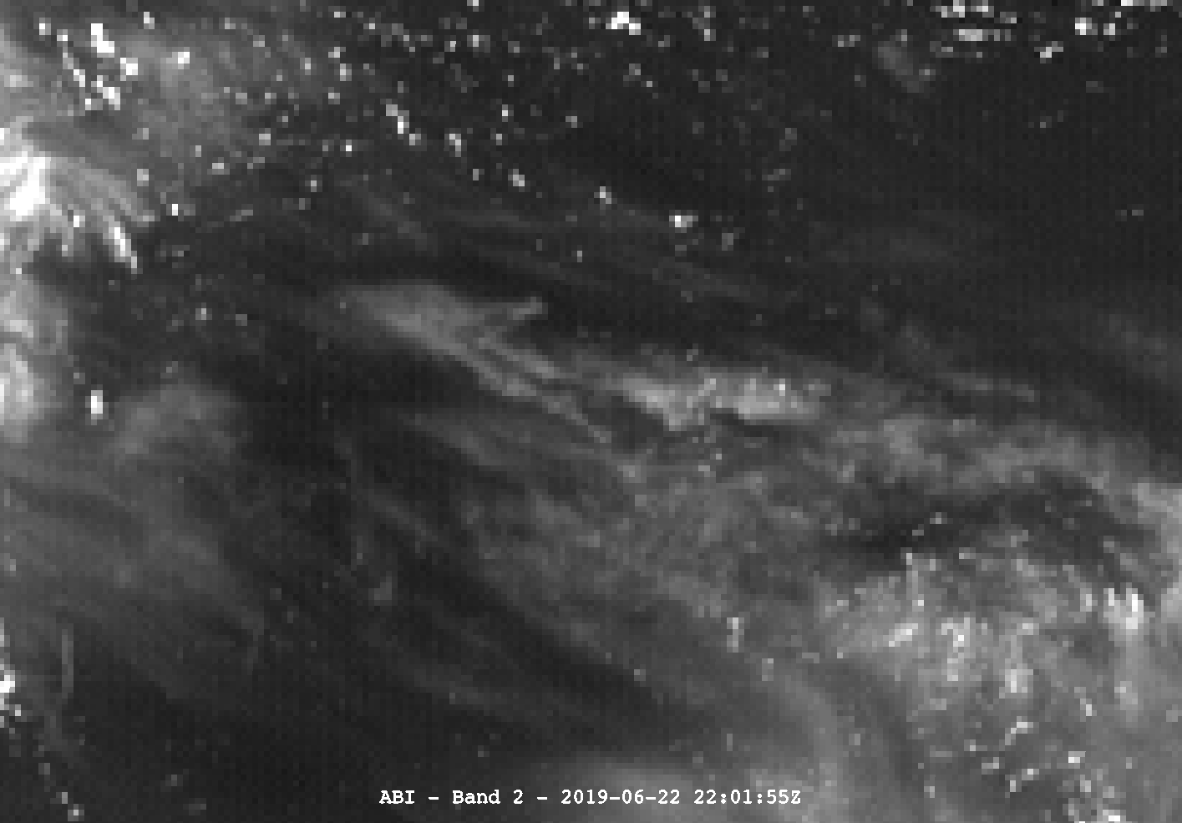
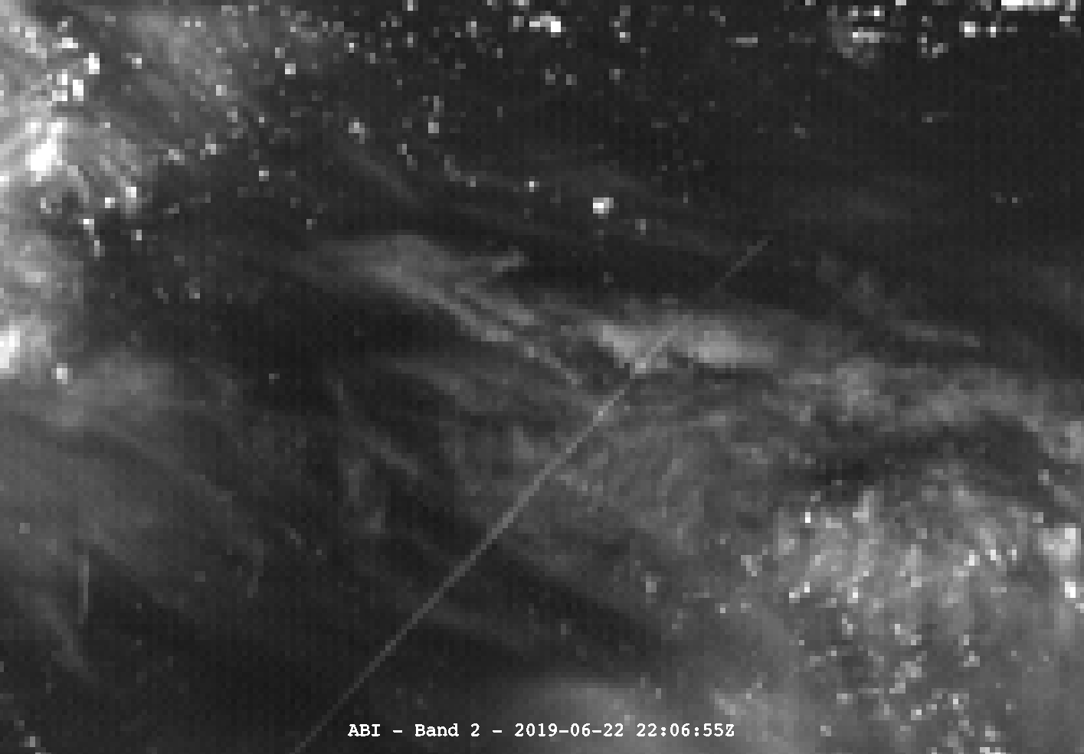

Slide 11
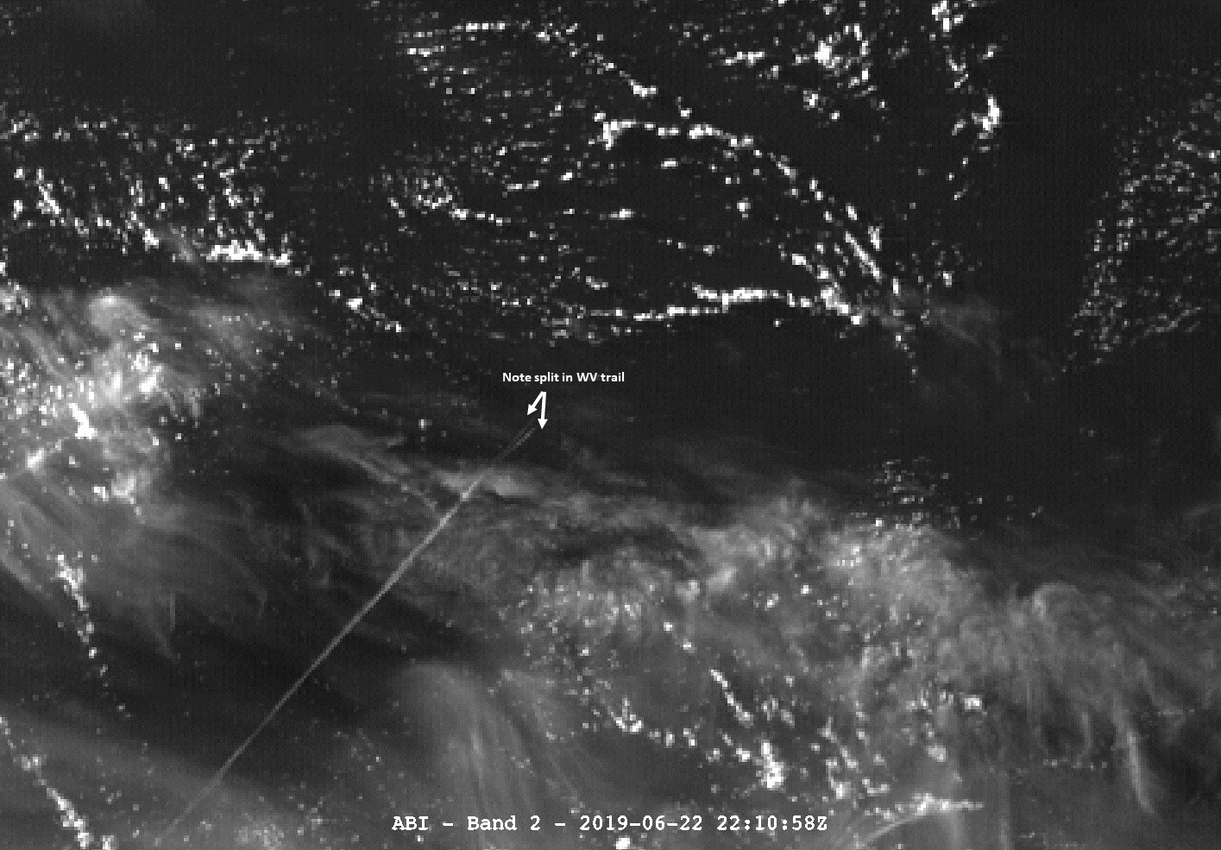
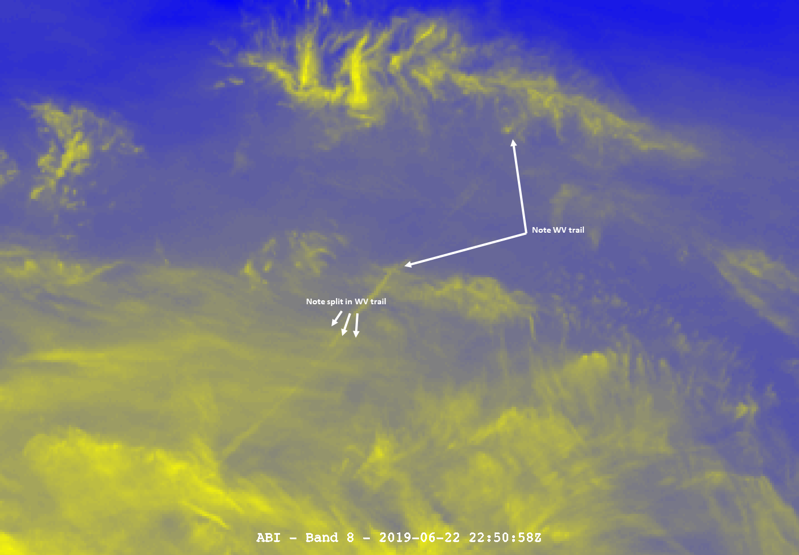
ABI
In addition to the sudden appearance of the water vapor trail, there appears to be numerous “splits” in the trail near the approximate location of the cloud resulting from the explosion. This would be indicative of debris falling after the explosion, while the main body continued to travel farther before impact into the ocean.

Slide 12
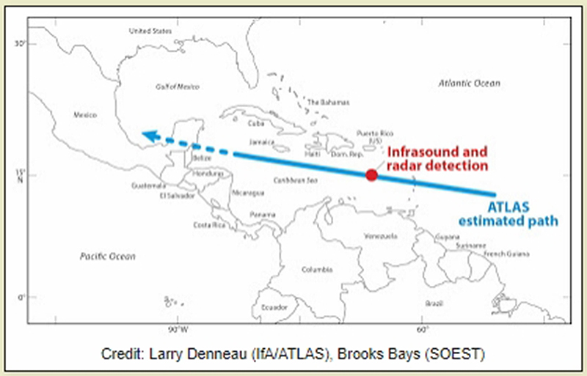
Questions?
Asteroid Terrestrial-impact Last Alert System (NASA/UofHawaii) estimated a path perpendicular to the apparent vapor trail. We are currently awaiting an official path from the International Asteroid Warning Network (IAWN), a group formed in response to the 2013 United Nations Assembly in response to a potential NEO impact threat.
Image provided via Frankie Lucena

